Slide 1
Python Variables
Variable Definition
Variables are nothing but memory locations to store values.
This means that when you create a variable you reserve some space in computer memory.
Its values are changed during program execution.
Python variables
- In Python no explicit declaration for variables and its Data type.
- So the declaration happens automatically while you assign a value to a variable.
- The equal sign (=) is used to assign values to variables.
- Also Data Type is assigned automatically based on the given value to the variable.

Slide 2
Variable Declaration..
Syntax
The operand to the left side of the “ = “ operator is the name of the variable
and the operand to the right of the = operator is the value stored in the variable.
Var_Name = Value

Slide 3
Examples
1) a = 100
here
'a' - is variable.
100 – is value and 100 is integer value
so here 'a' is integer variable.
2) name = "JAMAL"
Here
name - is variable ,
"JAMAL“ – is value and it is String,
So 'name' is treated as String variable..
3) rate = 25.75
Here
rate - is variable and
its value is "25.75" <=== that is floating value
So 'rate' is treated as float variable.

Slide 4
Multiple Assignment
Python allows you to assign a single value to several variables simultaneously.
For example
>>> a = b = c = 1
Here, an integer object is created with the value 1, and all three variables are assigned to the same memory location. You can also assign multiple objects to multiple variables.
For example
>>> a,b,c = 10,25,“David“
Here, two integer objects with values 10 and 25 are assigned to variables a and b respectively, and one string object with the value “David" is assigned to the variable c.

Slide 5
Standard Data Types
The data stored in memory can be of many types.
For example,
A person's age is stored as a numeric value
and his or her address is stored as alphanumeric characters.
Python has various standard data types that are used
to define the operations possible on them and the storage method for each of them.
Python has five standard data types
Numbers
String
List
Tuple
Dictionary

Slide 6
Python Numbers
Number data types store numeric values.
Number objects are created when you assign a value to them.
For example
>>> var1 = 50
>>> var2 = 25.75
Python supports four different numerical types
int (signed integers)
long (long integers, they can also be represented in octal and hexadecimal)
float (floating point real values)
complex (complex numbers)

Slide 7
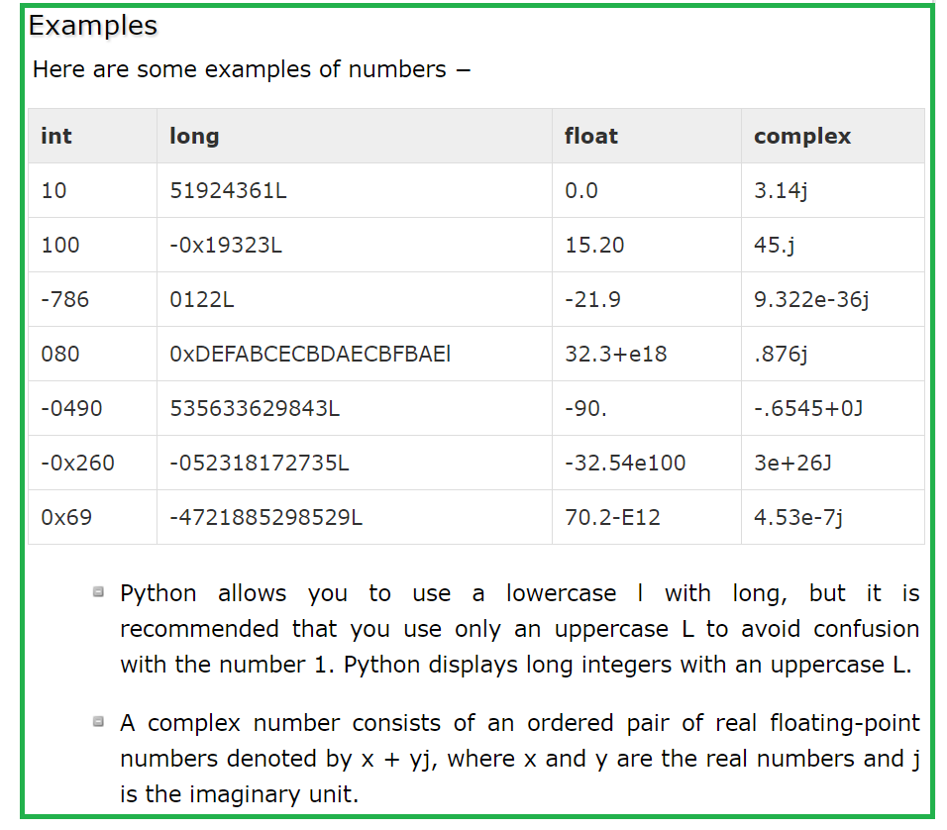
Python Numbers…

Slide 8
Python Strings
Definition
Strings are set of characters represented with the quotation marks.
Example
>>> S1 = “ JAMAL “
>>> S2 = ‘ TAMIL NADU ‘
Python allows for either pairs of single or double quotes.
Subsets of strings can be taken using the slice operator ([ ] and [:] ) with indexes starting at 0 in the beginning of the string and working their way from -1 at the end.
The plus (+) sign is the string concatenation operator and the asterisk (*) is the repetition operator.

Slide 9
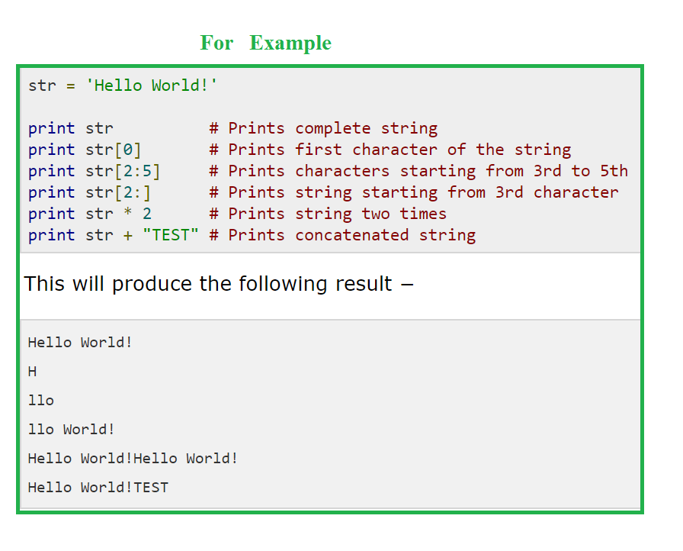
Python Strings

