Slide 1
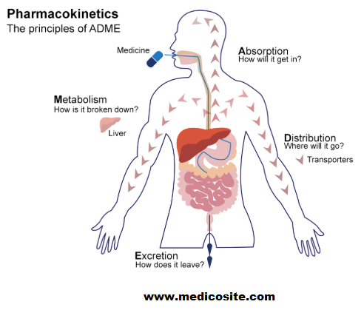
ADME
A.Fasila Begum
Assistant Professor
Department of Microbiology
Jamal Mohamed College
Trichy

Slide 2
Introduction
ADME – Pharmacokinetics and pharmacology for Absorption, Distribution, Metabolism and Excretion.
PK – Movement of drug molecules through a various physiological compartments.
Determine the processes of drug delivery (in) and removal (out) from the body.
Important concept that describes potential impact of drug with in the living system.
Movement and metabolism of molecules is determined by the physiochemical properties of the molecules as well as host system.

Slide 3
Absorption
Transfer of drug from its site of administration to the blood stream.
There are four main routes of exposure:
Inhalation through the respiratory system
Dermal through skin or eye contact
Ingestion through gastrointestinal system
Injection
Absorption determines the compound bioavailability.
Route of administration is more important consideration of drug delivery.

Slide 4
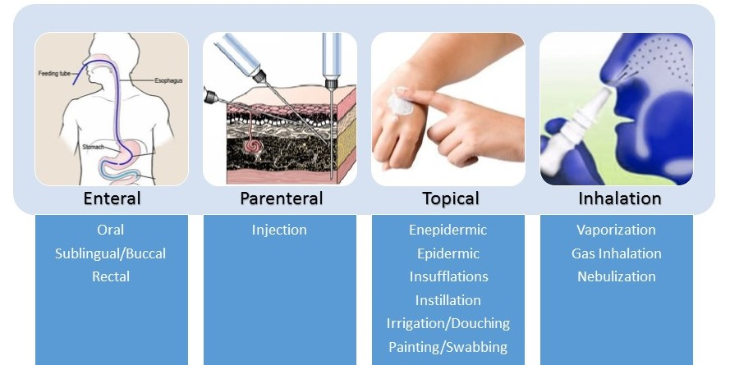
Drug administration
Enteral routes:
Sublingual
Oral
Rectal
Parenteral routes:
Intravenous
Intra-arterial
Intrathecal
Intramuscular
Subcutaneous
Inhalation
Topical application

Slide 5
Distribution
Once drug is absorbed in to the blood stream and it has to be carried throughout the body.
Distribution is much more rapid then elimination and is accomplished via the circulation and is influenced by regional blood flow.
The delivery of a drug from the bloodstream to the site of drug action primarily depends on blood flow, capillary permeability, the degree of binding (attachment) of the drug to blood and tissue proteins, and the relative lipid-solubility of the drug molecule.
Volume of distribution is defined as the volume that would accommodate all drugs in the body, if the concentration was the same in plasma.

Slide 6
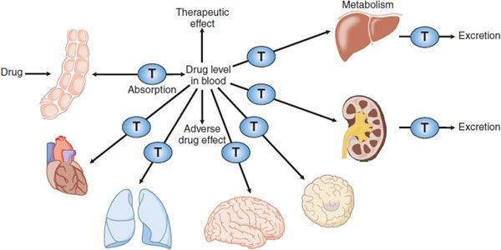
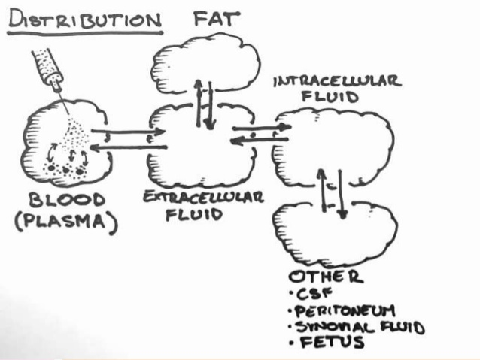
Distribution of drug is not uniform throughout the body because different tissues receive the drug from plasma at different rates and to different extents.
Pharmacological action of drug depends upon its concentration at the site of action distribution plays a significant role in onset, intensity and duration of action.
Factors affecting distribution
Tissue affinity
pH
Blood flow
Physiochemical property of drug
Plasma binding protein

Slide 7
Metabolism (Biotransformation)
Chemical alteration of drug in the body.
Converts non-polar lipid soluble compound to polar lipid insoluble compounds to avoid reabsorption in renal tubes.
Biotransformation is a specific term used for the chemical transformation of drugs in the living organisms.
Two phases of biotransformation
Phase I – Nonsynthetic metabolism
Oxidation, reduction, hydrolysis, cyclisation and decyclisation.

Slide 8
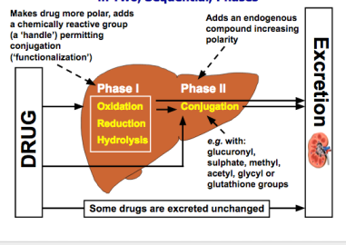
Phase II – Synthetic metabolism
Conjugation of drug or it phase I metabolites with an endogenous substrate.
Glucoronide conjugation, acetylation, methylation, sulfate conjugation, glycine conjugation and nucleotide synthesis.
Factors affecting biotransformation:
Concurrent use of drug
Genetic polymorphism
Pollutant exposure from environment or industry
Pathological status
Age

Slide 9
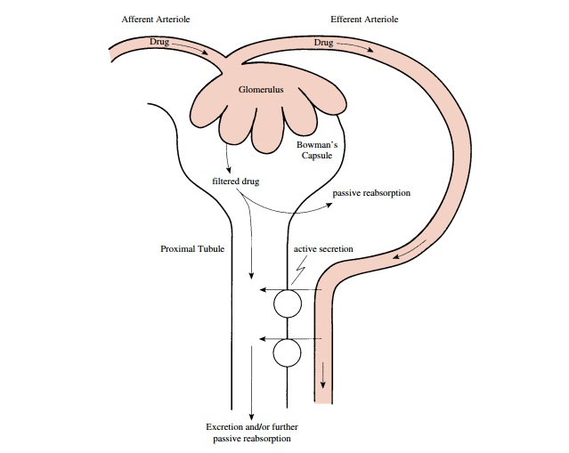
Excretion
Transport procedure which the prototype drug or other metabolic products are excreted through excretory organ.
Hydrophilic compounds can be easily excreted.
Routes of drug excretion is:
Kidney
Biliary excretion
Sweat and saliva
Exhaled air
Kidney is the most important organ for the excretion of drug and other metabolites.
Some compounds are also excreted via bile, sweat, saliva and exhaled air.

Slide 10
Drug excretion involves the followin processes:
Renal glomerular filteration
Renal tubular secretion
Renal tubular reabsorption
Biliary excretion

