Slide 1

Dr. S. Abdul Saleem
Associate Professor of Comp. Science
Jamal Mohamed College(Autonomous)
Tiruchirappalli-20
Dr. S. Abdul Saleem
Associate Professor of Computer Science
https://www.onlinegdb.com/online_c_compiler#

Slide 2
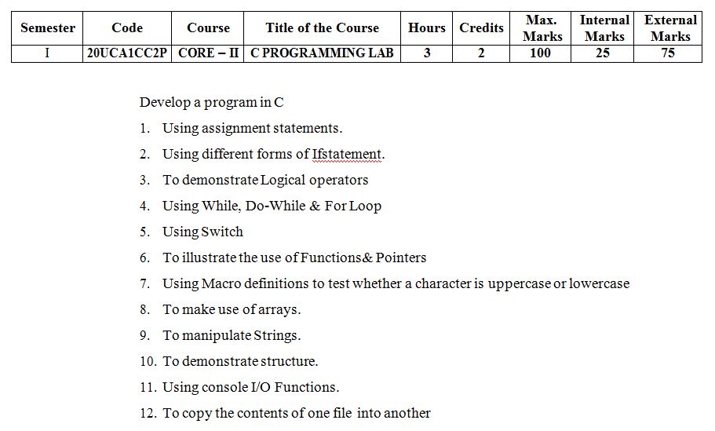

Slide 3
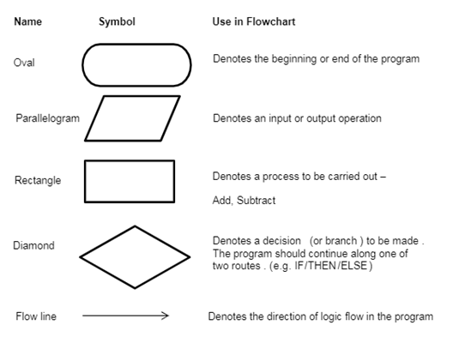
Flowchart Symbols

Slide 4
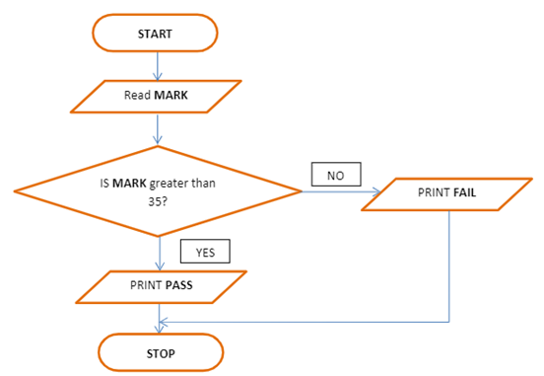
Flowchart for simple if..else statement

Slide 5
1a) Program for finding area of a Circle
#include<stdio.h>
#define pi 3.143
int main()
{
float radius, area;
printf(“\n Enter the radius : “);
scanf(“%f”, &radius);
area = pi * radius *radius;
printf(“\nArea of the Circle is = %f”, area);
return 0;
}
Input variable
Output variable

Slide 6
1b )Program to check Odd or Even number using if..else Statement
#include<stdio.h>
void main()
{
int number;
printf(“\n Enter a number : “);
scanf(“%d”, &number);
if( number%2 == 0)
printf(“%d is an EVEN number“, number);
else
printf(“%d is an ODD number“, number);
}

Slide 7
2 b) Biggest among three numbers using nested if Statement
#include<stdio.h>
void main()
{
int num1,num2,num3;
printf(“\n Enter three numbers \n“);
scanf(“%d %d %d”, &num1, &num2, &num3);
if( num1 > num2)
if (num1 > num3)
printf(“%d is the Biggest number“, num1);
else
printf (“%d is the Biggest number“, num3);
else
if(num2 > num3)
printf(“%d is the Biggest number“, num2);
else
printf (“%d is the Biggest number“, num3);
}

Slide 8
2 c) Obtaining the Grade of a Student using else if Statement
The marks obtained by a student in 5 different subjects are input through the keyboard. The student gets a grade as per the following rules:
Percentage above or equal to 75 - Distinction
Percentage between 60 and 74 – First class
Percentage between 50 and 59 - Second class
Percentage between 40 and 49 – Third class
Percentage less than 40 - Fail
Write a C program to calculate the grade obtained by the student using else if ladder statement.

Slide 9
2c.) Program for obtaining the Grade of a Student using else if ladder Statement
# include <stdio.h> void main( ) { int m1, m2, m3, m4, m5; float per ; printf(“\n Enter five marks of a student”); scanf(“%d %d %d %d %d “, &m1,&m2,&m3,&m4,&m5); if(m1>=40 && m2 >= 40 && m3>=40 && m4>=40 && m5 >= 40) { per = ( m1+ m2 + m3 + m4+ m5 ) / 500 * 100; if ( per >= 75 ) printf ( “\n Distinction\n" ) ; else if ( per >= 60 ) printf ( “First Class\n" ) ; else if ( per >= 50 ) printf ( "Second Class\n" ) ; else printf ( "Third Class\n" ) ; } else printf ( “Fail\n" ) ; } | Output Enter five marks of a student 67 66 68 60 62 First Class

Slide 10
3 Program for finding biggest number using Logical Operator
#include<stdio.h> void main() { int a,b,c; printf(“\n Enter any three numbers \n“); scanf(“%d %d %d”, &a, &b, &c); if( a > b && a > c ) printf(“%d is the Biggest number“, a); else if(b > c) printf(“%d is the Biggest number“, b); else printf (“%d is the Biggest number“, c); }

Slide 11
4 a) Program using while Loop
//Program to find the sum of natural numbers #include<stdio.h> void main() { int i=1,sum=0,n; printf("\nEnter the value of n : "); scanf("%d",&n); while(i<=n) { printf("\n %d",i); sum=sum+i; i++; } printf("\nSum of first %d numbers = %d",i-1,sum); } | Output Enter the value of n : 10 Sum of first 10 numbers =55

Slide 12
4 a) Program using while Loop
Program to find sum of the individual digits of a given number using while loop #include<stdio.h> void main() { int number,digit,sum=0; printf(“\nEnter the value of number”); scanf(“%d”,&number); while(number>0) { digit = number % 10; sum = sum + digit; number = number/10; } printf(“Sum of the individual digits = %d”,sum); } | Output Enter the value of number 123 Sum of the individual digits= 6

Slide 13
4 b) Program using do..while Loop
Program to reverse the given number using do.. while loop #include<stdio.h> void main() { int number,digit,reverse=0; printf("\nEnter the value of number"); scanf("%d",&number); do { digit = number % 10; reverse = reverse*10+digit; number = number/10; }while(number>0); printf("The Given number in reverse order = %d",reverse); } | Output Enter the value of number 123 The given number in reverse order = 321

Slide 14
4 c) Program using for Loop
Program to find the factorial of a given number #include <stdio.h> void main() { int i,n,f=1; printf("\n Enter a number"); scanf("%d",&n); for(i=2;i<=n; i++) f= f * i; printf("\n Factorial of %d is = %d",n,f); } | Output Enter a number 5 Factorial of 5 is = 120

Slide 15
5. Program to display day of a week using switch statement
#include <stdio.h> void main() { int x; printf("Enter your option : "); scanf("%d",&x); switch(x) { case 1: printf("\n Sunday"); break; case 2: printf("\n Monday"); break; case 3: printf("\n Tuesday"); break; case 4: printf("\n Wednesday"); break; | case 5: printf("\n Thursday"); break; case 6: printf("\n Friday"); break; case 7: printf("\n Saturday"); break; default: printf("\n Invalid Number"); } } Output Enter your option : 6 Friday

Slide 16
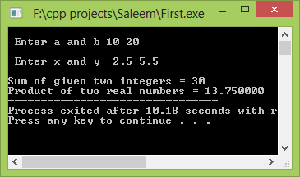
6a). Program using function
Function declaration
#include<stdio.h> int add(int, int); float multiply(float, float); void main() { int a,b, sum; float x,y,product; printf("\n Enter a and b "); scanf("%d %d", &a, &b); sum=add(a,b); printf("\n Enter x and y "); scanf("%f %f", &x, &y); product=multiply(x,y); printf("\nSum of given two integers = %d",sum); printf("\nProduct of two real numbers = %f",product); } | int add(p,q) int p,q; { return (p+q); } float multiply(s,t) float s,t; { return (s*t); }
Function Definition
Function Call

Slide 17
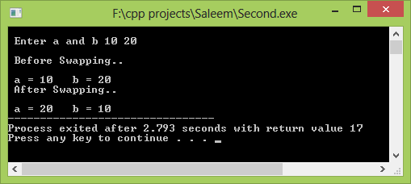
6b). Program using functions & Pointers
Function declaration
#include<stdio.h> void swap(int *, int *); void main() { int a,b; printf("\n Enter a and b "); scanf("%d %d", &a, &b); printf("\n Before Swapping..\n”); printf(“\n a = %d b = %d”,a,b); swap(&a,&b); printf("\n After Swapping..\n”); printf(“\n a = %d b = %d”,a,b); } | void swap(int *p, int *q) { int temp; temp = *p; *p = *q; *q = temp; }
Function Definition
Function Call

Slide 18
Thank You

