Slide 1
Your Résumé as a First Impression

Slide 2
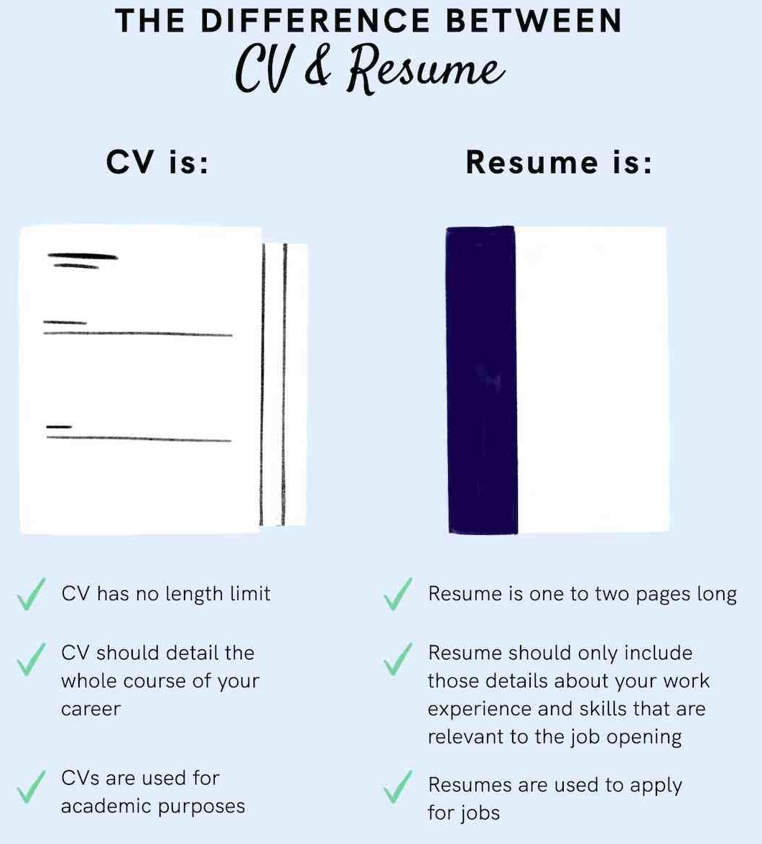

Slide 3

How to Get Your Resume Noticed by Employers
It can be a challenge to get your resume noticed by employers
But there are ways to weak it & move it beyond the Applicant Tracking Systems (ATS) which employers use to provide an initial screening of hundreds of applications they receive.
Sulaiman Rahman, CEO of DiverseForce says “recruiters may not be the only ones you need to impress… Organizations are increasingly using automation to screen resumes, so it’s important for job seekers to use keywords that are also found in the actual job description”.

Slide 4

A résumé only works if it makes its way to the Hiring Authority who decides to interview you!
  Résumés are scanned
    By Recruiters usually less than 30 seconds!
    By Applicant Tracking Systems (a computer)
  Résumés are screened to rule out applicants who do not meet the qualifications or present themselves professionally in writing
  Résumés that make it past the scanners and screeners are scrutinized to reduce the number of candidates and ranked to invite the most qualified to interview

Slide 5
Five Keys to an Outstanding Résumé
Because | You Should | Key to Success
Recruiters and Hiring Managers look for candidates who are “best qualified” for a specific position | Tailor your résumé to each position and the employer’s needs | FOCUS
Recruiters and Hiring Managers look for results and achievements with quantifiable data | Write a “results-oriented” résumé and quantify where possible | ACCOMPLISHMENTS
Skills are transferable from one job, or situation, to another | Give concrete examples of your relevant transferable skills | TRANSFERABLE SKILLS
Résumés are often placed into keyword-searchable databases | Analyze the position description for keywords— use the same verbs and add nouns for the specific details from your activities (nouns) | KEYWORDS
Recruiters and Hiring Managers scan résumés | Ensure the readability of your one-page résumé | APPEARANCE

Slide 6
Five steps to tailor your Résumé to address the employer’s needs
1
Choose a job target, an actual job you want that you are qualified for.
2
Read the job description carefully to understand what skills, knowledge and experience are required.
3
Review your educational, work & volunteer experiences & skills. Make a list of your top three to four strongest skills, abilities, and knowledge that make you a strong candidate. This is how you maintain the FOCUS of your résumé.
4
For each key skill required in that position, think of an accomplishment from your experience (work, school, volunteer experience) that is relevant. Transferable skills count!
5
  Use the STAR Method to write action statements that show results and describe and support your claim that you are a great match! (Situation, Task, Action(s), Results)
Everything on a résumé must be on target. Your targeted résumé should make it easy for the reader or computer program to see that you have the qualifications needed for the job.

Slide 7
Writing an Objective
An objective is optional on a résumé and when written well will help the recruiter or hiring manager understand why you are interested in the position. Write an objective that is brief and to the point. Below are examples to help you develop your objective.
Formula 1: Focus on the kind of position you want (or the title of the one you’re applying for).
Example: Seeking a part-time position as an Administrative Assistant.
Formula 2: Focus on the field or industry in which you are interested in working.
Example: Seeking a position in the Information Technology field.
Formula 3: Focus on your skills and abilities.
Example: Seeking a position that will utilize my communication, data-entry skills, and strong work ethic.

Slide 8
DO’S and DON’TS
Do:
  Schedule a résumé critique appointment with a Career Advisor
  Proofread and review for consistent formatting
  List information in order of importance and relevance to the job description
  Create a separate reference list to bring to the interview
  Use 14 – 16 point font size for your name and 10 – 12 for the body of your résumé
  Single space within paragraphs and double space between sections
  Use 8 ½” X 11” white or ivory résumé paper
  Use 1-inch margins, never less than 0.5 inches
  Include your name and page number at the top of the second page (if you have one)

Slide 9
Don’t:
  Use fancy fonts or colors. Use readable fonts such as Times, Arial, or Palatino.
  Use an unprofessional email address (i.e. hotmama@gmail.com)
  Use an unprofessional voicemail greetin.
  List references on your résumé
  Use phrases such as “responsibilities included”
  Use résumé templates included in word processing software
  Include routine job duties such as “making copies”
  Write long objectives such as, “To find a sales position at a medium-sized corporation where I can grow and develop my management skills
  Use abbreviations
  Crowd the page

Slide 10
Resume Headings Highlight your Qualifications
Strategically order headings to place the most important information at the “top” of your résumé. For technical skills, be sure to include your level of proficiency (Knowledge of, Familiar with, Experience in, etc.)
Example of Heading Order
Objective
Skills
Education
      Related Coursework
      Projects
      Honors and Awards
Work experience
Internships
Volunteer Experience
Training

Slide 11
Work Experience
  List your most recent work first, then your earlier work (reverse chronological order)
  Include the name of the employer, your job title, location, and the dates of employment
  Include all work experience, even if it was short term or unpaid
  Include all jobs even if they are not related to your current job objective, because they help create a picture of reliability and willingness to work
  Include jobs even if your parents or relatives were the employer
  Emphasize job-related skills and abilities by writing strong phrases that begin with a verb (see list of “Action Verbs” on pg. 6)
  Always keep the needs of your employer in mind. Address the specific requirements of a position by relating your related skills, qualifications, and accomplishments
  List accomplishments whenever possible rather than just describing duties
  Write short, clear phrases. Use the minimum number of words necessary to accurately convey what you want to say
  Use present tense verbs for current positions and past tense verbs for previous positions
  Avoid introductory phrases such as “my duties included” or “I was in charge of”
  Avoid personal pronouns (“my” or “I”)
  Avoid use of verbs ending in “ing”

Slide 12
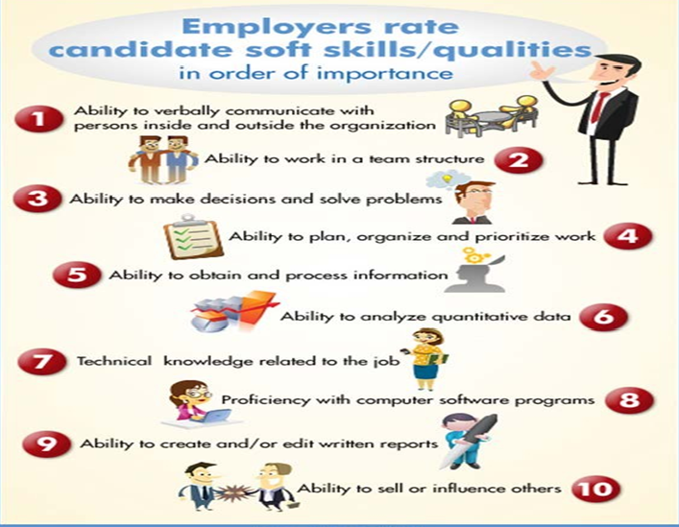

Slide 13
Sample Resume
First and Last Name
Street Address • City, State Zip
Student@csustan.edu • Phone Number
Portfolio: Portfolium web address is optional.
OBJECTIVE
Utilize the formula to focus on the kind of position you want, field or industry you are interested in, or your skills and abilities.
SKILLS
List software and proficiency (advanced knowledge, familiar with, etc.)
List language(s) and proficiency (fluent, conversational or basic).
Demonstrated experience with…
EDUCATION
California State University, Stanislaus, Turlock, CA Graduation Month Year
Bachelor of Arts or Science, Name of Major
Minor or Concentration
Overall GPA 4.0 and/or Major GPA 4.0
Dean’s List: Semester and Year
Related Coursework
Course Title Course Title
Course Title Course Title
AWARDS
List name of award, Year
EXPERIENCE
Position Title Month Year – Month Year
Company/Organization Name, City, State
Use bullet points to describe your accomplishments (bullets will lead the reader’s eyes more easily)
Always start each bullet with “action verbs” – add adjectives to emphasize
State an accomplishment that demonstrates your skills in this field/position
Use present tense verbs for current positions and past tense for previous positions
INTERNSHIP EXPERIENCE
Internship Title Month Year – Month Year
Company/Organization Name, City, State
Use bullet points same as work experience above to describe accomplishments
VOLUNTEER EXPERIENCE
Volunteer Title Month Year – Month Year
Community Service Organization, City, State
Write accomplishment statements and describe transferable skills the same as you would for paid work, if relevant

Slide 14


