Slide 1
Dr.A.ZEENATH AMMAN , M.Com.,M.Phil.,MBA., PGDCA., Ph.D.
ASSISTANT PROFESSOR OF COMMERCE
JAMAL MOHAMED COLLGE (AUTONOMOUS)
TRICHY – 20.

Slide 2
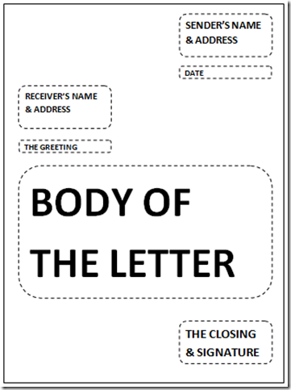
BUSINESS COMMUNICATION
Layout of a Business Letter

Slide 3
Meaning of Business Letters:
In these days of telecommunication, letter is still the chief method of conveying message.
Letter maintains the personal touch, serves as a record and also makes it possible to have multiple copies, if required.
Qualities of a Good Business Letter:
1. Clarity: Clear thinking and simple expression are the two important virtues of effective writing. A good letter should show its idea directly and clearly. Each sentence should be as simple as possible. The reader should have no difficulty in understanding what the writer means to say. When the reader gets the same meaning from the-message as what the sender intended, it is a good letter.

Slide 4
2. Conciseness:
Transmission of maximum information by using minimum words should be the aim of letter-writing. Unnecessary details and roundabout expressions should be avoided. People are busy and they receive a number of letters daily. Unless one says quickly what one wishes to say, he will not be able to get the attention of the reader and focus it on the message. Therefore, a letter should be simple and brief.
3. Completeness:
The letter should contain all the essential points a reader is expected to know. For example, a sales letter should include the description of the goods, price, quality, how and where to buy, the date of delivery, discounts etc. If it gives only partial information, it is not a complete letter.
4. Correctness:
The correctness demands no error at all in grammar, idiom, spelling, and punctua­tion. Besides, the information given in the letter must be accurate; otherwise it will shake the confidence of the reader. The message should not be transmitted unless the sender is sure of its correctness.

Slide 5
5. Courtesy:
Courtesy means politeness. It always pays to be courteous in business. It softens the sting of an unpleasant piece of information, creates goodwill and produces a favourable response. Good­will is a great asset for an organisation and courtesy in correspondence is one of the most natural and economical means of building it.
6. Cheerfulness:
There should be no negative approach in a letter. It must begin with a positive and optimistic note. The approach should be friendly and convincing.
7. Promptness:
Promptness in replying a letter is absolutely necessary. The general practice is to reply a letter the same day it is received. When it is known that a reply to a letter requires time it is necessary to acknowledge the letter received and intimate the probable time required sending full reply.

Slide 6
8. Appropriateness:
Appropriateness refers to writing or replying letters keeping in mind the rela­tion and psychology of the reader as well as the need of the occasion. The tone, style and language should be changed according to the occasion.
9. The ‘You’ attitude:
In business letters, the reader’s interest must be emphasised and not the sender s interest. To make letters effective, avoid words such as T and “we’ and use as many as ‘you’ as possible. The ‘you attitude’ can be used effectively in all kinds of business letters.
10. Integral:
The purpose of business communication is to create understanding, bring about coop­eration and initiate constructive action. Therefore, all communication should be in conformity with the general objectives of the organisation.

Slide 7
Layout of a Business Letter:
The general appearance of the letter will create a favourable impression in the minds of the reader.
1. Stationery:
For making an initial impression it is necessary to use good quality paper. Use of the best stationery is a good investment. White paper is preferable as the letters stand out clearly on it and make easy reading. The size of the paper may be according to the suitability of each organisation.
2. Typing:
Typing saves time and gives a good appearance. It is, therefore, necessary to get the letters neatly typed. Typing of letter involves extra expenses. But the appearance of the letter will pay rich dividends.

Slide 8
3. Margin:
Margin in a letter adds to its attractiveness. One inch (2.54 cms) margin on all sides is the standard one. Margin may be suitably changed according to the size of the paper and it should give a picture frame appearance.
4. Folding:
Care should be taken when folding a letter. It should be done with minimum number of folds and the letter should not look bulky when placed in a cover. The folds should be well pressed down. When a letter is placed in a cover it must give a smart look.
5. Envelope:
The colour and quality of the envelope must match the inside letter. The envelope should suit the size of the paper on which the letter is typed.

Slide 9


