Slide 1

Dr. S. Abdul Saleem
Associate Professor of Comp. Science
Jamal Mohamed College(Autonomous)
Tiruchirappalli-20
Dr. S. Abdul Saleem
Associate Professor of Computer Science
https://www.onlinegdb.com/online_c_compiler#

Slide 2
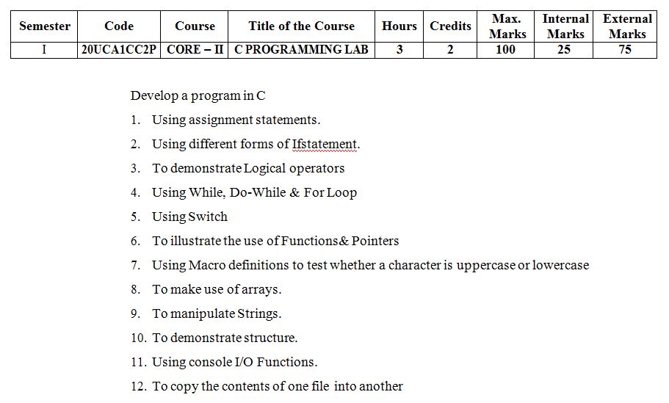

Slide 3
7) Program using Macro definition
#include <stdio.h>
#define IS_UPPER(x) (x >= 'A' && x <= 'Z')
#define IS_LOWER(x) (x >= 'a' && x <= 'z')
void main()
{
char ch;
printf("Enter any character: ");
ch = getchar();
if (IS_UPPER(ch))
printf("'%c' is uppercase\n", ch);
else if (IS_LOWER(ch))
printf("'%c' is lowercase\n", ch);
else
printf("Entered character is not alphabet");
}

Slide 4
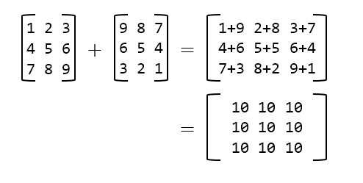
Matrix Addition

Slide 5
8. Program to find the sum of all the elements in a Array
#include <stdio.h>
void main()
{
int arr[10];
int i, n, sum=0;
printf("Enter size of the array: ");
scanf("%d", &n);
printf("Enter %d elements in the array: ", n);
for(i=0; i<n; i++)
{ scanf("%d", &arr[i]); }
for(i=0; i<n; i++)
{ sum = sum + arr[i]; }
printf("Sum of all elements of array = %d", sum);
}

Slide 6
9. Program to add the given two matrices
#include <stdio.h>
void main()
{
int A[2][2], B[2][2], C[2][2];
int row, col;
printf("Enter elements in matrix A of size 2x2: \n");
for(row=0; row<2; row++)
{
for(col=0; col<2; col++)
{ scanf("%d", &A[row][col]); }
}
printf("\nEnter elements in matrix B of size 2x2: \n");
for(row=0; row<2; row++)
{
for(col=0; col<2; col++)
{ scanf("%d", &B[row][col]); }
}
for(row=0; row<2; row++)
{
for(col=0; col<2; col++)
{ C[row][col] = A[row][col] + B[row][col]; }
}
printf("\nSum of matrices A+B = \n");
for(row=0; row<2; row++)
{
for(col=0; col<2; col++)
{ printf("%d ", C[row][col]); }
printf("\n");
}
}

Slide 7
10. Program to concatenate two strings
#include <stdio.h>
void main()
{
char str1[20], str2[20];
int i, j;
printf("Enter first string: ");
gets(str1);
printf("Enter second string: ");
gets(str2);
/* Move till the end of str1 */
i=0;
while(str1[i] != '\0')
{ i++; }
/* Copy str2 to str1 */
j = 0;
while(str2[j] != '\0')
{
str1[i] = str2[j];
i++;
j++;
}
// Make sure that str1 is NULL terminated
str1[i] = '\0';
printf("Concatenated string = %s", str1);
}

Slide 8
11. Sorting names in Alphabetical order
#include <stdio.h>
void main()
{
char str1[20], str2[20];
int i, j;
printf("Enter first string: ");
gets(str1);
printf("Enter second string: ");
gets(str2);
/* Move till the end of str1 */
i=0;
while(str1[i] != '\0')
{ i++; }
/* Copy str2 to str1 */
j = 0;
while(str2[j] != '\0')
{
str1[i] = str2[j];
i++;
j++;
}
// Make sure that str1 is NULL terminated
str1[i] = '\0';
printf("Concatenated string = %s", str1);
}

Slide 9
Thank You

