Slide 1
Bacterial Cell Wall
Class : I B.Sc Microbiology
Dr. H. VAJIHA BANU
Assistant Professor
Department of Microbiology
Jamal Mohamed College (Autonomous)
Tiruchirappalli-620 020

Slide 2
CELL WALL
The cell wall is the outer most layer of the cell. In many cases the cell wall comes in direct contact with the
environment.
Function
•
•
•
Protection of the cell.
Maintains the shapes of the cell. Maintains the osmotic integrity of the cell.

Slide 3
•
Assist some cells in attaching to other cells or in eluding antimicrobial drugs.
•
Not present in animal cells, so can target cell wall of bacteria with antibiotics.
•
Providing attachment sites for bacteriophages.
•
Play an essential role in cell division.
•
Providing a rigid platform for surface appendages- flagella, fimbriae and pili.

Slide 4
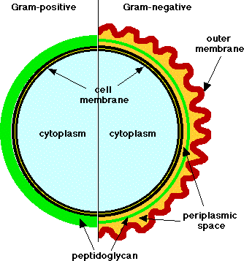
Bacterial classification

Slide 5
Peptidoglycan
Peptidoglycan, also known as murein, is
a polymer consisting of sugars and amino acids that forms a mesh-like layer outside the cell membrane of most bacteria forming the cell wall.
The sugar component consists of alternating residues
•
of β-(1,4) linked N-acetylglucosamine and N-
acetylmuramic acid.
These subunits which are related to glucose in their structure are covalently joined to one another to form glycan chains.
•

Slide 6
•
Attached to the N-acetylmuramic acid is a peptide chain of three to five amino acids. The peptide chain can be cross-linked to the peptide chain of another strand forming the peptidoglycan.

Slide 7
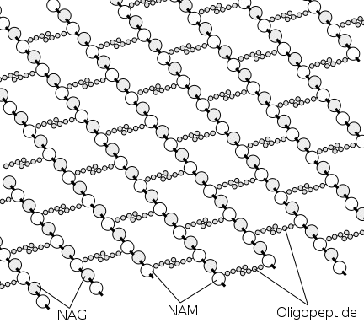
Peptidoglycan structure

Slide 8
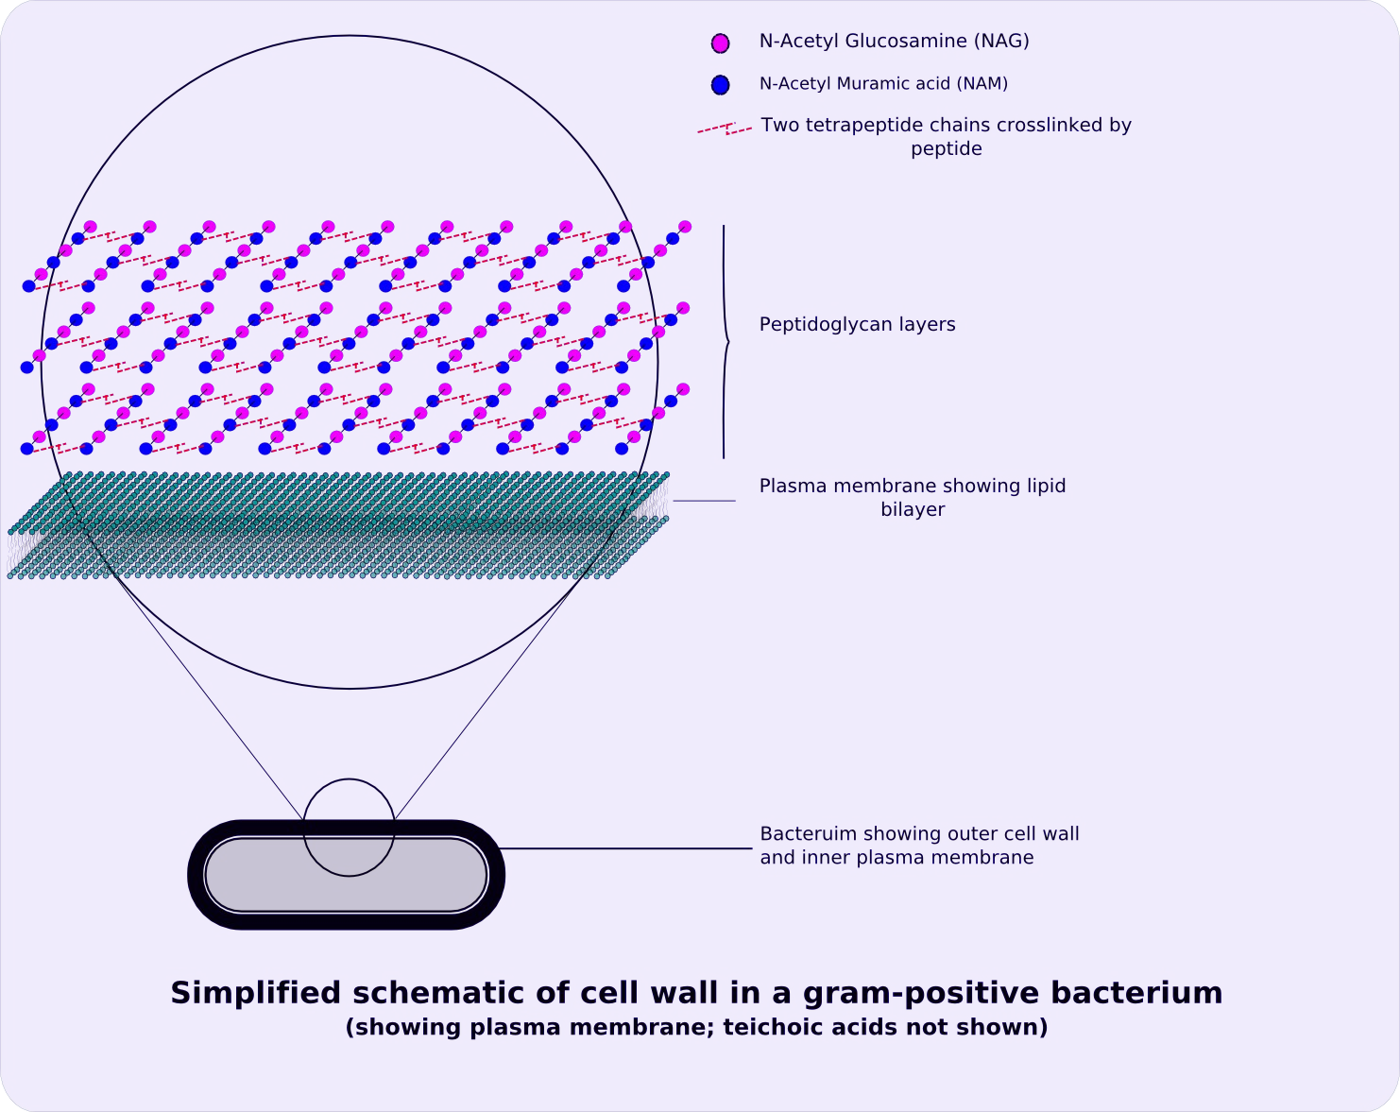
Peptidoglycan structure

Slide 9
Gram Positive Cell wall
Usually thick, homogenous, composed mainly of peptidoglycan.
It accounts for 50-90% of the dry weight of the cell wall.
Contain large amount of teichoic acids (polymers of glycerol or ribitol joined by phosphate group).

Slide 10
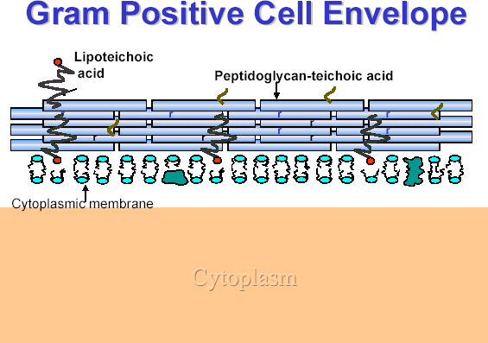

Slide 11
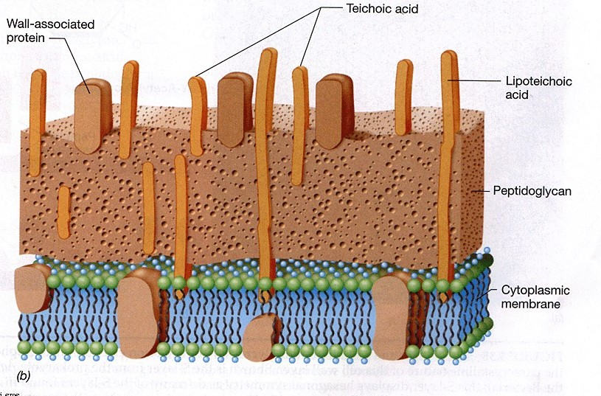
Special components of Gram positive cell wall
Teichoic acid

Slide 12
Teichoic acid
Teichoic acids are connected to either peptidoglycan or to plasma membrane lipids.
Absent in gram negative bacteria.
Function of Teichoic Acid:
. Antigenic determinant (receptor molecule for bacteriophages).
. Participate in the supply of Mg to the cell by binding Mg++
. Regulate normal cell division.
For most part, protein is not found as a constituent of the G+ cell wall except M protein on group streptococci.

Slide 13
Gram Negative Cell Wall
Multi layered and more complex than Gram positive cell walls.
Peptidoglycan of gram negative bacteria is thin and comprises only 10% or less of cell wall.
Outer membrane lies outside the thin peptidoglycan layer.
Most abundant protein is Braun’s lipoprotein.

Slide 14
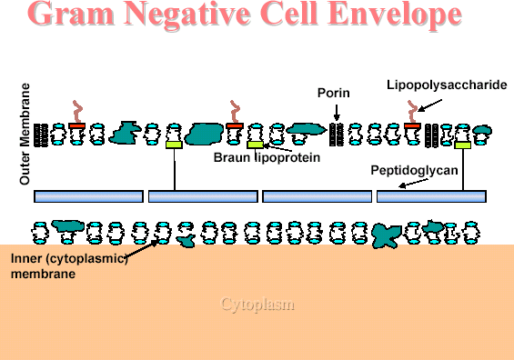

Slide 15
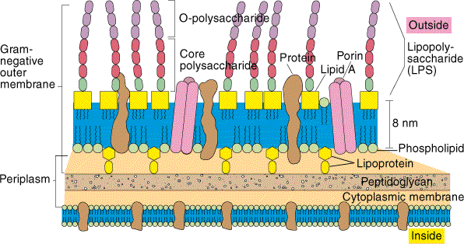
Special components of Gram negative cell wall

Slide 16
Periplasm:
The region between the cytoplasmic membrane and the outer membrane is filled with a gel-like fluid called periplasm.
In gram negative bacteria, all secreted proteins are contained within the periplasm, unless they are specifically translocated across the outer membrane.
•
Periplasm is filled with the proteins that are involved in various cellular activities, including nutrient degradation and transport.

Slide 17
Outer membrane
Peptidoglycan layer is surrounded membrane in the gram negative bacteria.
by outer
Its outside leaflet is made up of lipopolysaccharides, rather than phospholipids.
For this reason, the outer membrane is also called the lipopolysaccharide layer or LPS.
The outer membrane functions as a protective barrier and excludes many toxic compounds.

Slide 18
•
Lipopolysaccharide molecule is extremely important from a medical stand point.
It consists of three parts, two of them are medically significant.
•
Lipid A…..embedded in membrane.
Core polysaccharide…..located on membrane.
O antigens….which are short
the surface of
polysaccharides
extended out from core.

Slide 19
•
Lipid A: The chemical makeup of lipid A molecule plays significant role in our body’s ability to recognize the presence of invading bacteria.
It is toxic in nature, as a result the LPS can act as an endotoxin, causing symptoms like fever, diarrhea and shock.
•
•
O-antigen: It is including glucose,
composed of carbohydrates, galactose, mannose and some
other sugars in varying combinations.
The O-antigens can react with antibodies.
•
their specific

Slide 20
THANK YOU

