Slide 1
COMMUNICATION SKILLS ENGLISH
K. Nisha
Assistant Professor
Department of English
Jamal Mohamed College
Trichy-20

Slide 2
TOPIC
ORAL COMMUNICATION-
ORGANS OF SPEECH-
ENGLISH PHONEMES(CONSONANT TABLE, VOWEL TABLE)
PRACTICE

Slide 3
PRESENTED BY
KANIS KANT.S.R
KANNAN.R
MADHAN.S
MAHINDRA RAJA.N
MATHESHWARAN.R

Slide 4
COMMUNICATION
The imparting or exchanging of information by speaking, writing or using some other medium.
TYPES OF COMMUNICATION:
VERBAL
NONVERBAL
VISUAL
VERBAL:
Verbal communication is the use of words to convey a message.
Verbal communication comprises written and oral communication.

Slide 5
NON-VERBAL COMMUNICATION
Non-verbal communication is the transmission of messages or signals through a non-verbal platform.
Eye contact , facial expression , gestures ,posture and body language.
VISUAL COMMUNICATION
Visual communication is the use of visual elements to convey ideas and information.
It include but are not limited to signs , typography , drawing , graphic design , illustration , advertising and electronic resources.
Humans have used visual communication since prehistoric times.

Slide 6
ORAL COMMUNICATION
Oral communication implies communication through mouth.
Speeches , presentation , discussion are all forms of oral communication.
IMPORTANCE OF ORAL COMMUNICATION
It saves time by letting you convey your message directly to the person and getting their response immediately.
It’s the most secure form of communication for critical issues and important information.
It helps to resolve conflicts with face to face communication.

Slide 7
FACTORS FOR EFFECTIVE ORAL
COMMUNICATION
Think before you speak….
Speak with confidence…..
Be clear and concise…..
Be aware of your non-verbal communication cues….
Be a good listener…..
Think about the perspective of your audience….
Vary your vocal tone..

Slide 8
ORGANS OF SPEECH
The various organs of our mouth which we use to produce speech sounds are called “ORGANS OF SPEECH”
Speech as we know, is made up to sounds.
The organs are helpful in producing speech sound.
Air from lungs converted into speech sound.
The primary purposes they are meant for tongue, nose , etc ..
Must be noted that for producing any sound , air is necessary.
MAJOR ORGANS OF SPEECH:
Lungs
Trachea (windpipe)
Lip
Tongue
Mouth ETC,,,,,,,

Slide 9

ORGANs OF SPEECH ANIMATION

Slide 10
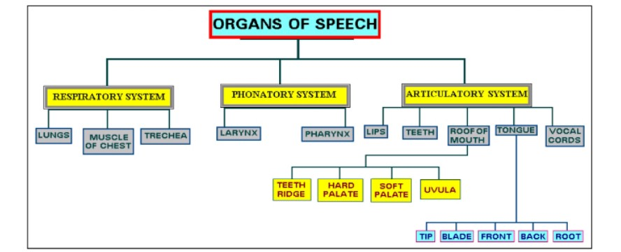
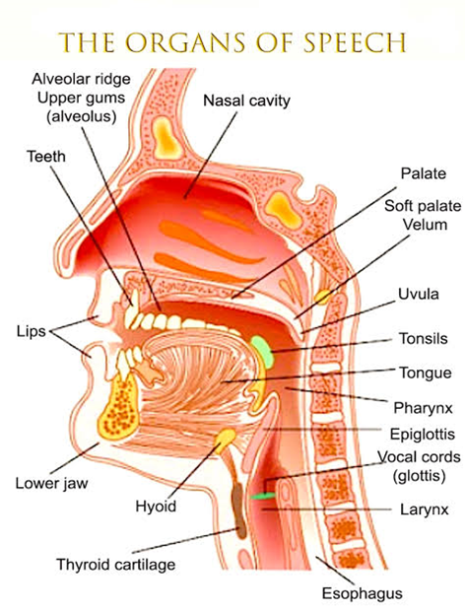
ORGANs OF SPEECH

Slide 11
PHONEMES
A Phoneme is a sound or a group of different sounds perceived to have the same function by speaker of the language or dialect in question.
Phonemes (speech sounds) are presented in writing by placing the letters used to represent the sound between slaches.
The two major phoneme categories are:
                Vowels
                Consonants
Vowels:
      A Vowel is a sound made with your mouth fairly opened.
      A speech sound a,e,i,o,u produced without obstraction in the mouth
      Example : a – Apple ,e – Elephant, i – igloo ,o – octopus , u – umbrella .

Slide 12
Some words do not have vowel letters at first, but it produces vowel sounds.
      Example : hour ,honest ,etc.,
CONSONANTS :
        A Consonant is a sound made with your mouth fairly closed.
        A consonant is any letter of the alphabet except vowels (a,e,i,o,u).
        Example : ball , dates, etc.,
        Some words have vowel letters at first but , it produces sound like consonants.
        That’s why it comes under the consonant words.
        Example : one , university , etc.,

Slide 13
PRACTICE
Practice is important because it allows you to deliver the total speech.
The ability to communicate effectively increases due the practice.
Best practices for more effective communication are:
Listen actively.
Respond in a timely manner.
Keep a good sense of humour. If you don’t practice
Confidence. you don’t deserve to win
Maintain eye contact.
Talk with yourself.
Talk with open mind.
If you don’t practice
You don’t deserve to win

Slide 14
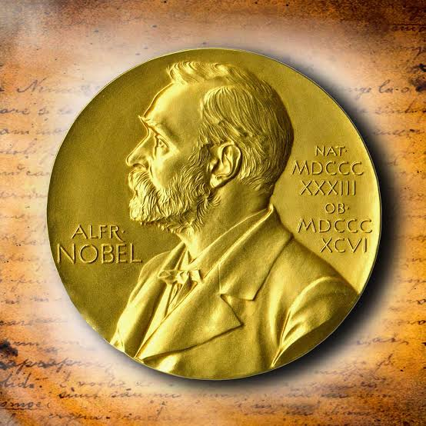
PRACTICE LEADS TO PERFECTION AND PERFECTION
LEADS TO SUCCESSION

Slide 15
☺
THANK YOU

