Slide 1
STRUCTURE OF ATOMS
Presented by ,
Dr.N.Packialakshmi,
Assistant professor,
Department of Microbiology
JMC,Trichy-620020.

Slide 2
Overview of Atomic Structure
Atoms are made up of particles called protons,neutrons,and electrons,Which are responsible for the mass and charge of atoms.
ATOM: The smallest possible amount of matter which still re -trains its identity as a chemical element, consisting of a nucleus surrounded by electeons

Slide 3
PROTON:positively charged sub-atomic particle forming part of the nucleus of an atom and determining the atomic number of an element.It weighs 1 amu
NEUTRON:A subatomic particle forming part of the nucleus of an atom .It has no charge.It is equal in mass to a proton or it weighs 1 amu

Slide 4
*Retains all of the chemical properties of an element.
*Atoms combine to form molecules which then interact to form solids ,gases or liquids.
*For example, water is composed of hydrogen and oxygen atoms that have combined to form water molecules.
*Many biological processes are devoted to breaking down molecules into their component atoms

Slide 5
ATOMIC PARTICLES
*Atoms consist of three basic particles
*protons
*electrons
*neutrons
*The nucleus center of an atom contains the protons( positively charged)and the neutrons (no charge ).
*The outermost regions of the atom are called electrons shells and contain the electrons (negatively charged)
*Atoms Have different properties based on the arrangement and number of their basic particles

Slide 6
The hydrogen atoms (H) contains only one proton.one electron ,and no neutrons.
This can be determined using the atomic number and The mass number of the element

Slide 7
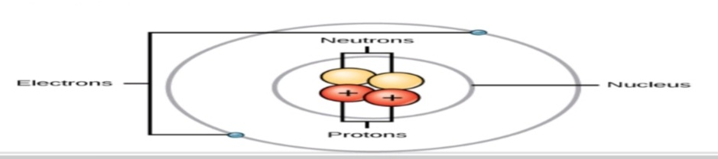

Slide 8
ATOMIC MASS
Protons and neutrons have approximately the same mass, about 1.67×10^-24grams .
Scientists define this amount of mass as one atomic mass unit or one Dalton.
Although similar in mass ,protons are positively charged, while neutrons have no charge.
Therefore, the number of neutrons in an atom contributes significantly to its mass,but no to its charge

Slide 9
Electrons are much smaller in mass than protons,weighting only 9.11×10^-28 grams ,or about 1/1800 of an atomic mass unit.
Therefore,they do not contribute much to an element 's overall atomic mass .
When considering atomic mass it is customary to ignore the mass of any electrons and calculate the atoms mass based on the number of protons and neutrons alone

Slide 10
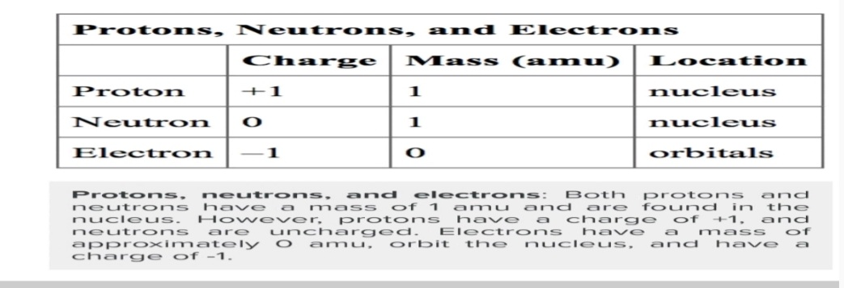

Slide 11
Atomic Number and Mass Number
The atomic number is the number of protons in an element,while the mass number is the number of protons plus the number of neutrons

