Slide 1
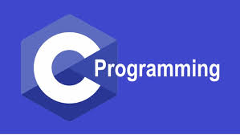
Dr. S. Abdul Saleem
Associate Professor of Comp. Science
Jamal Mohamed College(Autonomous)
Tiruchirappalli-20
Dr. S. Abdul Saleem
Associate Professor of Computer Science
https://www.onlinegdb.com/online_c_compiler#

Slide 2
Functions
A function is a self-contained block of statements that performs a particular task.
Users can define their own functions for the specific tasks.
User defined functions have following three elements
  Function Declaration
  Function Call
  Function Definition
Function Declaration (or function prototype) is similar to the variable declaration.
In order to use this function we need to invoke it at a required place in the program. This is known as the function call.
The function definition is an independent program module that is specifically written to implement the requirements of the function

Slide 3
General Format of Function Definition
return-type function-name(formal parameter list)
{
Local variable declaration
Executable statement1;
Executable statement2; // Function Body
………………………..
return statement;
}
The above function header consists of three parts: the return-type, function-name and formal parameter list. The default return-type any function is integer type.
Remember, void in the main() function means , it doesn’t return any value to the calling OS.
The function-body contains the declarations and statements necessary for performing the required task.
The return statement is used to return a value to the calling program. This statement may be omitted when the return-type of the function is specified as void.

Slide 4
The return statement
Syntax :
return; or
return (expression);
The first form doesn’t return any value; it acts as closing brace of the function .
For example
if(error) return;
The second form of return with an expression returns the value of the expression. For example
int multiply(int x, int y)
{
int p;
p = x*y;
return p;
}
It returns the value of p, which is the product of the value of x and y. The last two statements can be combined into one statement as return (x*y);

Slide 5
function call Statement
A function can be called by simply using the function-name followed by list of actual parameters enclosed in the parenthesis.
The different ways of calling multiply function are
int x;
x=multiply(10,5);
x=multiply(a,b); where a and b are variables
x=multiply(a+5,b-2);
x=multiply(10,multiply(2,3));

Slide 6
Function Declaration (or Function Prototype)
The function declaration consists of four parts:
Function return type
Function name
Parameter list
Termination semicolon
General format
return-type function-name(parameter-list or arguments);
Note : This declaration may be placed in either global of all function or inside the function definition.
Rules:
The parameter list must be separated by commas
The parameter names do not need to be same in the prototype declaration and the function definition.
The types must match the types of the parameters in the function definition , in number and order.
Use of the parameter names in the declaration is optional
If the function has no formal parameters, the list is written as void
The return-type must be void if no value is returned
The return-type is optional, when the function returns int type value
Types mismatch between declaration and definition lead to compilation error

Slide 7
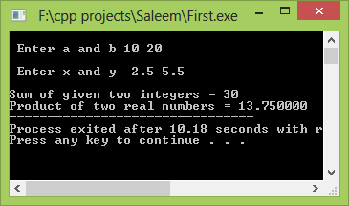
Program using function
Function declaration
#include<stdio.h> int add(int, int); float multiply(float, float); void main() { int a,b, sum; float x,y,product; printf("\n Enter a and b "); scanf("%d %d", &a, &b); sum=add(a,b); printf("\n Enter x and y "); scanf("%f %f", &x, &y); product=multiply(x,y); printf("\nSum of given two integers = %d",sum); printf("\nProduct of two real numbers = %f",product); } | int add(p,q) int p,q; { return (p+q); } float multiply(s,t) float s,t; { return (s*t); }
Function Definition
Function Call

Slide 8
Scope Rule of Functions
In General, the scope of a variable is local to the function in which it is defined.
In the above program, the presence of i is known only to the function main( ) and not to any other function. Similarly, the variable k is local to the function display( ) and hence it is not available to main( ). That is why to make the value of i available to display( ), wehave to explicitly pass it to display( ). Likewise, if we want k to be available to main( ), we will have to return it to main( ) using the return statement. I
# include <stdio.h> void display ( int ) ; int main( ) { int i = 20 ; display ( i ) ; return 0 ; } | void display ( int j ) { int k = 35 ; printf ( "%d\n", j ) ; printf ( "%d\n", k ) ; }

Slide 9
Scope Rule of Functions
#include <stdio.h>
int function1(int); //Function prototype
int main()
{ int i=10,m;
printf("\n i = %d", i);
m= function1(i);
printf("\n m = %d",m);
return 0;
}
int function1(int j)
{
int k=20;
printf("\n j= %d",j);
printf("\n k= %d",k);
return (k);
}

Slide 10
Pointers
What is Pointer ?
Pointer is a variable, which holds the address of another variable. Pointer variable is preceeded by ‘*’ Asterisk symbol
For example
#include<stdio.h>
void main()
{ int a=10,*p;
p = &a;
printf("\na = %d",a);
printf("\n*p = %d",*p);
}
In the above program, the address of variable ‘a’ is assigned on pointer variable ‘p’. So now ‘p’ points to the location of variable ‘a’ and prints the value as ‘10’

Slide 11
Call by value and Call by reference
The function call statement always pass the ‘values’ of variables to the called function. Such function calls are called ‘calls by value’. It means that, we are passing only values of variables to called function. Therefore any changes made on these values in called function will not affect the variables in the calling function. For example
sum = calsum ( a, b, c ) ;
f = factr ( a ) ;
Instead of passing the value of a variable to a function , we can also pass the location number (also called address) of the variable to a function. It is called ‘call by reference’.
In call by reference, the pointers in the called function point to the variables in the calling function. Therefore these pointers can affect the actual arguments in the calling function.
For example
swap(&a, &b);

Slide 12
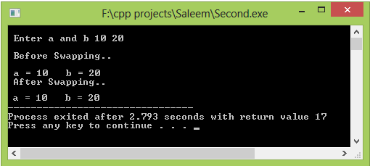
Program for swapping numbers using function(Call-by-Value)
Function declaration
#include<stdio.h> void swap(int , int); void main() { int a,b; printf("\n Enter a and b "); scanf("%d %d", &a, &b); printf("\n Before Swapping..\n”); printf(“\n a = %d b = %d”,a,b); swap(a,b); printf("\n After Swapping..\n”); printf(“\n a = %d b = %d”,a,b); } | void swap(int p, int q) { int temp; temp = p; p = q; q = temp; }
Function Definition
Function Call

Slide 13
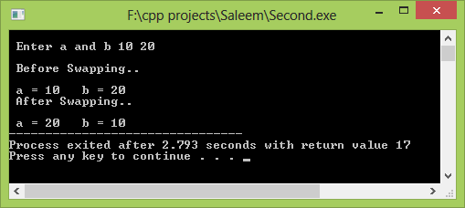
Program using functions & Pointers (Call-by-Reference)
Function declaration
#include<stdio.h> void swap(int *, int *); void main() { int a,b; printf("\n Enter a and b "); scanf("%d %d", &a, &b); printf("\n Before Swapping..\n”); printf(“\n a = %d b = %d”,a,b); swap(&a,&b); printf("\n After Swapping..\n”); printf(“\n a = %d b = %d”,a,b); } | void swap(int *p, int *q) { int temp; temp = *p; *p = *q; *q = temp; }
Function Definition
Function Call

Slide 14
Thank you

