Slide 1
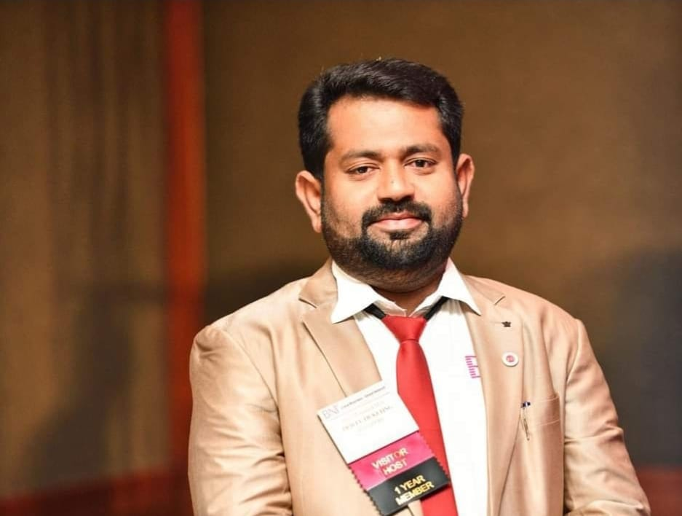
ENTREPRENEURIAL DEVELOPMENT
Dr. m.a.raja mohamed,
P.G & RESEARCH Department of economics,
jamal mohamed college,
tiruchirappalli-620020.

Slide 2
ENTREPRENEUR:
The word entrepreneur is derived from French word “entreprendre” which means “to undertake”
The term was first coined by RICHARD CANTILLON, a French baker in 18th century to mean a person who is uncertainty entrepreneur is an organiser who combined various products of factors to produce a socially viable product

Slide 3
ORIGIN OF ENTREPRENEUR :
In the 16th century it was refer to person engaged in millitary journey.
In 17th century it was extended to the person engaged in engineering activities like construction etc.
In 18th century it was used to refer to persons engaged in economic aspect of human activities.

Slide 4
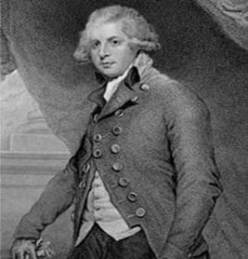
DEFINITION:
Entrepreneur is an agent who lays means of production at certain prices in order to combine in to a product that he is going to sell at prices that are uncertain out the moment at which he commits himself to his costs.
-RICHARD CANTILLON

Slide 5
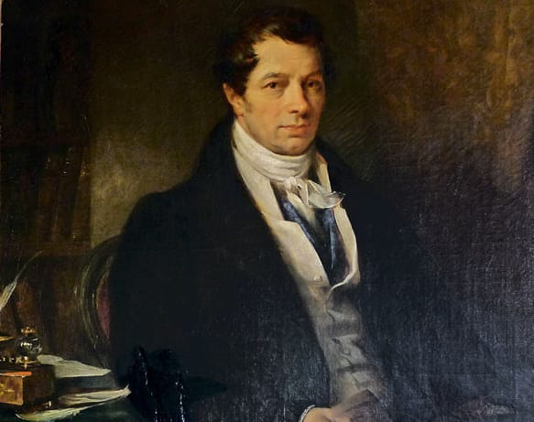
DEFINITION:
An entrepreneur is the economic agent who unites all means of production the labour, the capital or land and who finds the value of product which results from their employment, the reconstruction of the entire capital that he utilises and value of wages, interest and the rent that he pays as well as profit.
belonging to himself
-J.B SAY

Slide 6
CHARACTERISTICS OF SUCCESSFUL ENTREPRENEUR:
Innovator
Risk taker
Good organiser
Optimistic
Foresight
Visionary
Self confident
Perseverance
Emotional balance
Hard work
Decision making
Patient
Communication skill
Leadership and team spirit
Interpersonal skill
Creative

Slide 7
FUNCTIONS OF ENTREPRENEUR:
Initiating and leading business activities
Allocating employees duties
Forecasting business changes
Identifying business opportunities
Creating and sharing wealth
Improving the standard of living
Creating jobs

Slide 8

TYPES OF ENTREPRENEUR:
INNOVATIVE ENTREPRENEUR:
An Innovative Entrepreneur is a person who creates and implements new ideas, products, or services in order to bring about positive change in the market and society.

Slide 9

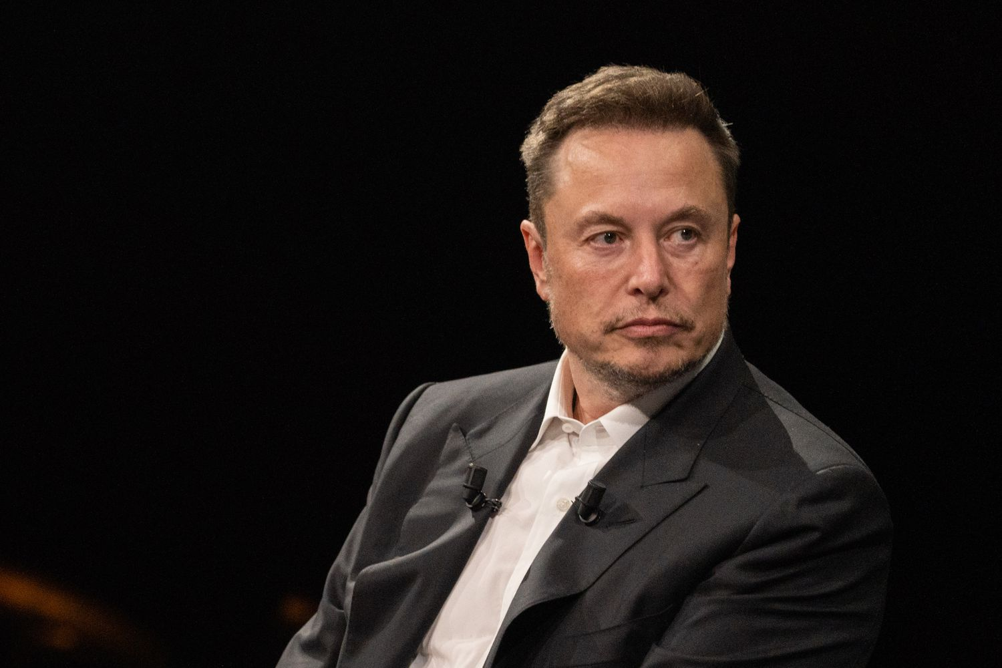
EXAMPLES:
Mark Zuckerberg
Co-Founder of Facebook
Elon Musk
CEO of Tesla Motors

Slide 10

ADOPTIVE OR IMITATIVE:
Imitative entrepreneurship refers to the process of creating a business by copying or adapting an existing concept or business model.
These entrepreneurs take an existing business idea, product, or service and replicate it.
This is often done with slight modifications in a different market or location.

Slide 11

FABIAN ENTREPRENEURS:
Fabian Entrepreneurs are characterized by their cautious approach to business, prioritizing stability and long-term sustainability over rapid growth.
They are risk-averse, preferring gradual innovation and relying on proven methods and thorough market research before making strategic decisions.

Slide 12
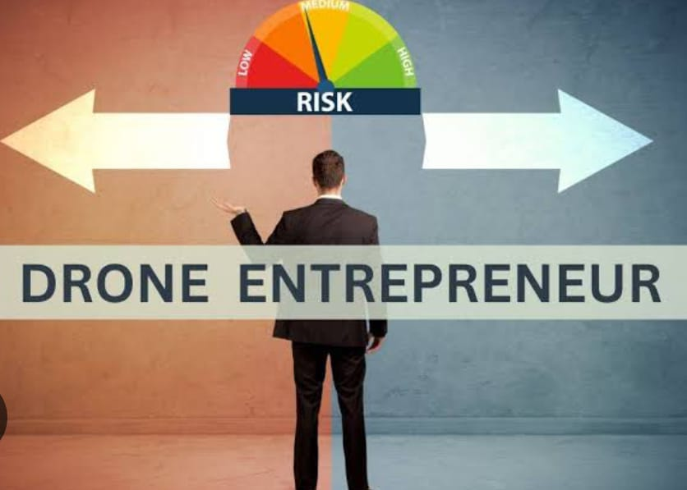
DRONE ENTREPRENEURS:
A “drone entrepreneur” is someone who sticks to traditional methods and resists the adoption of new technologies.
They prefer the comfort of familiar practices over the uncertainty of innovation.

Slide 13
ON THE BASIS OF MOTIVE, ENTREPRENEUR MAY CLASSIFIED INTO THREE TYPES:
Managing entrepreneurs who chief goal is security.
Innovating entrepreneur who want excitement.
Controlling entrepreneur who above all desire.

