Slide 1
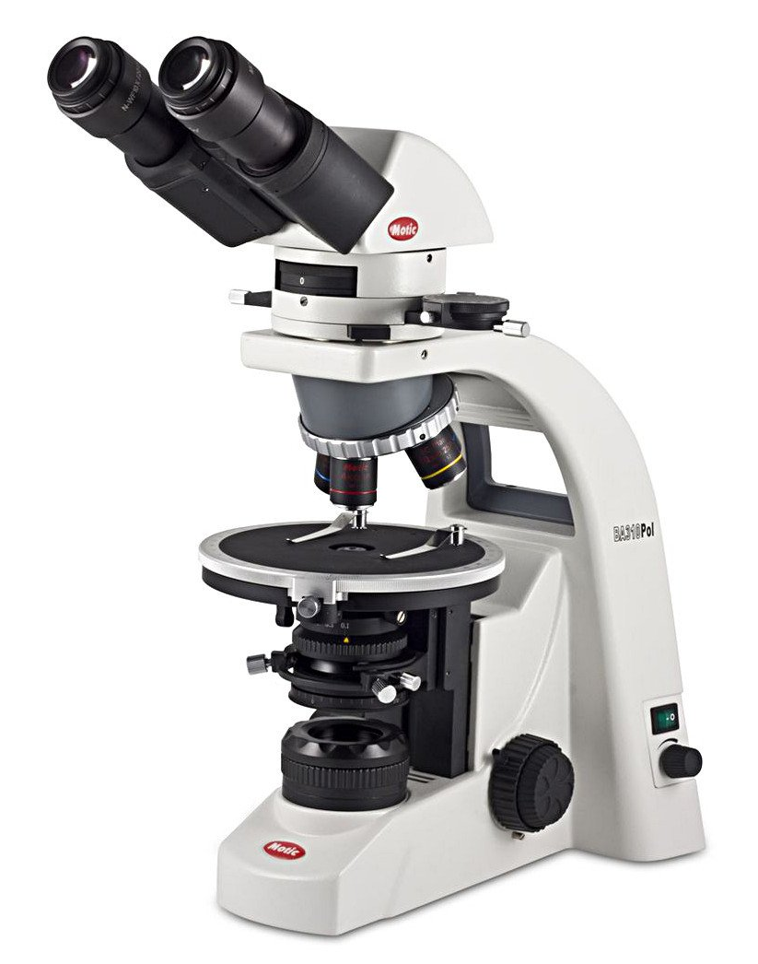
microscopy
Ms. A.Fasila Begum
Assistant Professor
Dept. of Microbiology
Jamal Mohamed College

Slide 2
Introduction
Microscopy is the technology of making very small things visible to naked eyes.
The science of investigating small objects using such an instrument is called microscopy.
MICROSCOPE – An instrument used to see objects that are too small for the naked eyes.
In 1590 H. Janssen and his son Z. Janssen developed first microscope.
A microscope (from the Ancient Greek: micro – small and scope – to look objects.

Slide 3
Microscopy has three purposes
To magnify the image
To achieve proper resolution of the object
To provide sufficient contrast for study in the object
The development of microscopes helps the microbiologists not only in study of morphology of mo’s. But also
      To obtain clarity
      To study the internal structure of microorganisms
      To measure the length and breath of microorganisms.

Slide 4
Terms and Definitions
Magnification
    The objective lens magnifies the specimen and produces a real image.
    Three objective lens are attached to the nose of the microscope.
    In lower power the magnification of the objective lens is 10x and the high power magnifying objective lens include 40x, 100x.
    The real image is produced by objective lens is further magnified by ocular lens and thereby, the real image is converted into virtual image. The image is seen by the observer.

Slide 5
Objective lens:
        Low power 10x
        High power 40x
        Oil immersion 100x
Ocular lens with the magnification power of 10x.
The total magnification of light microscope is calculated by multiplying the magnifying power of the objective lens and ocular lens.
Total magnification = Magnifying power of the objective lens X magnifying power of the ocular lens

Slide 6
Power | Objective lens | Eye piece | Total Magnification
Low | 10X | 10X | 100X
High (dry) | 40X | 10X | 400X
High (oil) | 100X | 10X | 1000X
Resolving power
Resolving power of the microscope is the ability to distinguish two adjacent point as separate.
The resolving power of microscope depends on two factors
The wavelength of light
The numerical aperture of the lens system.

Slide 7
The wave length of light is used in light microscopy is 400-750 nm.
The resolving power of human eye is 0.25mm.
The resolving power of light microscope is 0.25µm.
The electron microscope can separate dots that are o.5nm.
Resolving power = Wavelength of light in nm
2 x Numerical aperture of objective lens

Slide 8
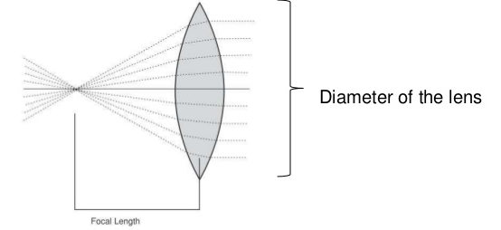
Numerical Aperture (NA)
Numerical aperture of lens is the ratio of the diameter of the lens to its focal local length.
NA can be decreased by decreasing the amount of light passes through a lens.
Greater the NA greater is the resolving power.
NA = n Sin θ/2
n – Refractive index of the medium
Sin θ = One half of the angle of light

Slide 9
Principle
Microscopy is to get a magnified image, in which structures may be resolved which could not be resolved with the help of unaided eye.
Principles and techniques of image formation
Following elements are always needed to form an image.
        Source of illumination
        Specimen to be observed
        The system of lenses or set of lenses
To illuminate the object light is necessary and its wavelength. It is also important in determining the resolution of microscope.

Slide 10
Classification
Based on the lens system
      Simple microscope
      Compound microscope
Based on the optical system
      Bright field microscope
      Dark field microscope
      Phase contrast microscope
      Fluorescent microscope
      Confocal microscope

Slide 11
Simple Microscope
Simple microscope is nothing but a single convex lens or a combination of more then one lens functioning like the single unit.
The superior quality lens can be constructed by combining two or more lenses into a single unit.
The magnifying unit of these type of microscope is 20X.

Slide 12
Compound Microscope
The modern microscope is generally called as the compound microscope.
A complex system arrangement of lenses that help in higher magnification and better resolution.
In its basic form, it consisted of two convex lenses aligned in a series: an objective lens closer to the specimen and an eyepiece (ocular) closer to the observer’s eye.
The compound microscope achieves a two stage magnification.

Slide 13
The objective projects a magnified image into a body tube of the microscope and the eyepiece further magnifies the image projected by the objective.
For example, the total visual magnification using a 10X objective and a 15X eyepiece is 150X.
Basically the modern microscope are in two types.
Light microscope – illumination through visible light
Electron microscope – source of illumination is a beam of electron.

Slide 14
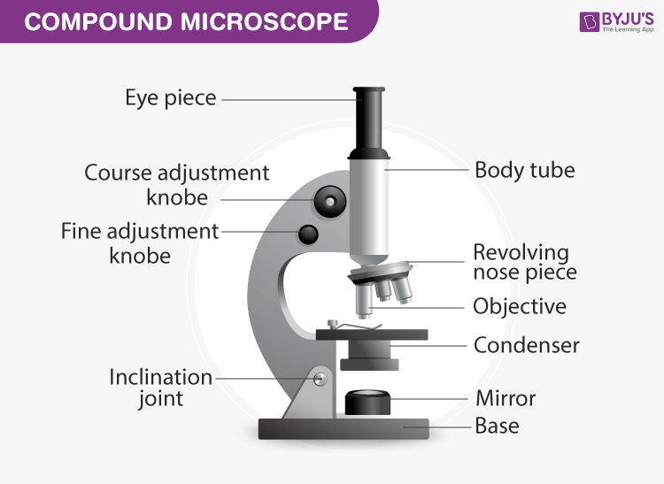
Parts of the compound Microscope

Slide 15
Bright Field Microscope
Bright field Microscope is also known as the Compound light microscope.
It is an optical microscope that uses light rays to produce a dark image against a bright background.
It is the standard microscope that is used in Biology, Cellular Biology, and Microbiological Laboratory studies.
This microscope is used to view fixed and live specimens, that have been stained with basic stains which gives a contrast between the image and the image background.
It is specially designed with magnifying glasses known as lenses that modify the specimen to produce an image seen through the eyepiece.

Slide 16
Principle
  For a specimen to be the focus and produce an image under the Brightfield Microscope, the specimen must pass through a uniform beam of the illuminating light.
  Through differential absorption and differential refraction, the microscope will produce a contrasting image.
  The functioning of the microscope is based on its ability to produce a high-resolution image from an adequately provided light source, focused on the image, producing a high-quality image.

Slide 17
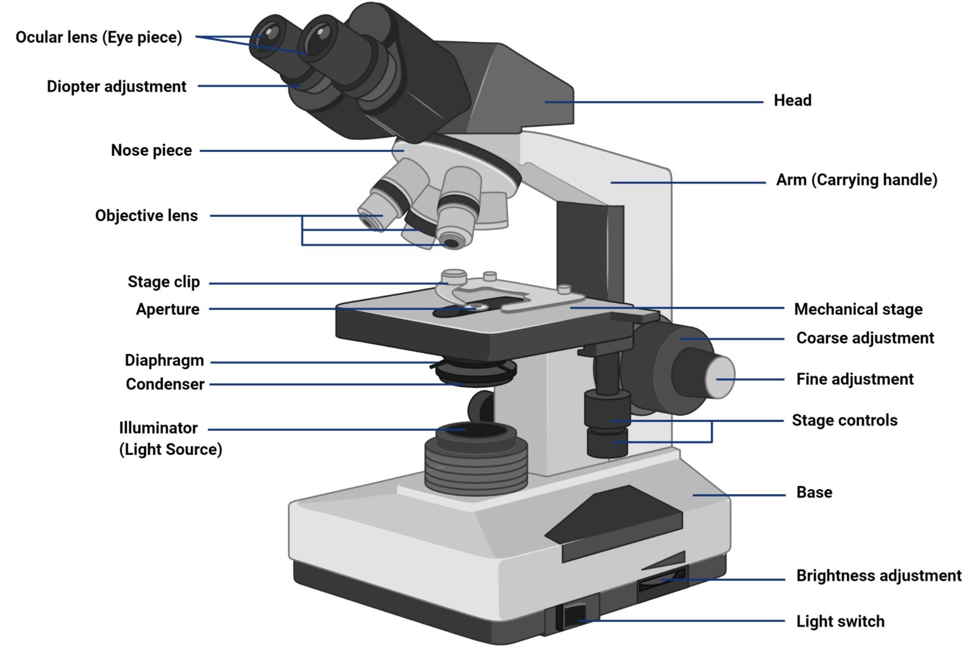
Parts of the Bright field microscope

Slide 18
The brightfield microscope is made up of various parts, including:
Eyepiece (Ocular lens) – it has two eyepiece lenses at the top of the microscope which focuses the image from the objective lenses. this is where you see the formed image from, with your eyes.
The objective lenses which are made up of six or more glass lenses, which make a clear image clear from the specimen or the object that is being focused.
Two adjusting knobs - the fine adjustment knob and the coarse adjustment knob, found on the microscopes’ arm, which can move the stage or the nosepiece to focus on the image. Their function is to ensure the production of a sharp image with clarity.

Slide 19
The stage is found just below the objectives and this is where the specimen is placed, allowing movement of the specimen around for better viewing with the flexible knobs and it is where the light is focused on.
The condenser: It is mounted below the stage which focuses a beam of light onto the specimen. It can be fixed or movable, to adjust the quality of light, but this entirely depends on the microscope.
The arm: This is a sturdy metallic backbone of the microscope, used to carry and move the microscope from one place to another. They also hold the microscope base which is the stand of the microscope. The arm and the base hold all the microscopic parts.
It has a light illuminator or a mirror found at the base or on the microscope’s nosepiece.

Slide 20
The nosepiece has about two to five objective lenses with different magnifying power. It can move round to any position depending on the objective lens to focus on the image.
An aperture diaphragm (contrast): It controls the diameter of the beam of light that passes through the condenser. When the condenser is almost closed, the light comes through to the centre of the condenser creating high contrast and when the condenser is widely open, the image is very bright with very low contrast.

Slide 21
Applications of Bright field microscope
Brightfield Microscope is used in several fields, from basic biology to understanding cell structures in cell Biology, Microbiology, Bacteriology to visualizing parasitic organisms in Parasitology.
Most of the specimens to viewed are stained using special staining to enable visualization. Some of the staining techniques used include Negative staining and Gram staining.
Some of its applications include:
Used to visualize and study the animal cells
Used to visualize and study plant cells.
Used to visualize and study the morphologies of bacterial cells.
Used to identify parasitic protozoans such as Paramecium.

Slide 22
Advantages
It is simple to use with few adjustments involved while viewing the image.
It can be used to view both stained and unstained.
The optics of the microscope do not alter the color of the specimen.
Disadvantages
The aperture diaphragm may cause great contrast which may distort the outcome of the image, therefore iris diaphragm is preferred.
It can not be used to view live specimens such as bacterial cells. Only fixed specimens can be viewed under the brightfield microscope.
Staining may introduce extraneously unwanted details into the specimen or contaminate the specimen.
It is tedious to stain the specimen before visualizing it under the brightfield microscope.

Slide 23
Dark Field Microscope
Dark-field microscopy is ideally used to illuminate unstained samples causing them to appear brightly lit against a dark background.
This type of microscope contains a special condenser that scatters light and causes it to reflect off the specimen at an angle.
Rather than illuminating the sample with a filled cone of light, the condenser is designed to form a hollow cone of light.
The light at the apex of the cone is focused at the plane of the specimen; as this light moves past the specimen plane it spreads again into a hollow cone.
The objective lens sits in the dark hollow of this cone; although the light travels around and past the objective lens, no rays enter it.

Slide 24
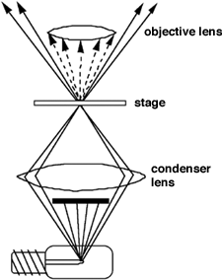
Living specimens may be observed more readily with dark field than with bright field microscopy.
Principle
To view a specimen in dark field, an opaque disc is placed underneath the condenser lens, so that only light that is scattered by objects on the slide can reach the eye.
Instead of coming up through the specimen, the light is reflected by particles on the slide.
Everything is visible regardless of color, usually bright white against a dark background.
The dark-field condenser with a central circular stop, which illuminates the object with a cone of light, is the most essential part of the dark-ground microscope.

Slide 25
This microscope uses reflected light instead of transmitted light used in the ordinary light microscope.
It prevents light from falling directly on the objective lens.
Light rays falling on the object are reflected or scattered onto the objective lens with the result that the microorganisms appear brightly stained against a dark background.
Uses
It is useful for the demonstration of very thin bacteria not visible under ordinary illumination since the reflection of the light makes them appear larger.
This is a frequently used method for rapid demonstration of Treponema pallidum in clinical specimens.

Slide 26
It is also useful for the demonstration of the motility of flagellated bacteria and protozoa.
Dark field is used to study marine organisms such as algae, plankton, diatoms, insects, hairs, yeast and protozoa as well as some minerals and crystals, thin polymers and some ceramics.
Advantages
Dark-field microscopy is a very simple yet effective technique.
It is well suited for uses involving live and unstained biological samples, such as a smear from a tissue culture or individual, water-borne, single-celled organisms.
A researcher can achieve a dark field by making modifications to his/her microscope.

Slide 27
Disadvantages
The main limitation of dark-field microscopy is the low light levels seen in the final image.
The sample must be very strongly illuminated, which can cause damage to the sample.

Slide 28
Phase Contrast Microscope
It is used to visualize unstained living cells. Most of the stains or staining procedures will kill the cells.
Phase contrast microscopy enables the visualization of living cells and live events.
It was developed by Zernike in early 1934. For this contribution he was awarded with Nobel Prize in 1953.
Principle
Small phase changes in light rays, induced by differences in the thickness and refractive index of the different parts of an object can be transformed into differences in brightness or light intensity.

Slide 29
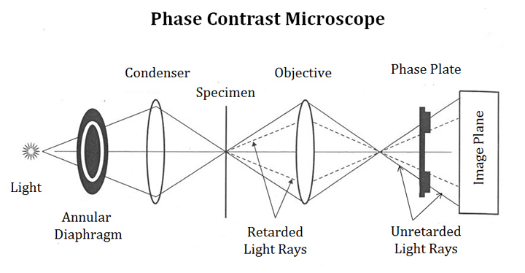
When light passes through cells, small phase shifts occur, which are invisible to the human eye.
In a phase-contrast microscope, these phase shifts are converted into changes in amplitude, which can be observed as differences in image contrast.

Slide 30
Components of Phase Contrast Microscope
Phase contrast microscope is similar to an ordinary microscope in its optical composition.
Similar to normal microscope, it possess a light source, condenser system, objective lens system and ocular lens system.
A phase contrast microscope differs from normal microscope in having two additional components:
Sub stage Annular Diaphragm
Phase plate
Sub-stage annular diaphragm
It is located below the sub stage condenser of the microscope. It helps to create a narrow, hollow cone of light to illuminate the object.

Slide 31
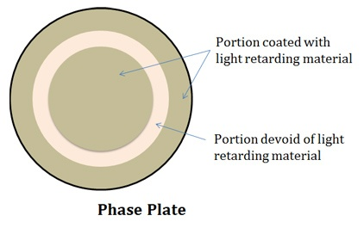
Phase plate
It is also called as diffraction plate or phase retardation plate. It is located at the back focal plane of the objective lens. The phase retarding components are coated on this plate. The phase plate is a transparent glass disc with one or few channels. The channel is coated with a material that can absorb light but cannot retard it. The other portion (other than channel) of the phase plate is coated with light retarding material such as magnesium fluoride. Phase plate reduces the phase of the incident light.

Slide 32
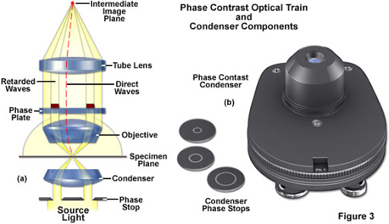
Light pathways in Phase Contrast Microscope

Slide 33
When the light pass through an unstained cell, it encounters regions in the cell with different refractive indexes and thickness.
When light rays pass through an area of high refractive index, it deviates from its normal path and such a light ray experiences phase change or retardation.
Light rays pass through the area of less refractive index remain undeviated (no phase change).
Applications
PCM enables the visualization of living cells.
It enables the visualization of unstained cells.
PCM can be used to view various cell organelles (mitochondria, nucleus, vacuole, etc.)

Slide 34
Helps to study the cellular events like cell division, cell lysis, phagocytosis, etc.
Used to visualize all type of cellular movements such as chromosomal or flagellar movements.
Enable the study of membrane permeability of cells and different organelles.
Advantages
Living cells can be observed in their natural state without previous fixation or labelling.
It makes a highly transparent object more visible.
No special preparation of fixation or staining etc. is needed to study an object under a phase-contrast microscope which saves a lot of time.

Slide 35
Limitations
Phase-contrast condensers and objective lenses add considerable cost to a microscope, and so phase contrast is often not used in teaching labs except perhaps in classes in the health professions.
To use phase-contrast the light path must be aligned.
Generally, more light is needed for phase contrast than for corresponding bright-field viewing, since the technique is based on the diminishment of the brightness of most objects.

Slide 36
Fluorescence Microscope
A fluorescence microscope is an optical microscope that uses fluorescence and phosphorescence instead of, or in addition to, reflection and absorption to study properties of organic or inorganic substances.
Fluorescence is the emission of light by a substance that has absorbed light or other electromagnetic radiation.
Phosphorescence is a specific type of photoluminescence related to fluorescence. Unlike fluorescence, a phosphorescent material does not immediately re-emit the radiation it absorbs.
The fluorescence microscope was devised in the early part of the twentieth century by August Köhler and his team.

Slide 37
When light is passed through some object, the object absorbs the light and re emit light with longer wavelength. This phenomenon is known as luminescence.
Like wise many chemicals absorbs light with shorter wavelength and emit light with longer wavelength. This phenomenon is termed as fluorescence.
Fluorescence is two types
        Auto fluorescence
        Secondary fluorescence
The substance which fluorescence by themselves are termed as Auto fluorescence. But when they combined with fluorescence light they fluorescence immediately and that type of substances are termed as secondary fluorescence.

Slide 38
Working Principle
In this case of microscope the source of light is either Mercury arc lamp or Xenon arc lamp.
In addition to objective and ocular lens the two special filters are used. They are
      Source or Exciter filter
      Barrier or Emission or Complementary filter
Source filter
This filter is placed between the source of mercury lamp and dichromatic mirror . This filter allows only the UV light to illuminate the specimen because the source may consists of visible light in addition with UV light.

Slide 39
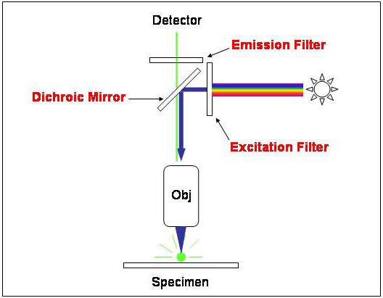
2. Barrier or Emission or Complementary filter
This filter is fitted in front of the eye piece. This filter is provided to filter the UV light residue which are not absorbed by the specimen. This is a safety filter for protecting our eyes from hazardous UV light.

Slide 40
Special feature of Fluorescence Microscope
The high intensity mercury lamp is used as the light source.
The excited filter transmits only blue light to the specimen and blocks out all other color.
The blue light is reflected downwards to the specimen by Dichromatic mirror (which reflects light of one colour but transmits light of another color).
The specimen is stained with fluorescent dye.
The stained potion absorbs blue light and emit green light which travels upward and penetrates the dichromatic mirror and reaches the barrier or emission filter.

Slide 41
This filter allows only the green light to pass the eye. However it blocks out any residual blue light from the specimen.
The stained portion of the specimen has glowing green against the black background.
The object or specimen appear bright against the dark background.
Applications
To identify structures in fixed and live biological samples.
Fluorescence microscopy is a common tool for today’s life science research because it allows the use of multicolor staining, labelling of structures within cells, and the measurement of the physiological state of a cell.

Slide 42
Advantages
Fluorescence microscopy is the most popular method for studying the dynamic behavior exhibited in live-cell imaging.
The sensitivity is high enough to detect as few as 50 molecules per cubic micrometer.
Different molecules can now be stained with different colors, allowing multiple types of the molecule to be tracked simultaneously.
These factors combine to give fluorescence microscopy a clear advantage over other optical imaging techniques, for both in vitro and in vivo imaging.

Slide 43
Disadvantages
Cells are susceptible to phototoxicity, particularly with short-wavelength light. Furthermore, fluorescent molecules have a tendency to generate reactive chemical species when under illumination which enhances the phototoxic effect.
Unlike transmitted and reflected light microscopy techniques fluorescence microscopy only allows observation of the specific structures which have been labeled for fluorescence.

Slide 44
Electron microscope

Slide 45
Introduction
Electron microscopy uses electron beam and magnetic field to produce the image.
It produce tremendous magnification, because of the extremely short wavelength electron beam used to magnify the specimen.
With electron microscope it is possible to resolve objects as small as ion.
The resolving power of the EM is 100 times greater than the light microscope.
It gives a magnification of 2000 times greater than light microscope.

Slide 46
It is much useful in studying virus, bacteria and the ultrastructure of cell organelles.
The first Electron Microscope was designed by Knoll and Ruska in 1932.
There are two types of electron microscope
      Transmission Electron Microscope (TEM)
      Scanning Electron Microscope (SEM)
In TEM, the electron beam is transmitted through the ultra thin object
In SEM, the electron beam scans the surface of the object and conveys its image to a TV screen.

Slide 47

Principle
In EM, an electron beam is used as illumination.
The wavelength of electron beam is very short (0.05Å to 0.005 nm).
The electron beam is produced by a filament heated by high voltage.
The electrons are collected and focussed on the object by electromagnetic coils.
The electrons are scattered differentially by constituent atoms of the object (specimen).
Those electrons passing through the object are collected and focussed by electromagnetic coils to form an image

Slide 48
The image is magnified by the electromagnetic projector coil which forms the final image of the object on photographic screen or film.
The photograph thus formed is called an electromicrograph.
The focussing of the image can be adjusted by changing the current in the projector coil.
The entire system is kept in a vacuum tube because the electrons can move in straight line only in vacuum.
EM can magnify the size of the object to 30,00,000 times.
The resolution power is also high.

Slide 49
Parts of the Electron Microscope
      Electron Gun
      Electromagnetic lenses
      Object
      Objective coil
      Amplifier coil
      Fluorescent screen
      Vacuum tube
      Cooling system

Slide 50
Electron Gun
The electron gun is a heated tungsten filament, which generates electrons.
It is the source of illumination.
Electromagnetic lenses
Condenser lens focuses the electron beam on the specimen. A second condenser lens forms the electrons into a thin tight beam.
The electron beam coming out of the specimen passes down the second of magnetic coils called the objective lens, which has high power and forms the intermediate magnified image.
The third set of magnetic lenses called projector (ocular) lenses produce the final further magnified image.
Each of these lenses acts as an image magnifier all the while maintaining an incredible level of detail and resolution.

Slide 51
Object
The object is placed below the second condenser lens in the focal length of the beam.
The object is placed on a supporting film mounted on a copper grid.
Objective coil
It is another electromagnetic coil, situated below the object.
It captures the transmitted electrons from the object and magnifies the image.
Amplifier coil
It amplifies the final image produced by the objective coil

Slide 52
Projector Coil
It projects the final image on the screen.
Fluorescent Screen
It receives the final image of the object.
Vacuum Tube
The entire set-up is placed in a vacuum tube, because the electrons move in a straight line only in vacuum.
Cooling system
Moderately large current is flowing through the electromagnetic coils.
So the coils get heated.
The coils are cooled by water circulating around the vacuum tube.

Slide 53
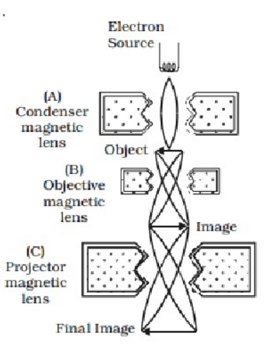
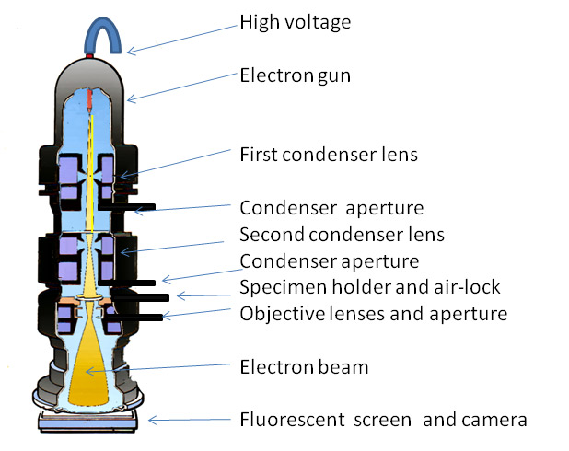
Electron Microscope

Slide 54
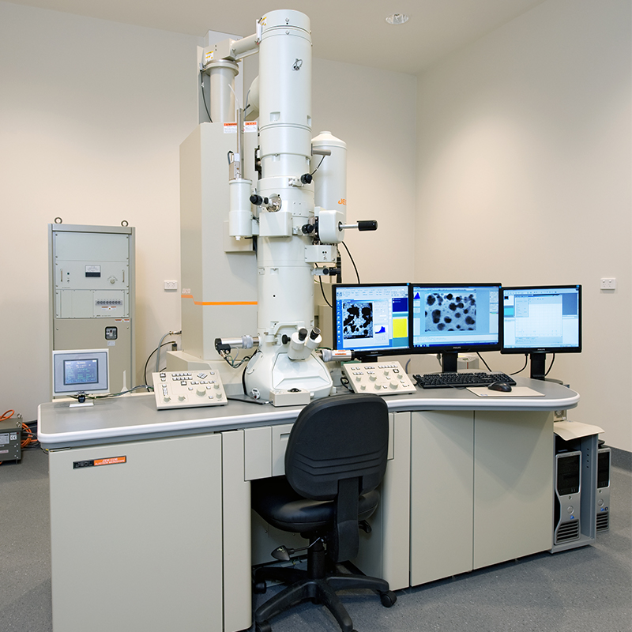
Transmission Electron Microscope

Slide 55
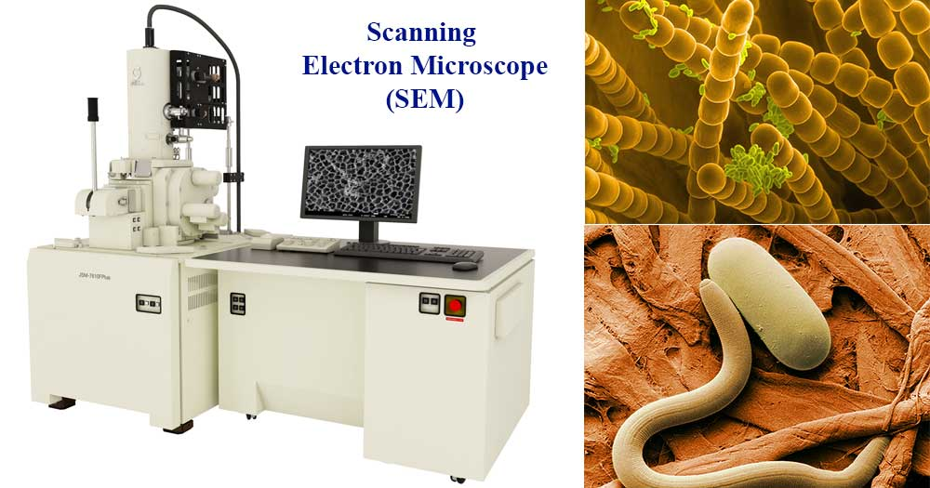
Scanning electron microscope

Slide 56
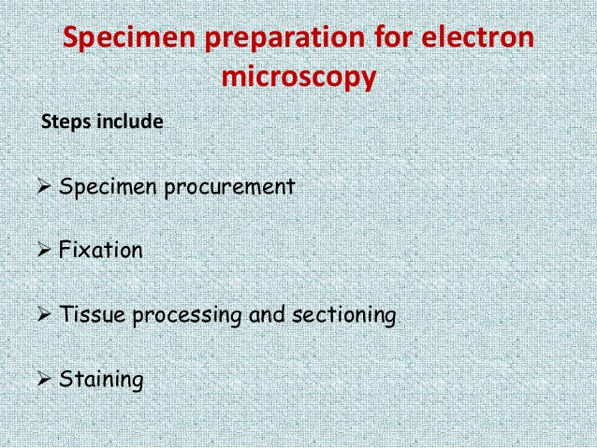

Slide 57


Slide 58
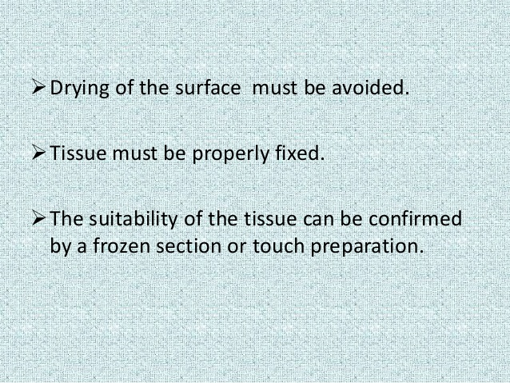

Slide 59
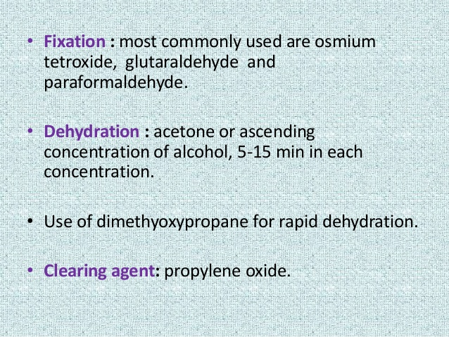

Slide 60
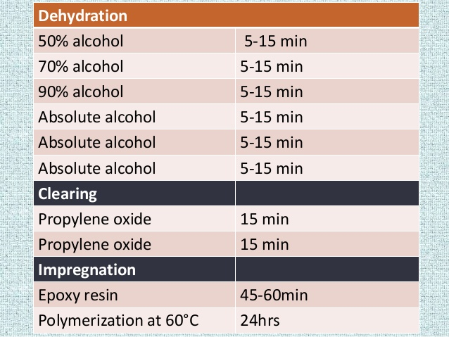

Slide 61
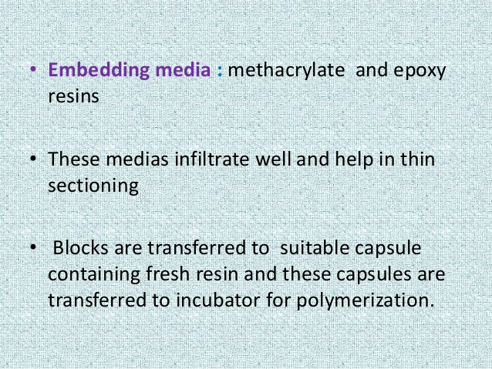

Slide 62
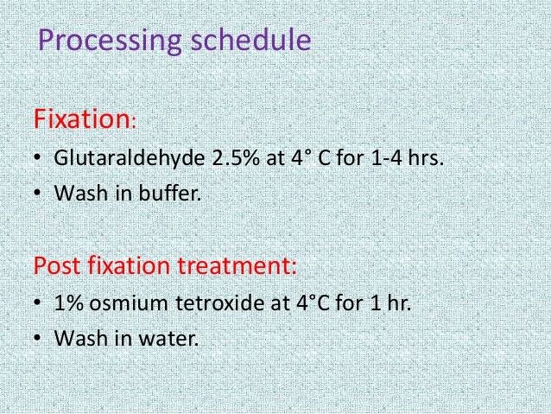

Slide 63
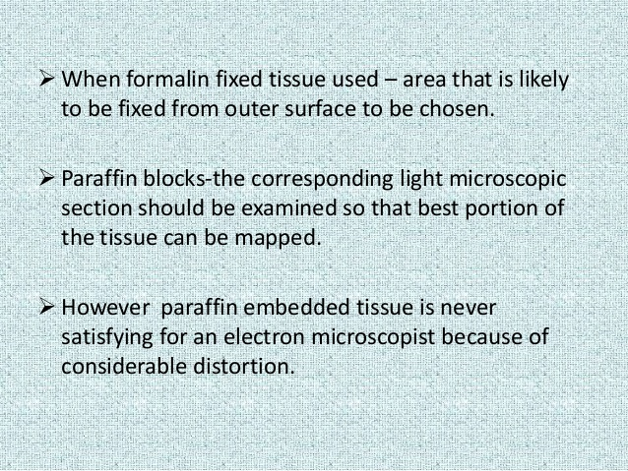

Slide 64
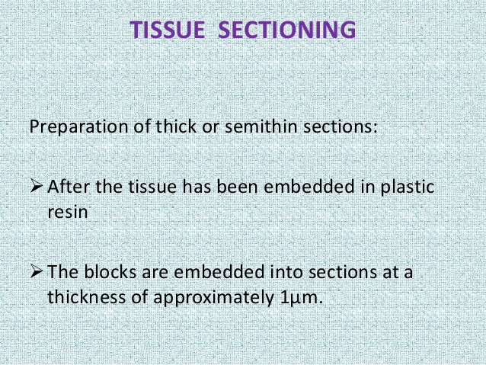

Slide 65
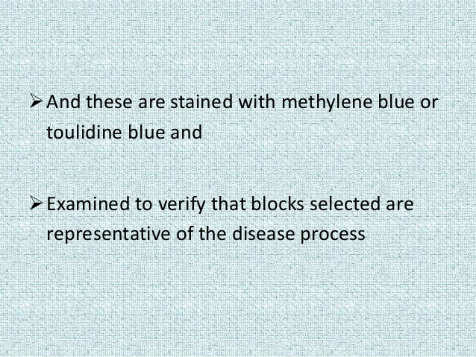

Slide 66
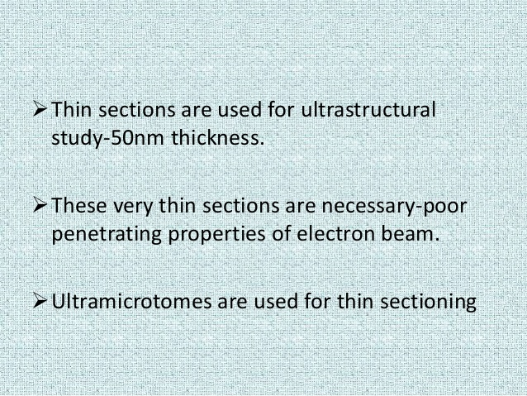

Slide 67


