Slide 1
G.L. CHRISTINA MARTHA
Assistant professor
Department of English
Jamal Mohamed college
Poem : A POISON TREE BY WILLIAM BLAKE
Poetry and Drama UG

Slide 2
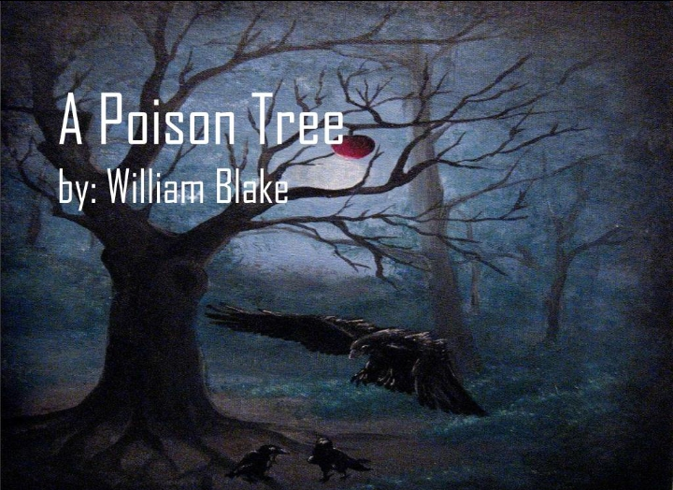
A POISON TREE
Presented by GL.Christina Martha
Presented by GL.Christina Martha

Slide 3
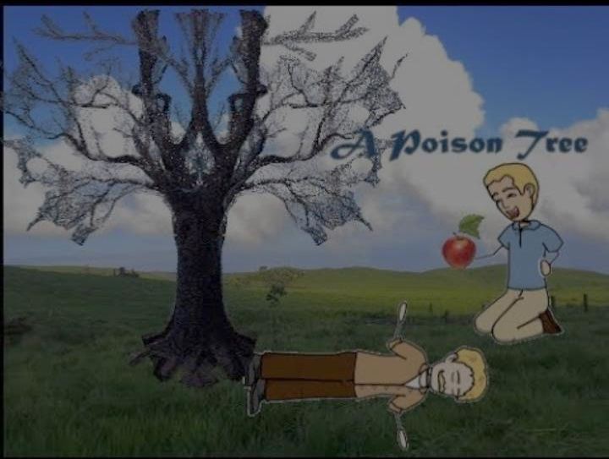
I Was angry with my friend:
I told my wrath, my wrath did end.
I was angry with my foe:
I told it not, my wrath did grow.
And I watered it in fears
Night and morning with my tears,
And I sunned it with smiles
And with soft deceitful wiles.
And it grew both day and night,
Till it bore an apple bright,
And my foe beheld it shine,
And he knew that it was mine,--
And into my garden stole
When the night had veiled the pole;
In the morning, glad, I see
My foe outstretched beneath the tree.

Slide 4
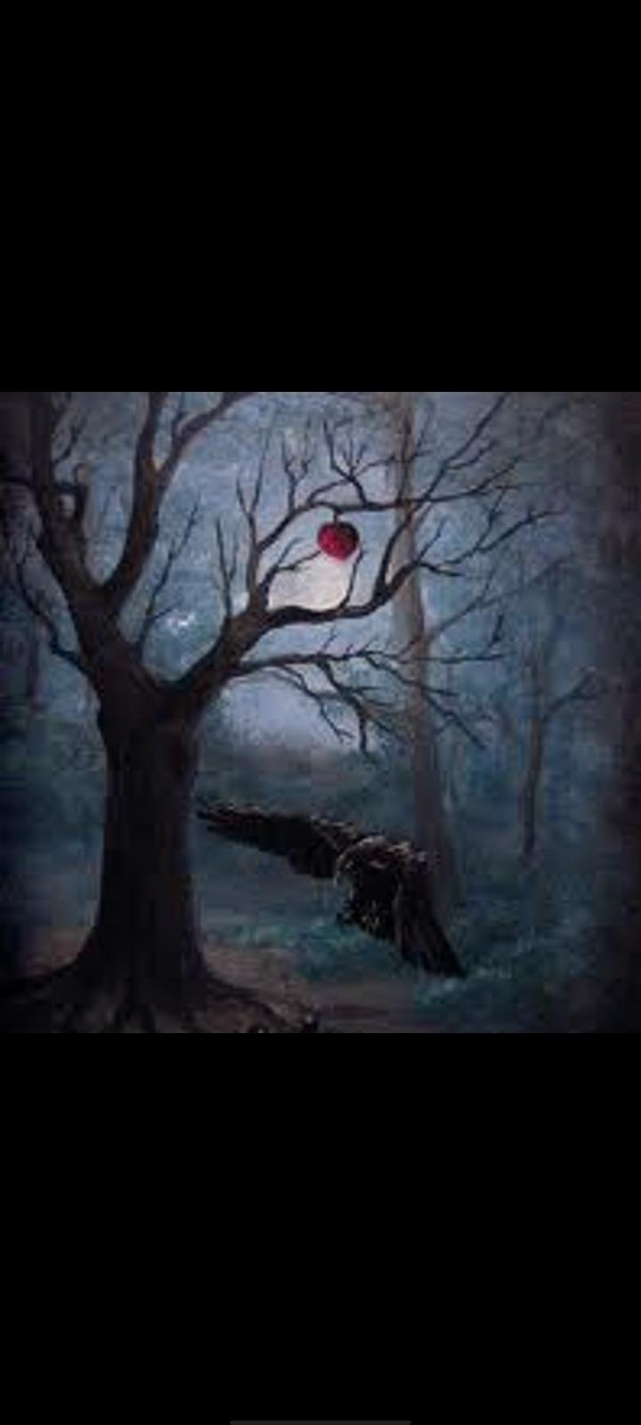
Introduction of author William Blake
William Blake was an english religious poet. He was born in London, England on 22th November 1757. Blake was not only an english poet, but a visionary poet of all ages. He lived during Romantic age and his works deplict the age of that time. His work does not get fame during his life but later on he tuned out to be a visionary poet of all the ages.
He was against race discrimination and wrote for the equal rights. He also raised child labour issues in his writings and other major issues of his ages in his poetry songs of innocent and of experience is a collection of illustrated poems by william Blake.

Slide 5

The songs of innocence dramatize the native hopes and fears thatinform the lives of the children and trace their tranformation as the child grows into adult hood . As it makes the Phychological passage from childhood innocence to adults experience.

Slide 6
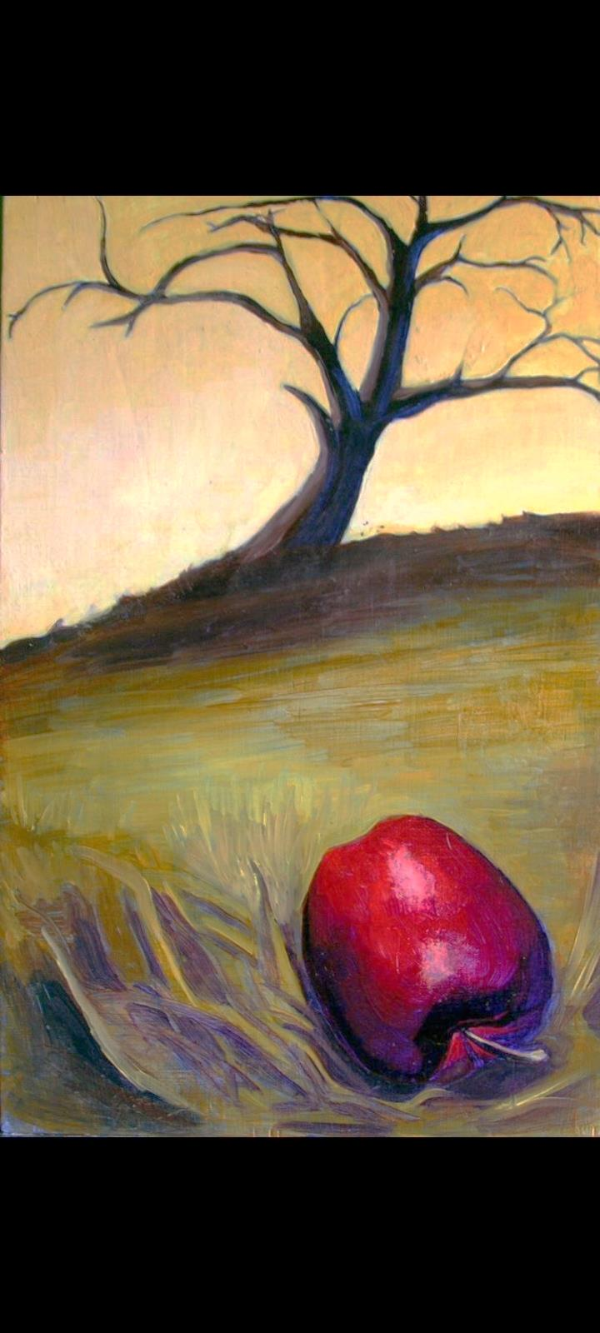

Introduction To a Poison Tree
A poison tree is a short poem and one of the most appreciated works of william Blake.Initally,this poem was published in his colletion of “SONGS OF EXPERIENCE” In the year 1794. A poison Tree is a descriptive poem that depicts human emotions and their consequences. This poem was published with the title “A Poison Tree “ in 1830 in the london university Magazine. Although Christian forbearance was its original title and Later on it was changed to reflect better throughts of the poet

Slide 7

A poison Tree is about the hatred and corrupted effects of anger towars others. In the poem Blake shares his experience with us that once he was angry with one of his friends and told him about the matter of annoyance. Consequently, the anger vanished away and both become friends again.
In contract, he tells that once he was angry over his enemy but he never told him about the matter, the anger kept growing in his mind against enemy and forced him to keep it hidden from his enemy.

