Slide 1
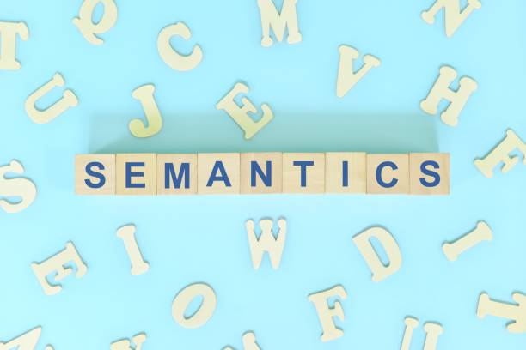
Presented by
Ms. A. FAMITHA BANU M.A., PGDCA, M.Phil., NET, SET
Associate Professor of English (SF-Women)
Jamal Mohamed College (Autonomous)
Trichy – 620020.

Slide 2
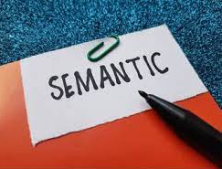
Definition of Semantics
Semantics studies how meaning is constructed, interpreted, clarified, obscured, illustrated and negotiated.
Explores meanings across words, phrases, sentences and even entire texts.
Differentiates literal meanings from figurative or contextual meanings.

Slide 3
Importance of Semantics
Helps in avoiding misunderstandings in daily communication, academia and translation.
Supports development in artificial intelligence and machine learning for language processing.
Provides insights into cultural perspectives and social relationships within languages.

Slide 4
Basic concepts in Semantics
Meaning: Central focus of semantics; can be direct or abstract.
Reference: How language elements relate to real or imaginary world entities.
Sense: Defines a word’s meaning based on its relationship with other words in a language.

Slide 5
Types of Meaning
Lexical Meaning: Core or dictionary meaning of individual words.
Sentence Meaning: How word order, syntax and grammar contribute to meaning.
Pragmatic Meaning: How social, cultural and situational factors impact interpretation.

Slide 6
Lexical Semantics
Studies word meanings, origins and evolutions.
Includes word relations (synonyms, antonyms) and word categories (concrete vs. abstract).
Investigates semantic changes, such as shifts, broadening or narrowing of meanings over time.

Slide 7
Sentence Semantics
Meaning of a sentence derived from individual words and their arrangement.
Examines how modifiers, qualifiers and clauses alter sentence interpretation.
Analyses how syntactic structure supports or changes the intended meaning.

Slide 8
Pragmatics vs. Semantics
Semantics: Deals with literal meanings without context.
Pragmatics: Considers social norms, context, tone and speaker intent.
Examples: How “Can you pass the salt?” could mean a request rather than a question.

Slide 9
Semantic Roles (Thematic Roles)
Agent: Entity performing an action
(e.g. “The dog chased the cat”).
Patient/Theme: Entity affected by the action
(e.g. “The cat” in “The dog chased the cat”).
Experiencer: Entity receiving sensory information
(e.g. “She” in “She felt cold”).

Slide 10
Sense Relations
Synonymy: Similar meaning words
(e.g. “happy” and “joyful”).
Antonymy: Opposite meanings
(e.g. “dark” vs. “light”).
Hyponymy: Relationship where a term is a type of a broader term
(e.g. “rose” is a hyponym of “flower”).
Meronymy: Part-to-whole relationship
(e.g. “wheel” as part of “car”).

Slide 11
Polysemy and Homonymy
Polysemy: Single word with multiple related meanings
(e.g. “light” for brightness or weight).
Homonymy: Same spelling/word form with unrelated meanings
(e.g. “bat” as animal vs. sports tool).
Helps illustrate challenges in translation and language processing.

Slide 12
Ambiguity in Semantics
Lexical Ambiguity: Word with multiple possible interpretations
(e.g. "pen" as writing instrument vs. animal enclosure).
Structural Ambiguity: Ambiguity in sentence structure
(e.g. "Visiting relatives can be annoying").
Ambiguity reveals complexity in sentence structure and contextual dependence in language.

Slide 13
Prototype Theory
Theory of how we categorize based on typical examples rather than strict definitions.
Prototype: Ideal example that defines a category
(e.g. “robin” as a prototype for “bird”).
Explains why some items are seen as "better" examples of a category than others.

Slide 14
Denotation and Connotation
Denotation: Exact, dictionary definition of a word without emotional or cultural influences.
Connotation: Additional cultural, emotional, or personal associations beyond the literal meaning.
Examples: “Snake” denotes a reptile but connotes danger or deceit in some cultures.

Slide 15
Compositional Semantics
Principle of Compositionality: Sentence meaning is derived from individual word meanings and structure.
Important in language construction and understanding idioms, metaphors and phrases.
Helps analyse complex sentences by examining how each word contributes to overall meaning.

Slide 16
Semantic Analysis Techniques
Componential Analysis: Breaking down words into defining semantic features
(e.g. “girl” = [+human, +female, -adult]).
Semantic Field Analysis: Grouping words within a similar domain
(e.g. words related to “weather”).
Distributional Analysis: Studying words through their use in different contexts.

Slide 17
Syntax vs. Semantics
Syntax: Rules for structuring sentences and phrases; does not always convey meaning directly.
Semantics: Interprets the meaning of those syntactically arranged words.
Example: Syntax forms a sentence structure; semantics gives it an I interpretable meaning.

Slide 18
Applications of Semantics
Translation: Ensures words convey equivalent meanings across languages.
NLP (Natural Language Processing): Enhances machine interpretation of human language.
Linguistic Research: Improves understanding of language evolution, cultural influence, and meaning variation.

Slide 19
Examples of Semantic Analysis
Idioms: Non-literal phrases with unique meanings
(e.g. “spill the beans” means “reveal a secret”).
Metaphors and Similes: Compare ideas symbolically
(e.g. “Time is a thief”).
Collocations: Common word pairings that carry specific meanings
(e.g. “heavy rain” vs. “strong rain”).

Slide 20
Conclusion
Semantics is a core element in understanding language and effective communication.
Links linguistic structure with cultural and situational meanings.
Continues to influence areas like technology, translation, linguistics and communication studies.

Slide 21


