Slide 1
FERMENTATION MEDIA FORMULATION STRATERGIES
PRESENT BY
Dr.N.PACKIALAKSHMI
ASSISTANT PROFESSOR
DEPARTMENT OF MICROBIOLOGY
JAMAL MOHAMED COLLEGE - TRICHY

Slide 2
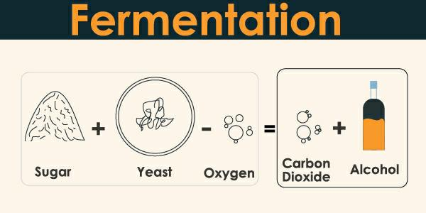
INTRODUCTION
Fermentation is a metabolic process that produces chemical changes in organic substrates through the action of enzymes. In biochemistry, it is narrowly defined as the extraction of energy from carbohydrates in the absence of oxygen.

Slide 3
MEDIA FORMULATION
Fermentation technology is widely used for the production of various economically important compounds which have applications in the energy production, pharmaceutical, chemical and food industry.
Although, fermentation processes are used from generations, the need for sustainable production of products, meet the market requirements in a cost effective manner has put forward a challenging demand.
For any fermentation based product, the most important thing is the availability of fermented product equal to that of market demand.
Various microorganisms have been reported to produce an array of primary and secondary metabolites, but in a very low quantity.
In order to meet the market demand, several high yielding techniques have been discovered in the past, and successfully implemented in various processes, like production of primary or secondary metabolites, biotransformation, oil extraction etc.

Slide 4
Nutritional Control of Metabolite Production
Fermented products that are used in our daily life are either primary or secondary metabolites produced during the trophophase and idiophase of the microbial growth, respectively.
High productivity titer is the pre-requisite for the industrial production of any type of metabolite.
The production of specific metabolites in high titer could be possible by maintaining proper control and regulation at different levels via transport and metabolism of extra-cellular nutrients, precursor formation and accumulation of intermediates

Slide 5
CARBON
Carbon is the most important medium component, as it is an energy source for the microorganisms and plays an important role in the growth as well as in the production of primary and secondary metabolite.
The rate at which the carbon source is metabolized can often influence the formation of biomass and/or the production of primary or secondary metabolites

Slide 6
CARBON
Simple to complex carbohydrates can be added to media as a source of carbon. We can add different sugars like mannitol, sorbitol, organic acids, fatty acids, proteins, peptides we can choose any of these as a source of carbon.
The selection of carbon source depends upon the availability as well as the cost of raw material. In most of the fermentation media, crude source of carbon is added.
Simple carbohydrates – simple sugars are semi purified polysaccharides and sugar alcohol are added. Sources of simple carbohydrates are Black strap molasses, Corn molasses, Beet molasses, sulphite waste liquor, Hydrol (corn sugar molasses), Cannery waste.

Slide 7
Complex carbohydrates – Source of complex carbohydrates are Starch, Corn, Rice, Rye, Milo, wheat potatoes etc. Source of starch cellulose are corn cobs, straws, wood waste, saw meal etc.
Marwick et al. (1999), while studying antibiotics production from marine bacteria noticed that the gradually assimilating carbon sources, like, galactose generally enhances the production of secondary metabolites (antibiotics).

Slide 8
NITROGEN
Like carbon, the selection of nitrogen source and its concentration in the media also play a crucial role in metabolite production. The microorganism can utilize both inorganic and/or organic sources of nitrogen.
Use of specific amino acids can increase the productivity in some cases and conversely, unsuitable amino acids may inhibit the synthesis of secondary metabolites

Slide 9
NITROGEN
Salts of urea, ammonia, and nitrate can be used as a nitrogen source.
When fermentation organisms are non-proteolytic in nature, pure form of urea, ammonia and nitrate are used as a source of nitrogen.
When fermentation organisms are proteolytic in nature, animal and plant raw material is used; like distillery dried solubles, Casein, Cereal grains, peptones, yeast extract, hydrolysate, and soybean meal etc.

Slide 10
USES:
There are two uses of fermentation media
Growth media
Fermentation media
Growth medium contains low amounts of nutrients.It is useful in creating raw material for further fermentation processes.
Fermentation media contains high amounts of nutrients. It is used in creating final products using fermentation.

Slide 11
THANK YOU !

