Slide 1
Branches of Economics

Slide 2
Studies individual economic units like households, firms, and markets.

Slide 3


Slide 4

Analyzes the role of money, banking, and monetary policy in the economy.

Slide 5

Explores how financial markets, institutions, and instruments affect economic decisions.

Slide 6

Investigates trade, finance, and investment between nations.

Slide 7

Examines government revenue, expenditure, and budget policies.

Slide 8

Studies the structure, behavior, and performance of firms and industries.

Slide 9

Examines the labour market, wages, employment, and labour laws.

Slide 10

Applies economic principles to business decision-making and strategy.

Slide 11
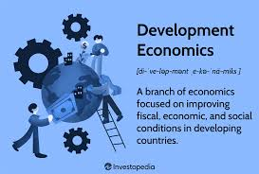

Slide 12

Analyzes the economic impact of environmental policies and resource management.

Slide 13
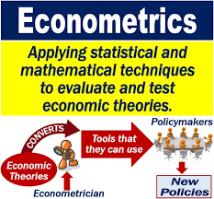

Slide 14
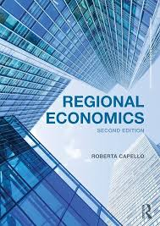
Examines economic growth, development, and policy at the regional level.

