Slide 1
Generation Time
Dr. N.Reehana
Asst. Prof- Microbiology
PG & Research Dept. of Microbiology
Jamal Mohamed College (Autonomous)
Tiruchirappalli – 620 020

Slide 2
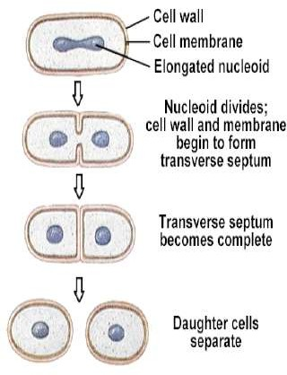
Generation Time (Doubling time)
What Time?
The time required for a
is Generation
cell to divide (and its population to double) is called the generation time
As you
seen in the picture, cell’s division
produces two cells, two cells’ divisions produce four cells, and so on.

Slide 3
The Mathematics of Growth
Generation (doubling) time
  time required for the population to double in size
  varies depending on species of microorganism and environmental conditions
  range is from 10 minutes for some bacteria to several days for some eukaryotic microorganisms

Slide 4
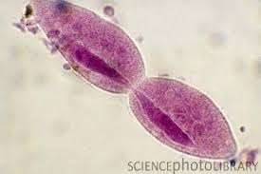
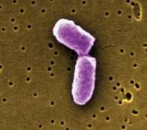
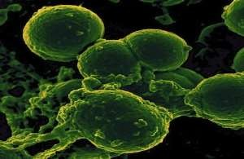
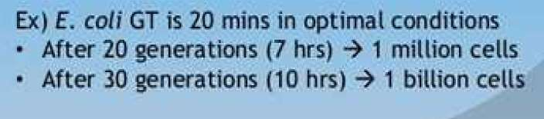
Bacterial Generation (Doubling) Time
Examples’;
Escherichia coli and other medically important bacteria -------20 mins
Staphylococcus aureus----27-30mins
Bacillus subtilis------25-27mins
Mycobacterium tuberculosis-----18 hours
Mycobacterium leprae------14 days
Treponema pallidum---1980 mins

Slide 5
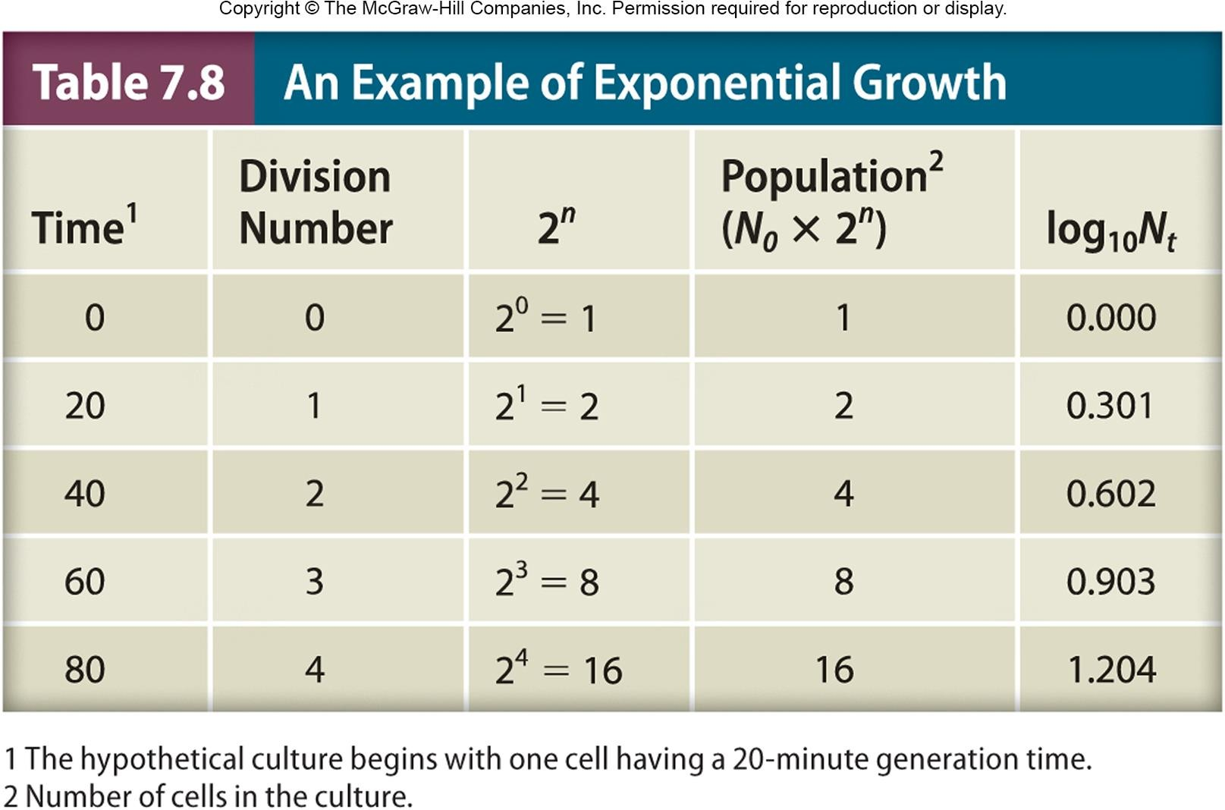

Slide 6
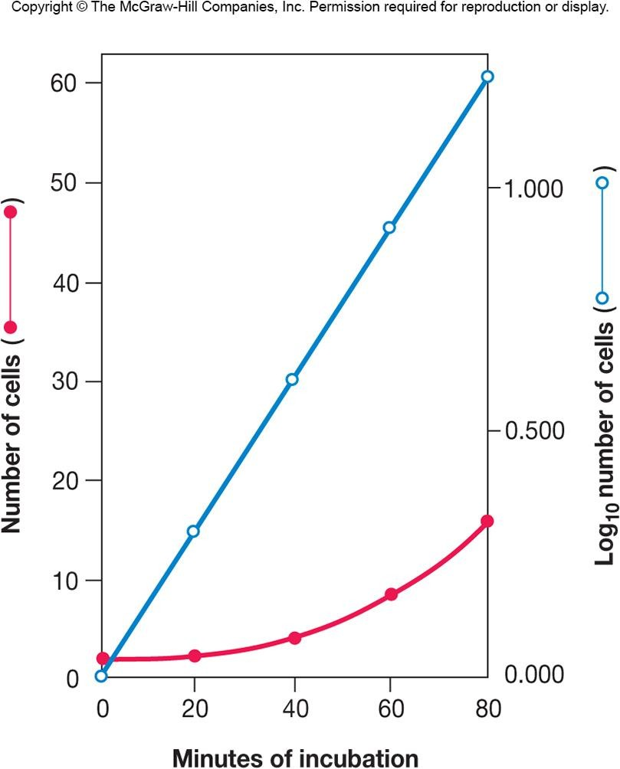
Exponential Population Growth
Population is doubling every generation

Slide 7
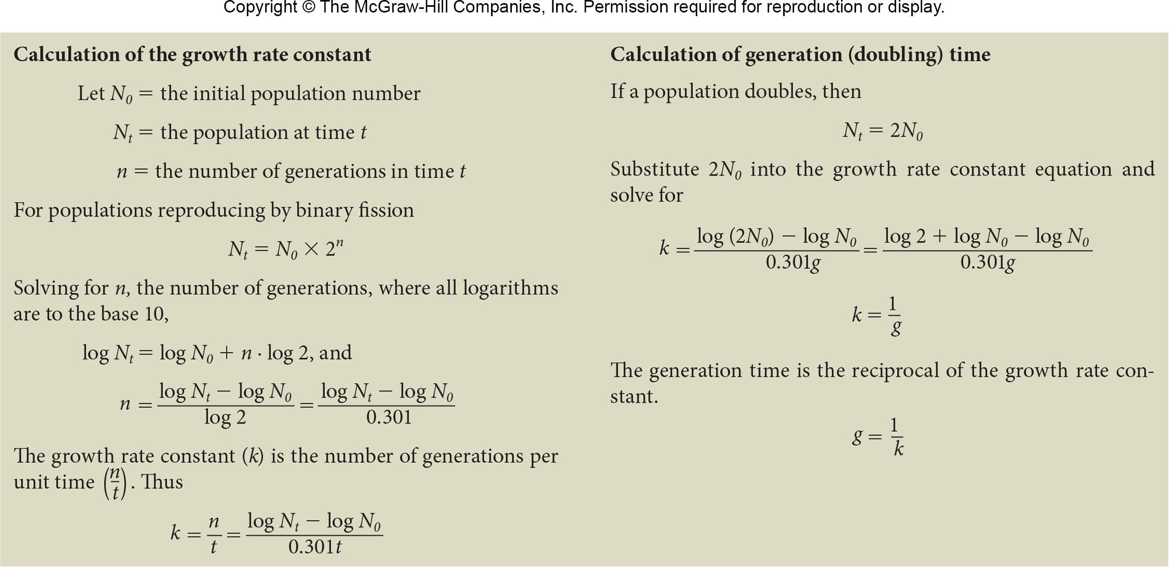
Measurement of Growth Rate and Generation Time

Slide 8
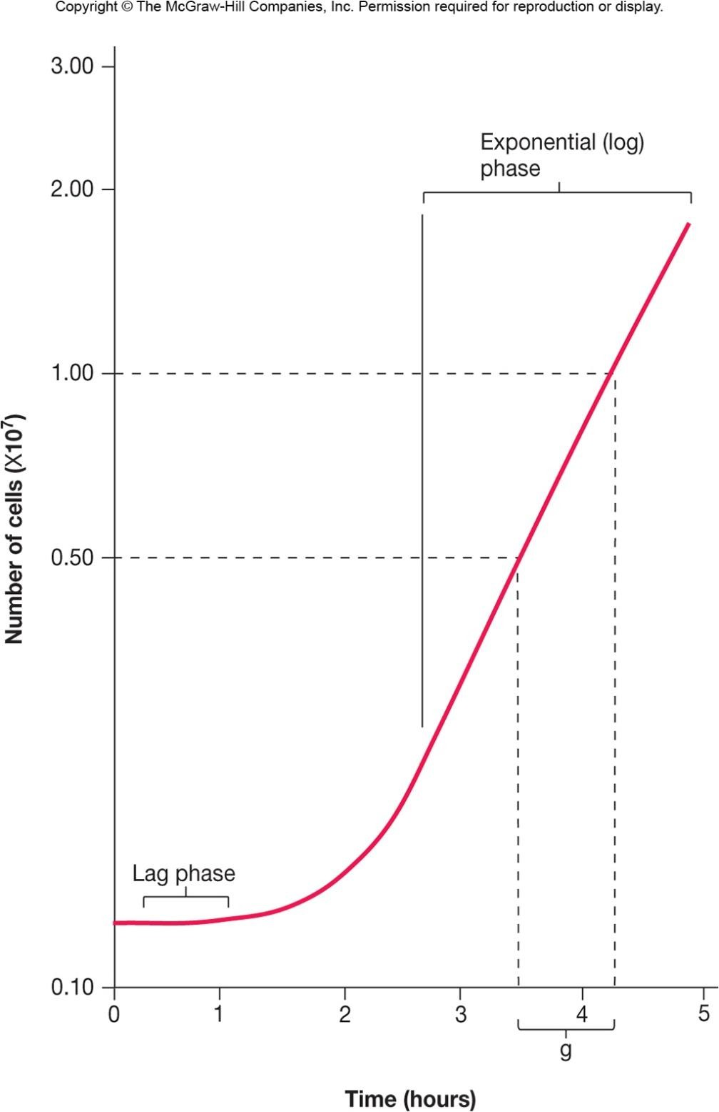

Slide 9

For example, suppose that a bacterial population increases from cells to cells in 10 hours.
Generation times vary markedly with the species of microorganism and environmental conditions. They range from less than 10 minutes (0.17 hours) for a few bacteria to several days with some eucaryotic microorganisms. Generation times in nature are usually much longer than in culture.

Slide 10
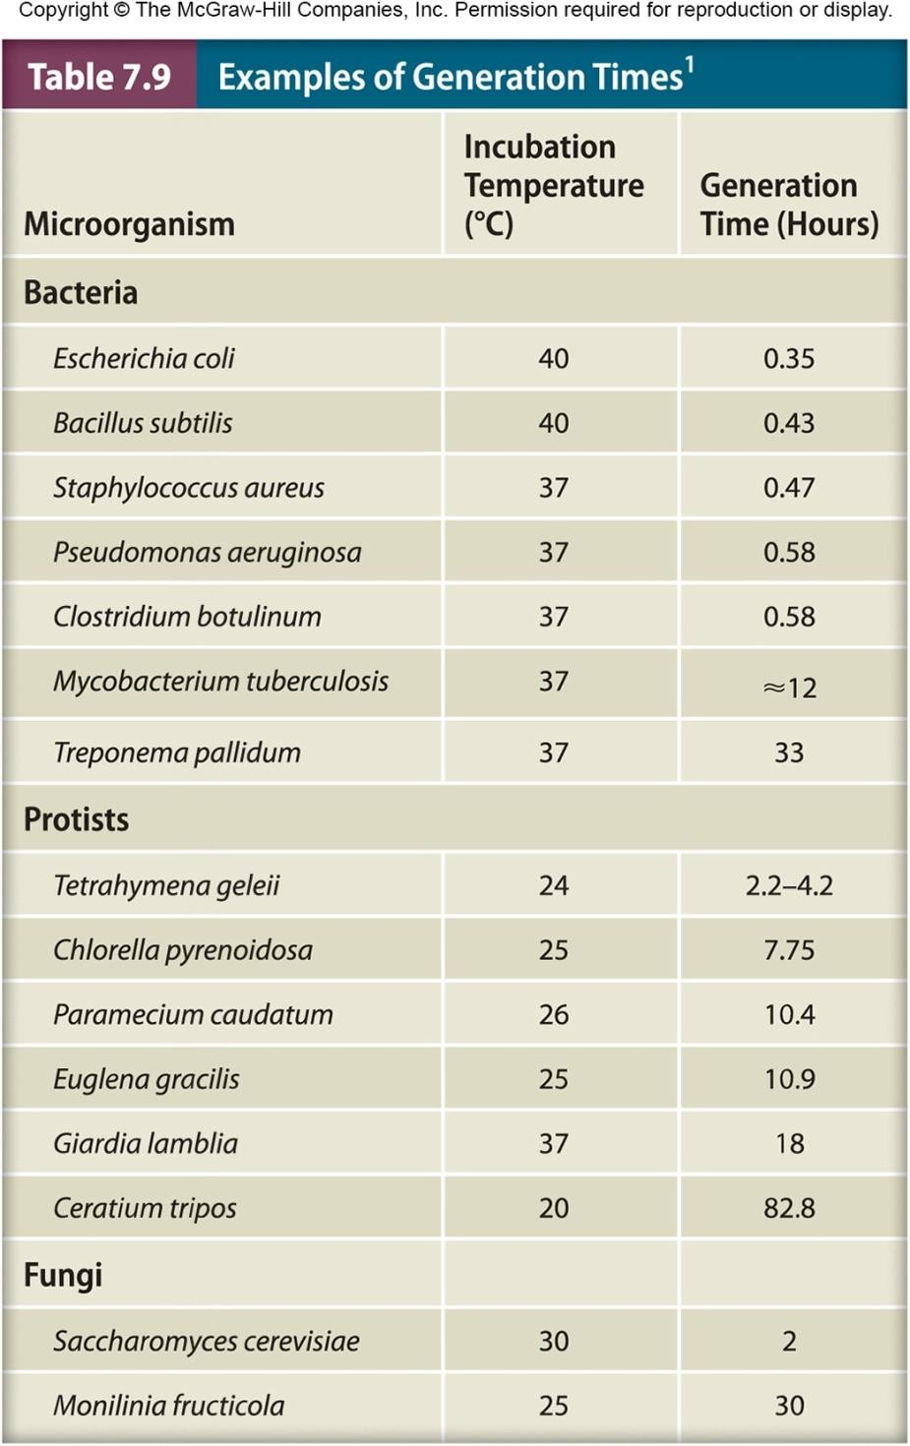

Slide 11


