Slide 1
s.roshni
ASSISTANT PROFESSOR jamal mohammed college trichy -20

Slide 2


Slide 3
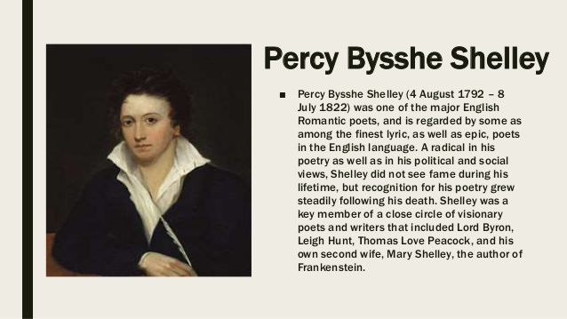

Slide 4
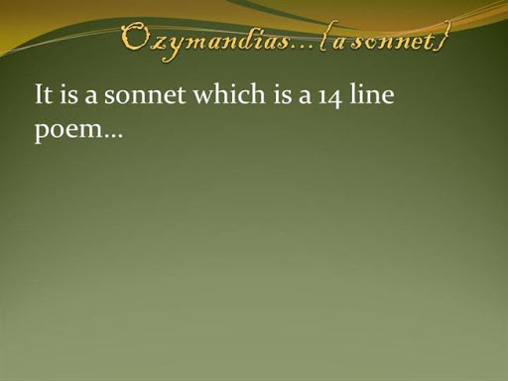

Slide 5


Slide 6
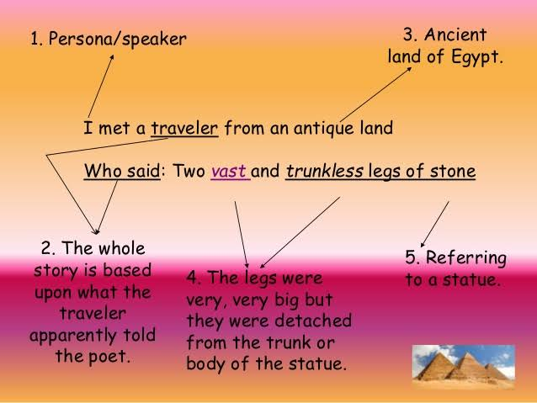

Slide 7
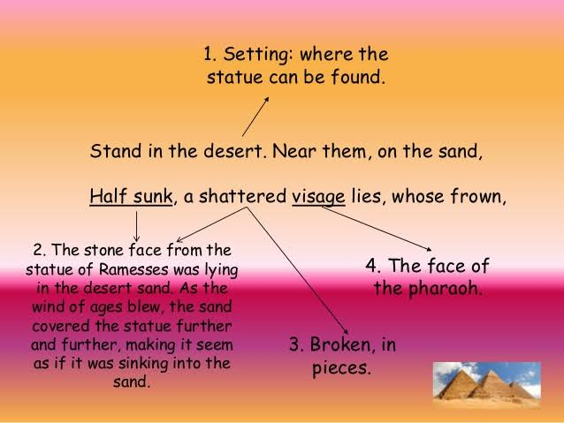

Slide 8
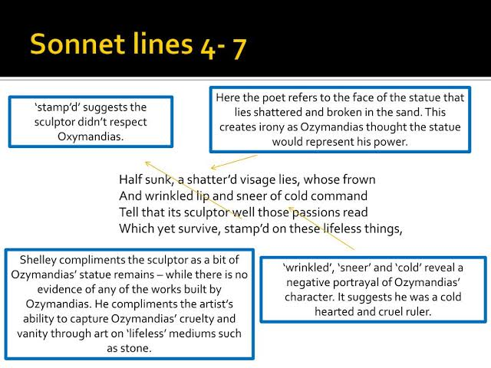

Slide 9
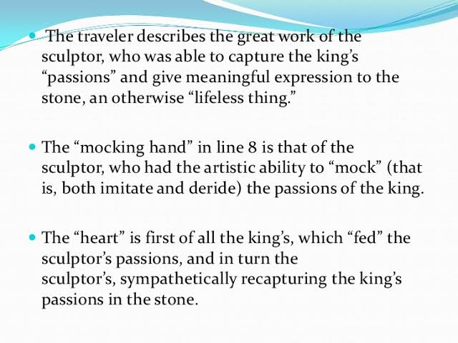

Slide 10


Slide 11
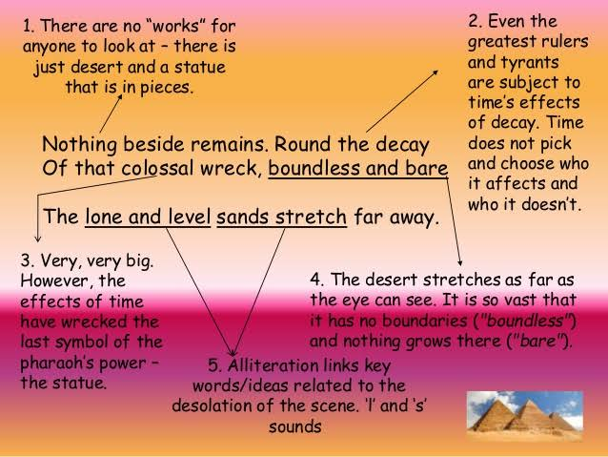

Slide 12
