Slide 1
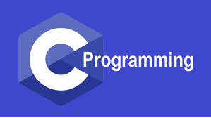
Dr. S. Abdul Saleem
Associate Professor of Comp. Science
Jamal Mohamed College(Autonomous)
Tiruchirappalli-20
Dr. S. Abdul Saleem
Associate Professor of Computer Science
https://www.onlinegdb.com/online_c_compiler#

Slide 2
What is C ?
C is a General Purpose Structured Programming Language
C is a High-level Language
C is a Machine Independent Language

Slide 3
History of C Language
International Group (1960)
ALGOL
BCPL
B
C
ANSI C
ISO C
C99/C18/C2X
Martine Richards (1967)
Ken Thompson (1970)
Dennis Ritchie (1972)
ANSI Technical Committee (1989)
ISO approval (1990)
(Lateral versions on 1999, 2018,and C2X may be on 2021)

Slide 4
History of C Programming
The root of all modern languages is ALGOL(ALGOrithmic Language), introduced by International group in 1960s.
In 1967, Martine Richards developed a language called as BCPL (Basic Combined Programming Language), primarily for writing System Softwares.
In 1970, Ken Thompson introduced B Language. It was used to create UNIX Operating System(OS) at Bell Laboratory.
In 1972, Dennis Ritchie introduced C language at AT & T Bell Laboratory. It was developed along with UNIX OS and it is strongly associated with UNIX OS.
In 1983, ANSI(American National Standards Institute) appointed a technical committee to define a standard for C. They introduced ANSI C in 1989. This language was approved by ISO (International Standards Organization) in 1990.

Slide 5
Importance of C Language
C is a Robust language, because it has rich set of built-in functions and operators used to write any complex programs.
C is a high-level language and it is well suited for writing both system software and business packages.
Most of the C compilers available in market are written in C language.
Programs in C are efficient and fast.
C is a free form language, which means it has no specific rule for the position at which a statement is to be written.
It has 32 keywords in ANSI version and it has several standard functions for developing programs.

Slide 6
Importance of C Language –Cont.
C is a highly portable language. It means C programs written for one computer can be run on another with little or no modification.
It is well suited for structured programming, therefore user can think of a problem in terms of function modules or blocks. These modules will make a complete program.
The modular structure of C makes program debugging, testing and maintenance easier.
C has the ability to extend itself. It means we can add our own functions to C library. So that the programming task becomes simple

Slide 7
How to learn C Language ?

Slide 9
Constants and Variables
In this figure 1.3, x is a variable, 3 and 5 are constants. 5 overwrite the earlier value 3
Declaration of a variable holds only one memory location on which we can store a value/constant at time
Constants are also called as Literals and variables are also called as Identifiers

Slide 10
What is a Constant ?
A constant is a fixed quantity
It will not change during the execution of a program
For example 234 56.72 -0.75e+3

Slide 16
What is a Variable ?
A variable is a quantity which will change during the execution of a program
The variables are also called as Identifiers

Slide 18
Variable Declaration
Variable declaration is used to distinguish the variable name in a C program and it tells the compiler what type the variable name belongs to and how many bytes memory location to be allocated to the variable
Variable declaration is done at the beginning of the program
Variable names are case sensitives. So the variable names Age, age and AGE are distinct and different.
C keywords cannot be used as variable names
For example
int Rollno, age, room_no ;
float basic_pay, total, tax;
char gender, flag, option;
A Bit is a Binary Digit (either 0 or 1)
8 Bits - 1 Byte
1024 Bytes - 1 Kilobyte (KB)
1024 KB - 1 Megabyte (MB)
1024 MB - 1 Gigabyte (GB)
1024 GB - 1 Terabyte (TB)
1024 TB - 1 Petabyte (PB)
Exa, Zetta, Yotta

Slide 19
Data Types
1. Basic / Primary/ Primitive Data Types
char - 1 Byte
int - 4 Bytes
float - 4 Bytes
double – 8 Bytes
2. Derived Data Types
arrays
structures
union
poniters
Qualifiers
signed
unsigned
short
long

Slide 22
Structure of a C Program

Slide 23
The Documentation Section consists of a set of comment lines giving the name of the program, the author and other details, which the programmer would like to use later.
The Link Section provides instructions to the compiler to link functions from the system library.
The Definition Section defined all symbolic constants.
The global Declaration Section is used to specify all the global variables, which are common to all the functions in a program.
The Main() function Section consists of two parts namely declaration part and executable part. The declaration part declares all the local variables used in the executable part. There is at least one statement in the executable part. These two parts must appear between the opening and closing braces. All the statements in these parts are end with semi-colon.
The Sub program Section contains all the user-defined functions that are used in the main() function.
All the sections except main() section may be absent, when they are not required.

Slide 24
/******************************************************
Compiler Type : Online C Compiler.
Author of the Code : Rahman K
Date of written : 29-03-2023
Name of the program : Finding area of a circle
******************************************************/
#include <stdio.h>
#include <math.h>
#define pi 3.142
float radius;
float func1();
int main()
{
float area;
printf("\n Enter the radius");
scanf("%f", &radius);
area = func1();
printf("\n Area of the Circle = %f", area);
return 0;
}
float func1()
{ return pi * pow(radius,2);}
Documentation Section
Link Section
Definition Section
Global Declaration Section
Main( ) function
Sub-program Section

Slide 26
Comments in C Program
Comments are used in a C program to clarify either the purpose of the program or the purpose of some statement in the program.
It is a good practice to begin a program with a comment indicating the purpose of the program, its author and the date on which the program was written.
Points to remember while using comment statements in C
Comment about the program should be enclosed within /* */.
Any number of comments can be written at any place in the program.
For example, a comment can be written before the statement, after the statement or within the statement as shown below
/* formula */ si = p * n * r / 100 ;
si = p * n * r / 100 ; /* formula */
si = p * n * r / /* formula */ 100 ;
c) Comments cannot be nested. This means one comment cannot be
written inside another comment. For example,
/* Cal of SI /* Author: gekay date: 25/06/2016 */ */ is invalid.

Slide 27
Input and Output Statements
Input Statement :
scanf(“format string”, &arg1, &arg2...arg_n);
For example
scanf(“%d %f %c”, &no, &salary, &gender);
For example:
scanf(“%c”,&option);
scanf(“%d %d %f”,&p,&n,&r);
Output Statement
printf(“format string” arg1, arg2,.... arg_n);
For example: Basic Pay = 5000.0000
printf(“ C = %d”, c); C = 5 Net pay = 7500.0000
printf(“\n Basic Pay =%f \n Net pay =%f”,basic,netpay);

Slide 28
First C Program with assigned inputs

Slide 29
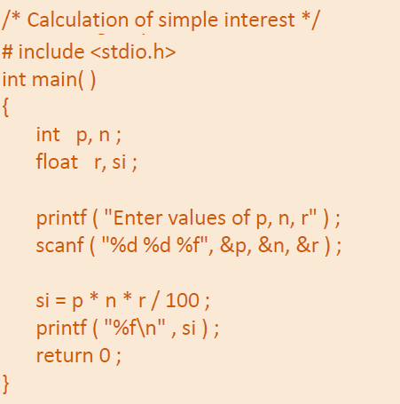
First C Program with I/O statements
The first printf( ) outputs the message ‘Enter values of p, n, r’ on the screen. Here we have not used any expression in printf( ) which means that using expressions in printf( ) is optional.
The use of ampersand (&) before the variables in the scanf( ) function is a must. & is an ‘Address of’ operator. It gives the location number (address) used by the variable in memory.
&a means scanf( ) function tells at which memory location should it store the value supplied by the user from the keyboard.

Slide 30
Activity 1 : Develop a C program for converting Fahrenheit to Celsius

Slide 31
Chapter - 2

Slide 32
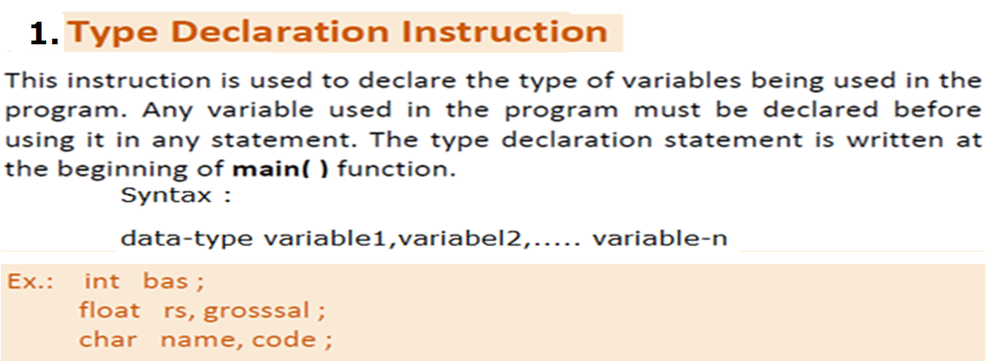
Initialization

Slide 33
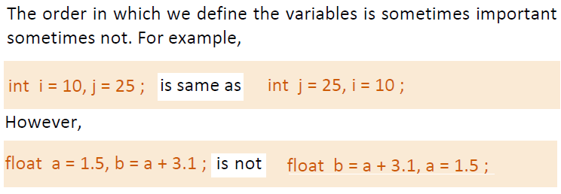
Reason : Because the variable ‘a’ is not declared before its use.

Slide 36
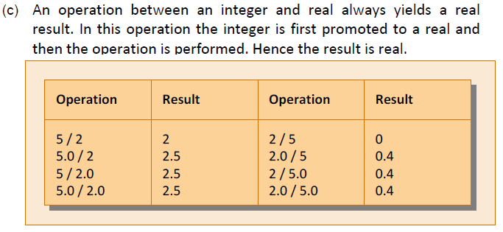

Slide 37
Type Conversion in Assignment operation
The type of the expression on right hand side and the type of the variable on the left-hand side of an assignment operator may not be same. In such a case, the value of the expression is promoted or demoted depending on the type of the variable on left hand side of =.
For example :
int i ;
float b ;
i = 3.5 ;
b = 30 ;
Here in the first assignment statement, though the expression’s value is 3.5, it cannot be stored in int i. In such a case, the float is demoted to an int and then its value 3 is stored in i.
Exactly opposite happens in the next statement. Here, 30 is promoted to 30.0 and then stored in float b, since float b cannot hold anything except a float value.

Slide 38
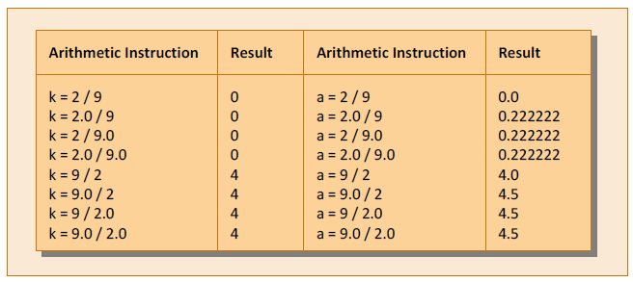
Another example :
int a=2,b=3,c=4;
int s = a * b * c / 100 + 37 / 4 - 3 * 5.1 ;
Here, some operands are ints whereas others are floats. As we know, during evaluation of the expression, the ints would be promoted to floats and the result of the expression would be a float. But when this float value is assigned to s it is again demoted to an int and then stored in s.

Slide 39
Operators in C
An operator is a symbol which performs operation on given data.
C has rich set of operators. The operators are classified as
Arithmetic Operators
Relational Operators
Logical Operators
Increment and decrement Operators
Bitwise Operators
Conditional Operator (Ternary Operator)
Assignment Operators
sizeof() Operator
Address of (&) Operator
Pointer (*) Operator

Slide 40
Arithmetic Operators
An operator is a symbol which performs operation on given operands according to its priority.
The priority or precedence in which the operations in an arithmetic statement are performed is called the hierarchy of operations.
C Arithmetic operators and their priority are listed below

Slide 41
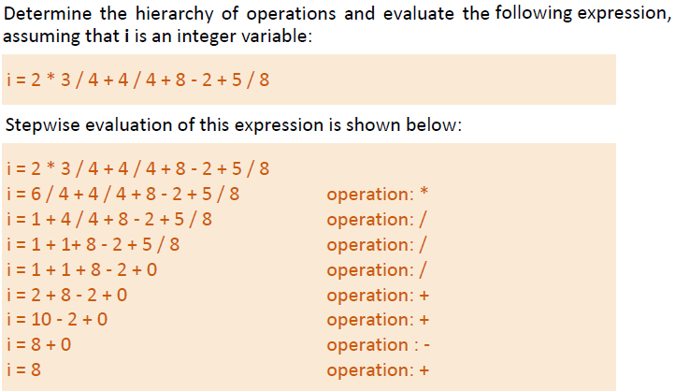
Arithmetic Operators

Slide 42
Associativity of Operators
When an expression contains two operators of equal priority the tie
between them is settled using the associativity of the operators. All operators in C have either Left to Right associativity or Right to Left associativity.
For example Consider the expression
a = 3 / 2 * 5 ;
Here there is a tie between operators / and * of same priority. Since both are having same Left to right priority, firstly / is done followed by *.
Another example a = b = 5; Here both = operators have same right to left priority. Therefore, second = is performed earlier than first =.

Slide 43
Relational and Logical Operators
Relational Operator | Description
< | Less than
<= | Less than or equal to
> | Greater than
>= | Greater than or equal to
== | Equal to
!= | Not equal to
Logical Operator | Description
&& | Logical AND
|| | Logical OR
! | Logical NOT

Slide 44
Increment and Decrement Operators
Logical Operator | Description
++ | Increment Operator
-- | Decrement Operator
These are unary operators, which can either preceded or followed by the operands.
++ operator adds 1 to its operand and -- subtracts 1 from its operand
The pre-increment operator in an expression, first increments its operand then perform operation with other operand. But the post-increment operator allows the operands to any operation and then increments the operand by 1
The above rule is also true for -- operator, but the value of the operand is decrement by 1

Slide 45
Increment and Decrement Operators
Example Programs
#include <stdio.h> void main() { int a=5, b=8, c,d; c = a++; d = b--; prinft(“\na = %d b = %d”,a,b); prinft(“\nc = %d d = %d”,c,d); } Output a = 6 b= 7 c = 5 d = 8 | #include <stdio.h> void main() { int a=5, b=8, c,d; c = ++a; d = --b; prinft(“\na = %d b = %d”,a,b); prinft(“\nc = %d d = %d”,c,d); } Output a = 6 b= 7 c = 6 d = 7
Pre-Increment and Pre-decrement operators
Post-Increment and post-decrement operators

Slide 46
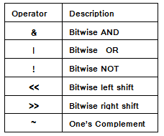
Bitwise Operators
The bitwise operators are used to perform the operations on the data in a variable at the bit-level
The Bitwise operators are tabulated here.
#include <stdio.h> void main( ) { unsigned char ch = 32 ; unsigned char dh ; dh = ~ch ; printf ( "~ch = %d\n", dh ) ; printf ( "~ch = %x\n", dh ) ; printf ( "~ch = %X\n", dh ) ; } | Output ~ch = 223 ~ch = df ~ch = DF Note : Here ch contains a value 32, whose binary equivalent is 00100000. On taking one's complement of it, we get 11011111, which in decimal is 223.

Slide 47
#include <stdio.h> void main( ) { unsigned char a = 6, b = 13 ; unsigned char c,d,e ; c = a & b ; d = a | b; e = a << 1; printf ( “c = %d\n", c) ; printf ( “d = %d\n", d ) ; printf ( “e = %d\n", e ) ; } | Output c = 4 d = 15 e = 12 Note : a=6 its binary equivalent is 0 0 0 0 0 1 1 0 b=13 its binary equivalent is 0 0 0 0 1 1 0 1 c=a&&b its binary equivalent is 0 0 0 0 0 1 0 0 d=a|b its binary equivalent is 0 0 0 0 1 1 1 1 a=6 its binary equivalent is 0 0 0 0 0 1 1 0 e=a<<1 its binary equivalent is 0 0 0 0 1 1 0 0
Serial Input

Slide 48
Conditional Operator
The conditional operator is also known as a ternary operator because it requires three operands.
The conditional statements are the decision-making statements which depends upon the output of the expression.
It is represented by two symbols, '?' and ':'.
Syntax:
(expression1) ? (expression2) : (expression3)
Here, expression1 is evaluated first, if it is TRUE, expression2 will be the result of conditional operation.
Suppose expression1 is FALSE, expression3 will be the result of the operation
For example
bigger = (a>b) ? a : b;
biggest =(a>b && a>c) ? a : ((b>c) ? b : c);

Slide 49
sizeof Operator
The sizeof operator is a compile-time unary operator and used to compute the size of its operand.
It returns the size of a variable. It can be applied to any data type, float type, pointer type variables.
When sizeof() is used with the data types, it simply returns the amount of memory allocated to that data type.
For example
int a=10;
printf(“Size of a = %d”,sizeof(a));
printf(“Size of double = %d, size(double));
Size of a = 4
Size of double = 8

Slide 50
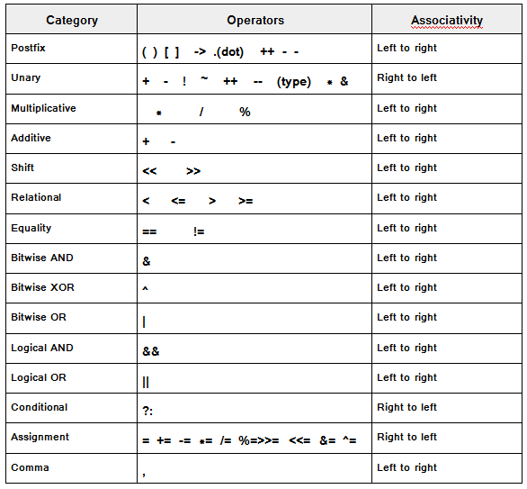
Operator Precedence in C

Slide 51
3. Control Instructions
Control Instructions determines the flow of control or the order in which the various instructions in a program are to be executed by the computer.
There are four types of control instructions in C. They are:
a) Sequence Control Instruction
b) Decision Control Instruction
c) Repetition or Loop Control Instruction
d) Case Control Instruction
The Sequence control instructions are executed in the same order in which they appear in the program.
Decision and Case control instructions allow the computer to take a
decision as to which instruction is to be executed next.
The Loop control instruction helps computer to execute a group of statements repeatedly.

Slide 53
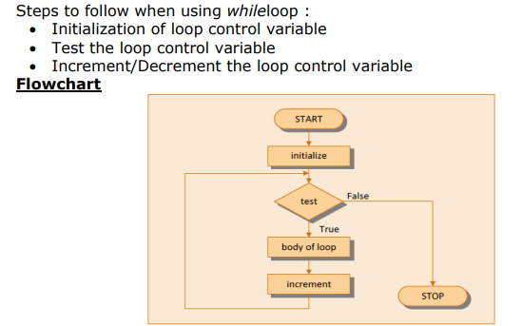

Slide 54
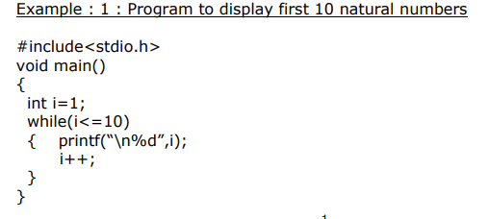

Slide 55
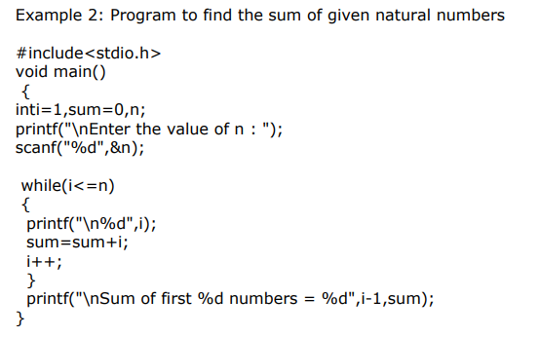

Slide 57
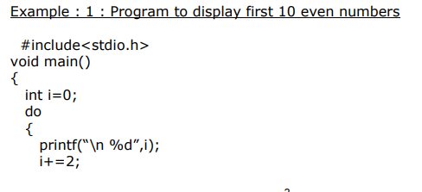

Slide 58
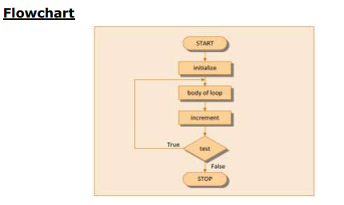

Slide 59
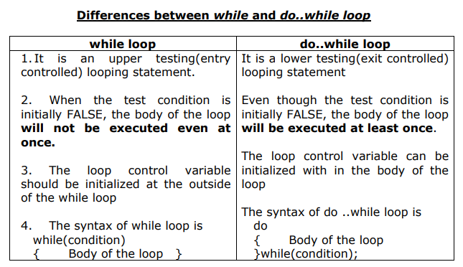

Slide 60
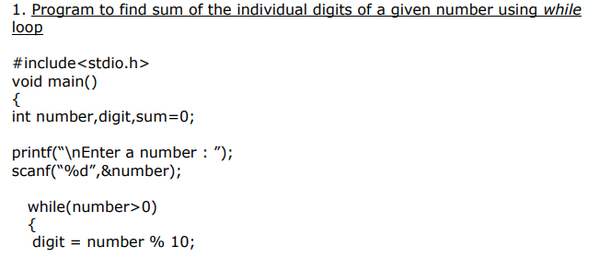

Slide 61
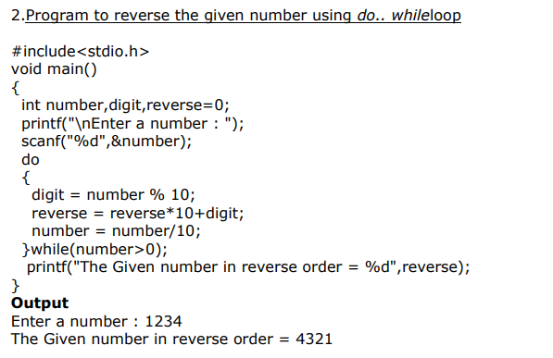

Slide 62
Will printed for 5 times

Slide 65
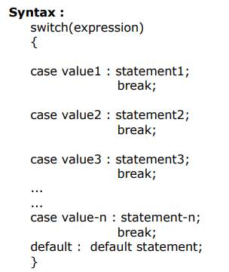

Slide 66
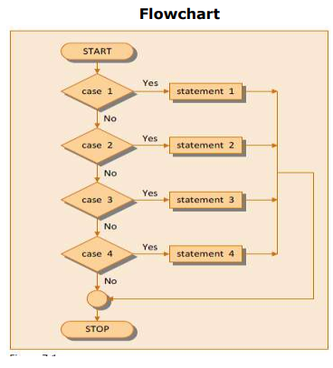

Slide 67
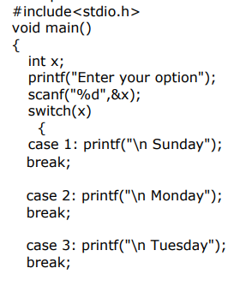
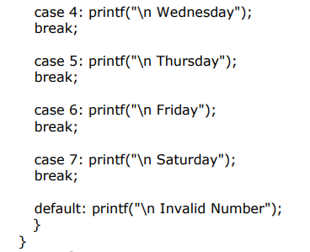

Slide 68
Thank You

