Slide 1
ECONOMICS OF GROWTH AND DEVELOPMENT
UNIT – I
By
Dr.K.N.Mohamed Fazil
Assistant Professor of Economics,
Jamal Mohamed College,
Trichy

Slide 2
Classical School of Economic Thought
The Classical School of economic thought was formalised by
Adam Smith,
Malthus,
Ricardo,
Mill and
Say
It is originated in the late 18th and early 19th centuries, especially in Britain. It focused on economic growth and economic freedom, advocating laissez-faire ideas and belief in free competition.

Slide 3
In this Unit
In the present unit, we discuss the models of development propounded by Smith, Ricardo, Mill and Malthus

Slide 4
ADAM SMITH’S THEORY OF ECONOMIC DEVELOPMENT

Slide 5
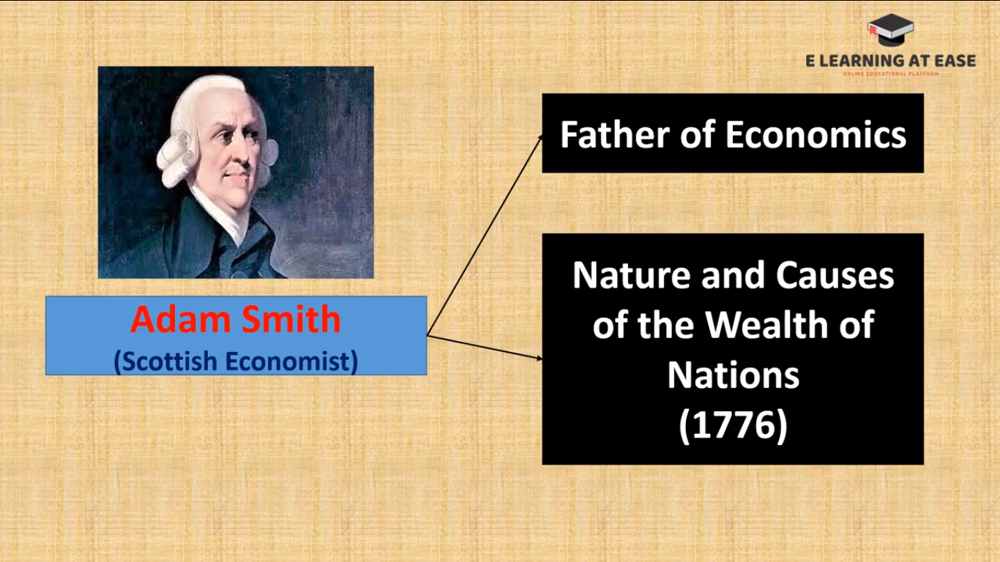

Slide 6
ASSUMPTIONS
a) Population growth depended on the sustenance available to accommodate the increasing workforce.
b) Investment was also endogenous; determined by the rate of savings
c) Land growth was dependent on conquest of new lands (e.g. colonisation) or technological improvements of fertility of old lands.
d) Technological progress could also increase growth overall; Smith's famous thesis that the division of labour or specialisation improves growth was a fundamental argument.
e) Smith also saw improvements in machinery and international trade as engines of growth as they facilitated further specialisation.
f) He also assumed the existence of perfect competition.

Slide 7
Main Features of Adam Smith’s Model
Natural law – lassiez-faire and self interest leads to Development.
Division of Labour – Division of labour increases productivity which depends upon the size of the market.
  It is division of labour that results in the greatest improvement in the productive powers of labour.
  The attributes of this increase in productivity are
    (i) the increase in the dexterity of every worker;
    (ii) the saving in time to produce goods; and
    (iii) to the inventions of large number of labour saving machines

Slide 8



Process of Capital Accumulatiom

Slide 9
Investment is made to earn profits
Profits tend to fall with economic progress when the rate of capital accumulation increases
Even with the fall in the rate of interest there is increase in capital accumulation and economic progress
Agents of Growth
  Farmers
  Producers
  Business Men
Shortage of natural resources stops growth

Slide 10
A Critical Appraisal
Rigid division of Society
One sided saving base
Unrealistic assumption of perfect competition
Neglect of Entrepreneur
Unrealistic Assumption of Stationery State:

Slide 11
RICARDIAN THEORY OF ECONOMIC DEVELOPMENT

Slide 12

David Ricardo
(British Economist & Politician)
1772-1823
The Principles of Political Economy and Taxation
1817

Slide 13
Assumptions
a) all land is used for production of corn,
b) law of diminishing returns operates,
c) supply of land is fixed,
d) demand for corn is perfectly in elastic,
e) labour and capital are variable inputs,
f) state of technical knowledge is constant and given,
g) all workers are paid a subsistence wage,
h) supply price and labour is given and constant,
i) demand for labour depends upon accumulations,
j) capital accumulation results from profit and
k) there is perfect competition.

Slide 14
Law of Diminishing Returns
The law of diminishing returns is an economic principle stating that as investment in a particular area increases, the rate of profit from that investment, after a certain point, cannot continue to increase if other variables remain at a constant. As investment continues past that point, the return diminishes progressively

Slide 15
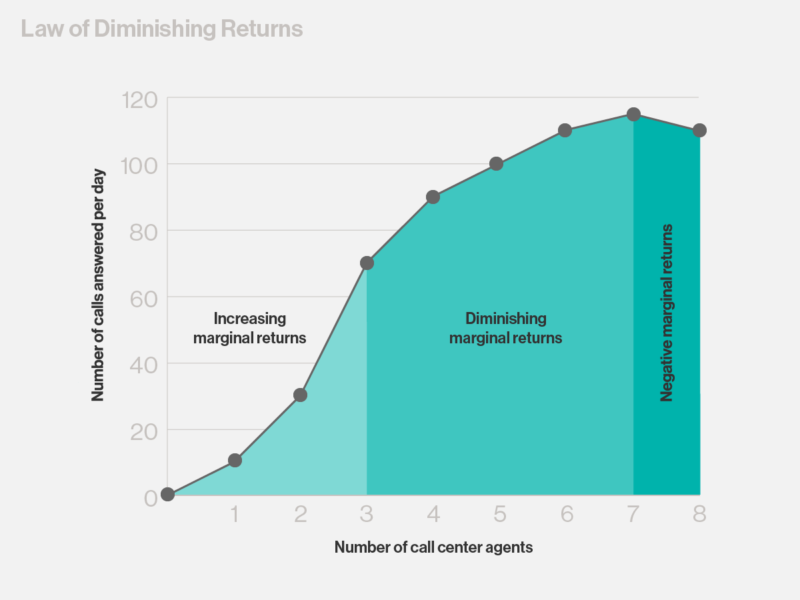

Slide 16
Main Features
The Ricardian model is based on the interrelation of three groups in the economy. They are
landlords,
capitalists and
labourers
among whom the entire produce of land is distributed.

Slide 17
Rent, Profit and Wages
(a) rent is that portion of the produce of earth which is paid to the landlord for the use of original and indestructible powers of the soil. It is the difference between average and marginal product. If all the land had the same properties of unlimited in supply and uniform in quality, no charge would make for its use.
(b) The wage rate is determined by wage fund divided by number of workers employed at the subsistence level.
According to the model, out of the total corn produced rent has the first right and the residual is distributed between wage and profit while interest is included in profit

Slide 18
Capital Accumulation
According to Ricardo capital accumulation is the outcome of profit because profit leads to saving of wealth which is used for capital formations.
Capital formation depends upon willingness to save and capacity to save which is more important.
The larger the surplus i.e. profit, the larger will be capacity to save.

Slide 19
i) The Profit Rate –
  In reality, profits depend upon wages, wages on price of corn and the price of corn depends upon the fertility of the marginal land.
  So there is an inverse relation between wages and profits.
  When due to improvement in agriculture, production increases, the price of corn falls and subsistence wages also fall and profits will increase leading to capital accumulation. This will raise demand for labourers raising wage rate and reducing profits.

Slide 20
ii) Increase in Wages –
  The wage rate increases when the prices of commodities forming the subsistence of the workers increase.
  As the demand for food increases, less fertile land is brought under control and more labourers are needed raising wage rate.
  Thus wages would rise with the increase in the price of corn. In a situation rent also increases, with the decline of capitalists’ profit capital accumulation also declines.

Slide 21
iii) Declining profits in other industries –
  The profits of the farmer regulate the profits of all other trades.
  Therefore the money rate of profit earned on capital must be equal both in agriculture and industry.
  If profit rate declines in the agricultural sector it will also decline is the manufacturing industry.

Slide 22
Other Sources of Capital Accumulation:
According to Ricardo economic development depends upon difference between production and consumption.
Capital may be increased by an increased production or by a diminished unproductive consumption.
However, the productivity of labour may be increased through technological changes and better organisation. It is in this way that capital accumulation can be increased.
But the use of more machines employs less workers leading to unemployment. So Ricardo regards technological conditions as given and constant.

Slide 23
a) Taxes:- Taxes are a source of capital accumulation in the hands of government.
  According to Ricardo, taxes are to be levied to reduce conspicuous consumption.
  Otherwise the imposition of taxes on capitalists land lords and labourers will transfer resources from these groups to the government, adversely effecting investment.
  So he does not favour the imposition of taxes.
b) Free Trade:- Ricardo is in favour of free trade. The profit rate can be saved from declining by importing corn. The capital accumulation therefore continues to be high. In this way the resources of the world can be used more efficiently through trade.

Slide 24
Stationary State:
According to Ricardo there is natural tendency for the rate of profit to fall in the economy so that the country ultimately reaches the stationary state.
When capital accumulation rises, with increase in profits,
production increases which raises the wage fund,
population increases, which raise the demand for corn and its price.
Inferior grades of land are cultivated.
Rents on superior land increase and reduce the share of the capitalists and labourers.
Profits decline and wages fall to subsistence.
The process of rising rents and falling profits continues till the output from the marginal land just covers the wages of labour employed and profits are zero.
There is no accumulation of capital, no increase in population and wage rate but rent is extremely high and there is economic stagnation.

Slide 25
Critical Appraisal

Slide 26
1) Neglects the impact of technology
2) Wrong Notion of Stationary State
3) Baseless Notion of Population
4) Unnecessary Importance to the law of Diminishing Returns
5) Impracticable laissez-faire Policy
6) Neglects Institutional factors and Interest-rate
7) Distribution rather than growth theory
8) Land also produces goods other that corn
9) Capital and labour not fixed co-efficients

Slide 27
Expected exam questions
Give the assumptions of Adam Smith’s theory of economic development, and describe its main features.
Critically evaluate the strengths and weaknesses of Smith’s theory of development.
Discuss how a nation falls into stationery state according to Ricardo.
State the assumptions of Ricardo’s theory of development. Compare the Ricardian model with Adam Smith’s theory of development.

Slide 28
MALTHUSIAN THEORY OF ECONOMIC DEVELOPMENT

Slide 29
Thomas Robert Malthus (British Economist)
1766-1834
An Essay on the Principle of Population.
1798
Principles of Political Economy
1820

Slide 30
Population and Economic Growth
Malthus posited his hypothesis that (unchecked) population growth always exceeds the growth of means of subsistence. He argued that while population rises geometrically, food supply increases arithmetically.
Actual (checked) population growth is kept in line with food supply growth by "positive checks" (starvation, disease and the like, elevating the death rate) and "preventive checks" (i.e. postponement of marriage, etc. that keep down the birth rate), both of which are characterised by "misery and vice".
There is nothing automatic about economic growth, Malthus warns.
Population growth by itself is enough to bring economic advance is absurd.
Mere increases in numbers do not provide a stimulus to economic expansion; population growth encourages development only if it brings an increase in effective demand.

Slide 31
Effective Demand
He flatly repudiated ‘Say’s law’, which said in effect that supply creates its own demand and that savings are just a demand for capital goods.
Saving in the sense of planned or ex-ante saving or abstinence, means not consuming; and not consuming in itself brings a decline in effective demand, profits and investment.

Slide 32
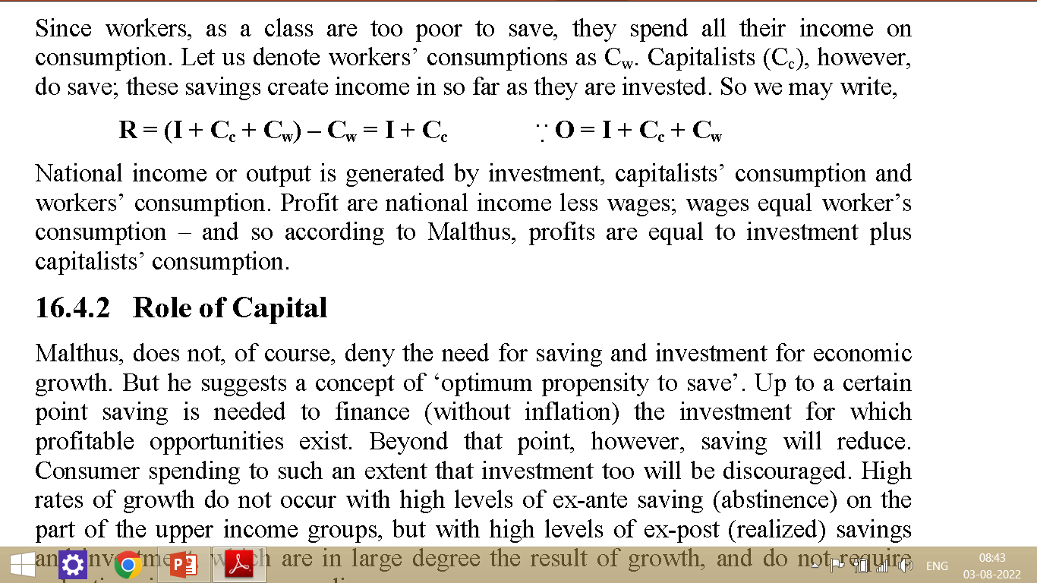
As we know that
O = R + W Or R = O - W
Where R = Profit
W = Wages
O = National output

Slide 33
Role of Capital
Malthus, does not, of course, deny the need for saving and investment for economic growth. But he suggests a concept of ‘optimum propensity to save’. Up to a certain point saving is needed to finance (without inflation) the investment for which profitable opportunities exist. Beyond that point, however, saving will reduce. Consumer spending to such an extent that investment too will be discouraged.
High rates of growth do not occur with high levels of ex-ante saving (abstinence) on the part of the upper income groups, but with high levels of ex-post (realized) savings and investment, which are in large degree the result of growth, and do not require reductions in consumer spending.
Like Smith and Ricardo, Malthus also believed in free enterprise and considered that the wealth effects of free trade are very high.

Slide 34
Structural Change leads to Economic Development
Malthus also stressed; economic development entails structural change of a sort which diminishes the relative importance of agriculture in the economy.
He argued that technological progress tends to increase employment
Malthus envisaged the economy as consisting of two major sectors: industrial and agriculture- the latter triggers the growth of the former
Capital was invested in agriculture until all the arable land was brought into cultivation, stocked and improved; after that there were no more opportunities for profitable investment in that sector, and investment opportunities existed only is the industrial sector.

Slide 35
Diminishing returns to increased employment on the land could be avoided only if technological progress in the industrial sector was rapid enough, and if enough investment took place, to absorb most of the population growth in the industrial sector and to reduce the cost of living of workers on the land, permitting reductions in their wage rates.
Malthus also, makes some suggestions about sectoral interaction in underdeveloped areas, which help to explain why they remain underdeveloped. First, he points out that each sector constitutes the market for the output of the other sector. Thus failure of either sector to expand acts as a drag on the growth of the other; ‘balanced growth’ is necessary if we are to have growth at all. The development of the industrial sector of underdeveloped countries is limited by the poverty of the agricultural sector.

Slide 36
A Critical Appraisal
There is no doubt that Malthus made a valuable contribution to the theory of economic growth.
This repudiation of say’s law and emphasizing the importance of effective demand and its relation to saving and investment are indeed noteworthy.
A great deal of what he wrote on the subject is applicable to an under-developed economy,.

Slide 37
J.S. MILL’S THEORY OF ECONOMIC DEVELOPMENT

Slide 38
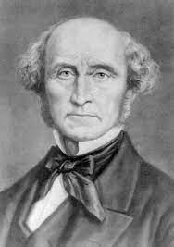
John Stuart Mill
English philosopher, political economist, Member of Parliament and civil servant.
(1806-1873)
Also Called Neo Malthusian
Famous Book
Principles of Political Economy 1848

Slide 39
Mill’s Coherent Exposition of the Growth Process
He defined in a very orderly way the three agents land, labour and capital followed by the degree of productiveness of his three production agents.
Recognising the limited quantity and productiveness of land, he introduced the diminishing returns as the most important proposition in the political economy
However, innovations and inventions are given capable of exercising, “an antagonistic influence on the law of diminishing returns to agricultural labour”.
Among innovations, he argued for the improved education of the working force, improved system of taxation and land tenure and more sold instruction for the rich classes that would increase their mental energy, generate feelings of public spirit in them and qualify them for constructive roles in society
Production, determined by scientific principles and distribution, determined by law, customs and other human institutions.

Slide 40
Population and Working Force
He favoured a sustained public policy to encourage smaller families, efforts in popular education and ultimately movement to a higher income per capita stationary state
Mill is known in demographic literature as a neo-Malthusian i.e. a believer in birth control. He argued so strongly for limitation of family size that one expects support for birth control to become explicit
In examining the forces that determine the productivity of the working force, he introduced the factors of production with which labour must combine i.e. the quality and availability of the soil and sources of raw materials, as well as the scale and quality of capital equipment

Slide 41
He went further ahead to question:
What determines the capacity and willingness of labour to engage in ‘steady and regular bodily and mental exertion’?
In what ways the workers differ with respect to skill, adaptability, and moral character?
He also questioned on the future of the working classes:
What can be the effect of the education and the movement of women towards equal rights on the size, quality and composition of the working force?
What is the evidence on the relation between labour productivity and profit sharing schemes?

Slide 42
Investment and Technology
Mill starts his exposition of the role of capital in production with a distinction between fixed and working capital.
In dealing with profits, he distinguishes three components: interest, insurance against risk and wages of superintendence
He also considers the determinants of the minimum profit rates, variations and the tendency of the profit in various sectors towards equality.
Mill’s views on investment process were considered incomplete by economists like Schumpeter

Slide 43
Business Cycles
He believed that since the calculations of the producers and traders being imperfect, there are always some commodities which are more or less in excess and some are in deficiency.
The reason for this being the rising prices, which dupes the producers of riches. But when the illusion vanishes, the commodities are in excess supply and there is a glut of commodities.
Thus Mill had a clear sense that an almost periodical cyclical process had been under way in which investment decisions made by individuals operating without full knowledge of the investment decisions of the others and acting in response to the same signals of future loss and profit

Slide 44
The Stages of and Limits to Growth
Mill concludes that the economical progress of a society constituted of landlords, capitalists and labourers
They are leading to agricultural improvement which tends to the progressive enrichment of landlords. Labourer’s subsistence tends to rise and profits to fall.
In contrast to his predecessors Mill idea of stationary state was a virtue that had the possibilities opened up in general and the elevation of the intellectual and social position of the working class and by birth control

Slide 45
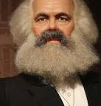
Karl Heinrich Marx
(1818-1883)
a German philosopher, critic of political economy, economist, historian, sociologist, political theorist, journalist and socialist revolutionary.
His best-known titles are the 1848 pamphlet The Communist Manifesto and the four-volume Das Kapita

Slide 46
MARXIAN THEORY OF ECONOMIC DEVELOPMENT
Marx's theory differed from the earlier classical economists in many ways.
Firstly, unlike Smith or Ricardo, Marx did not believe that labour supply was endogenous to the wage.
As a result, Marx had wages determined not by necessity or "natural/cultural" factors but rather by bargaining between capitalists and workers.
This process however was considered to be influenced by the amount of unemployed labourers in the economy (the "reserve army of labour", as he put it).
Marx also argued profits as the determinants of savings and capital accumulation.

Slide 47
Organic Composition of Capital, and Surplus Value
Like the classical economists, Marx believed there was a declining rate of profit over the long-term. The long-run tendency for the rate of profit to decline is brought about not by competition increasing wages (as in Smith), nor by the diminishing marginal productivity of land (as in Ricardo), but rather by the "rising organic composition of capital".
Marx defined the "organic composition of capital" as the ratio of what he called constant capital to variable capital. Thus according to Marx, total value of output is
y = c + v + s
where y is output, ‘c’ constant capital, ‘v’ variable capital and ‘s’ surplus value.
The rate of profits, Marx claimed, is defined as:
r = s/(v +c)
where r is the rate of profit, s is the surplus, and (v+c) are total advances (constant and variable). Surplus, s, is the amount of total output produced above total advances,

Slide 48
Declining Rate of Profit
Marx then argued that the organic composition of capital (c/v) tended to rise over time, thus the rate of profit has a tendency to decline.
The basic logic can be as follows. For simplicity, assume a static economy (no labour supply growth). As the surplus accrues to capitalists and, necessarily, capitalists invest that surplus into expanding production, then output will rise over time while the labour supply remains constant. Thus, the labour market gets gradually "tighter" and so wages will rise. Thus, v (= wL) or variable capital rises and r or profits fall.

Slide 49
Increasing Rate of Exploitation
Marx called the ratio of surplus to variable capital, s/v, the "exploitation rate" (surplus produced for every dollar spent on labour).
There is a natural tendency for the rate of profit to fall. One way to prevent this decline would be to increase the exploitation rate in proportion to which variable capital declines relative to constant capital.
The manner of increasing the exploitation rate, Marx claimed, was up to the devilish imagination of the capitalist.
Technological progress in the form of machinery or division of labour was not wholly beneficial way of improving growth either.

Slide 50
Marx envisioned that greater and greater cut-throat competition among capitalists for that declining profit. Then a crisis occurs: large firms buy up the small firms at cheaper rates
As capital becomes more concentrated in fewer hands, the increasing tendency for capital to be concentrated in fewer and fewer hands, combined with the greater misery of labour would culminate in ever greater "crises" which would destroy capitalism as a whole.

Slide 51
A Critical Appraisal
Marx’s explanation is, however, subject to criticisms. For example
1) Once the assumption of diminishing returns has been abandoned, a fall in profit is possible but not inevitable.
2) Marx’ s explanation of Rate of exploitation is limited by the length of working day, which is not a plausible assumption.

Slide 52
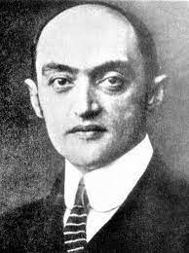
Joseph Alois Schumpeter (1883-1950)
was an Austrian-born political economist.
He served briefly as Finance Minister of German-Austria in 1919.
In 1932, he emigrated to the United States to become a professor at Harvard University, where he remained until the end of his career, and in 1939 obtained American citizenship
His famous book was “The theory of economic development” - 1911

Slide 53
Schumpeter’s theory of development assigns paramount role to the entrepreneur and innovations.
According to Schumpeter, the process of production is marked by a combination of material and immaterial productive forces.
The material productive forces arise from the original factors of production, viz., land and labour, etc.,
While the immaterial set of productive forces are conditioned by the ‘technical facts’ and ‘facts of social organization

Slide 54
The Schumpeterian production function can, therefore, be written as –
Q = ƒ [k, r, I, u, ν)
Where, Q stands for the output,
k for the Schumpeterian concept of “produced means of production”,
r for natural resources,
l for the employed labour force.
u represents the society’s fund of technical knowledge and ν represents the facts of social organization, i.e., the socio-cultural milieu within which the economy operates.

Slide 55
The above function shows that the rate of growth of the output depends upon
  the rate of growth of productive factors,
  the rate of growth of technology and
  the rate of growth of investment friendly socio-cultural environment.
  Schempeter held that the alterations in the supply of productive factors can only bring about gradual, continuous and slow evolution of the economic system.
  On the other hand, the impact of technological and social change calls for spontaneous, discontinuous change in the channels of output flow.

Slide 56
Thus taking into account these two types of distinct influences Schumpeter distinguished two components in the dynamic evolution of the economy –
  (a) the “growth component” which brings about gradual, continuous and slow evolution due to the changes in the factor availability,
  (b) the “development component” which brings about spontaneous and discontinuous change in the channels of output flow due to changes in the technical and social environments.

Slide 57
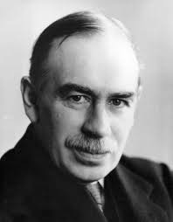
John Maynard Keynes
(1883-1946),
English economist,
The General Theory of Employment, Interest and Money (1936)

Slide 58
Keynes view on Development
Keynes analytical framework is mainly confined to the short period analysis and it has nothing to do with the problem of long term growth.
His framework has no relevance to Under Developed countries (UDCs)
His main concern was to find out the conditions necessary for a steady growth in a developed capitalist economy.
He revolutionised the theory of business fluctuations which was confined only to short period.

Slide 59
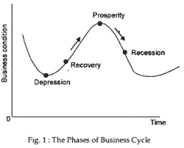

Slide 60
Assumptions
Cyclical Unemployment
Short Period Analysis
Closed Economy
Excess Supply of Labour and Complementary factors
Labour and Capital simultaneously Unemloyed

Slide 61
Rostow’s Model of Economic Growth

Slide 63
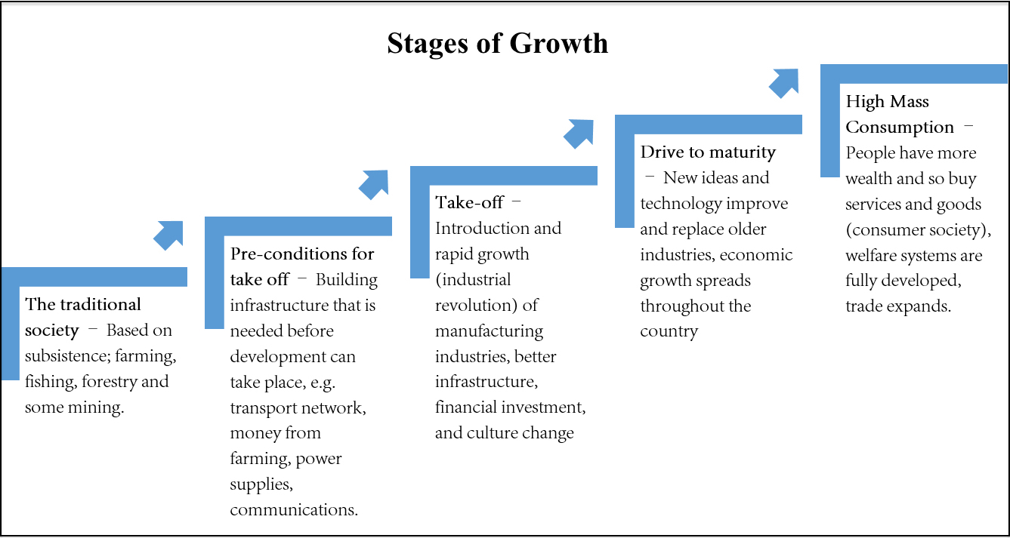

Slide 64
STAGE-I : THE TRADITIONAL SOCIETY
Rostow uses this term to define a country that has not yet started a process of development.
A traditional society contains a very high percentage of people engaged in agricultural and a high percentage of notional wealth allocated to what Rostow calls "nonproductive" activities, such as the military and religion.

Slide 65
STAGE-I : THE TRADITIONAL SOCIETY
i. Less developed society in terms of science and technology;
ii. Limited production function
iii. Industry activity shows a tendency to grow, but the progress is constrained by the inadequacy in scientific knowledge.
iv. Labour productivity is low
v. Predominance of agriculture leads to hierarchical social structure
vi. Concentration of political power
vii. Conventional techniques.

Slide 66
STAGE-II: THE PRECONDITIONS FOR TAKE-OFF
According to Rostow, the process of development begins when an elite group initiates innovative economic activities.
Under the influence of these well-educated leaders, the country starts to invest in new technology and infrastructure, such as water supplies and transportation systems. These projects will ultimately stimulate on increase in productivity.

Slide 67
STAGE-II: THE PRECONDITIONS FOR TAKE-OFF
Societies are in a process of transition, building up conditions which, in course of time, enable them to take-off;
Rise in rate of savings and investment;
Broadened outlook of people;
More emphasis on trade
Development of transport and communication

Slide 68
STAGE-III : THE TAKE-OFF STAGE
Rapid growth is generated in a limited number of economic activities, such as textiles or food products.
These few take-off industries achieve technical advances and become productive,
while other sectors of the economy remain dominated by traditional practices.

Slide 69
STAGE-III : THE TAKE-OFF STAGE
i. In this period, growth becomes a normal condition of the society;
ii. Begins with some sharp stimulus from political revolution, innovation
iii. Investment rises 5-10% of the national income
iv. Substantial manufacturing sectors became developed, leading to high growth rate
v. More complex economy

Slide 70
STAGE-IV : THE DRIVE TO MATURITY
Modern technology, previously confined to a few take-off industries, diffuses to a wide variety of industries, which then experience rapid growth comparable to the take-off industries.
Workers become more skilled and specialized.

Slide 71
STAGE-IV : THE DRIVE TO MATURITY
i. Changes in the character of labour force (more organized, increased wages)
ii. Changes in the character of entrepreneurship
iii. Increase in investment from 10-20% of National income
iv. Old methods are replaced by new technology
v. Increase in exports
vi. Less dependent on other countries
vii. Increase in standard of living
viii. Increase in per capita income
ix. Development of new sectors

Slide 72
STAGE-V : THE AGE OF MASS CONSUMPTION
A society approaches maturity. The economy shifts from production of heavy industry, such as steel and energy, to consumer goods, like motor vehicles arid refrigerators.

Slide 73
STAGE-V : THE AGE OF MASS CONSUMPTION
i. Attention shifts from problems of production to problems of consumption;
ii. Consumption of comforts and luxuries increase.
iii. Rate of investment rises above 20% of National Income
iv. Society assumes the role of a welfare state
v. Migration of population from village to cities
vi. Increase in financial security
vii. More employment opportunity
viii. Extensive use of durable consumer goods like automobiles and household instruments
ix. Progressive and prosperous society in which “hunger is something one reads about and poverty a memory”

Slide 74
According to Rostow's model, each country is in one of these five stages of development.
• More developed countries are in stage 4 or 5;
• less developed ones are in one of the three earlier stages.
• The model also asserts that today's developed countries like USA have already passed through the early stages.
Merits
Rostow based his model on studies of many countries and their economic and social history. His ideas provide a useful framework against which to consider the current or past state of o nation's economic and social standing.

Slide 75
Criticism
i. A number of nations such as USA, Canada, New Zealand were born free from traditional societies and they derived pre-conditions from Britain, which was already advanced;
ii. Pre-condition is not necessary before take-off to come, The development in agriculture continues in the take-off stage too;
iii. it does not define major specific criteria to measure a nation's performance or place it in any one of the five stages shown in the model (such as the level of earnings or proportion of workers in various sectors);
iv. the stages themselves may be said not to exist separately from each other (the 'drive to maturity' for example can, in fact, coincide with an age of 'high mass consumption’)
v. the degree of investment suggested by Rostow at the 'take-off stage was not in fact present in the histories of the developed nations of today.

