Slide 1
Rotavirus
Class: I M.Sc.,Microbiology
BY
A.Swedha
Assistant Professor
Department of Microbiology
Jamal Mohamed College(Autonomous)
Trichy

Slide 2
Rotavirus-Classification, Structure composition and Properties, Replication, Mode of Transmission, Pathogenesis, Clinical symptoms, laboratory diagnosis, Treatment, Prevention and Control
Rotavirus
Family: Reoviridae
Genus: Rotavirus
Classification of Rotavirus:
Classified into seven distinct groups (A to G) based on structural antigen VP6.
Group A, B, and C Rotaviruses are found in Human infection as well as animal infection
Group A Rotaviruses are most frequent Human pathogen

Slide 3
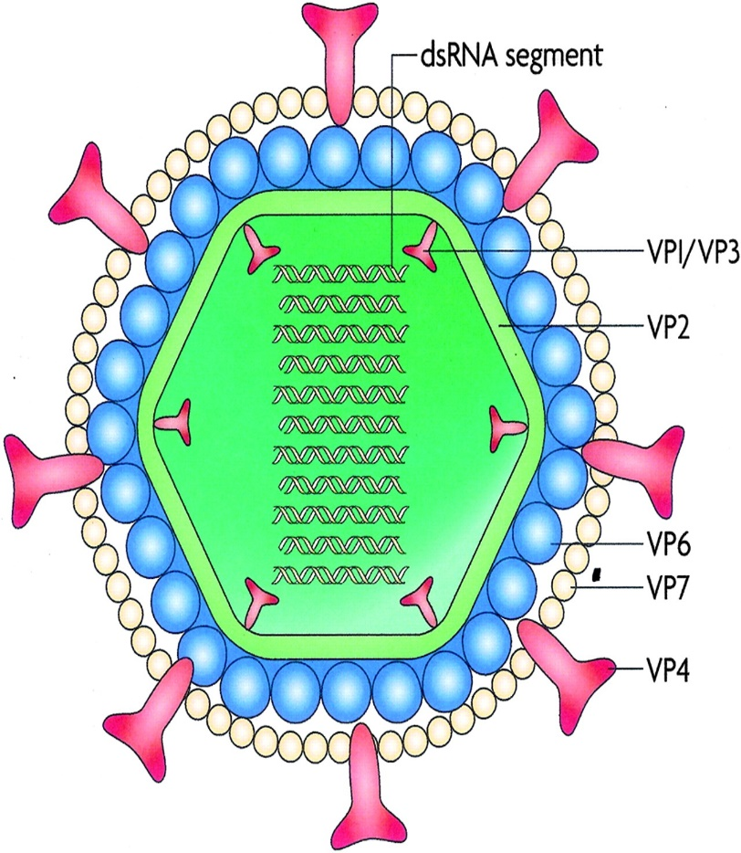
Structure, composition and properties of Rotavirus
Structure
Characteristics ”wheel” like appearance (Rota-means wheel)
Size: 65nm-100nm in diameter
Shape: Spherical shape
Symmetry: Icosahedral
2. Genome composition:
Genome: 11 segments of double stranded RNA (ds RNA )
Protein: 6 structural protein (VP) and 6 Non-structural protein (NSP)
Envelope: Absent
Nucleic acid is surrounded by two layer of capsid- inner capsid (VP6) and outer capsid (VP7)
VP4 is the spike protein, it is a cell surface receptor

Slide 4
3. Other properties
Replication: Occurs in cytoplasm of infected cell.
Rota virus contain an RNA-dependent RNA polymerase and other enzymes capable of producing capped RNA transcripts
Rota virus do not grow in cell line culture
Rotaviruses are inactivated by-
Heating to 100°C
Treatment with acid (pH<3),
Glutaraldehyde (3%),
Phenol,
Formalin,
Chlorine
Alcohol (70%)

Slide 5
Replication of Rota virus:
Attachment: by VP4 on cell surface receptor
Penetration: receptor mediated endocytosis
Un-coating in lysosome
Transcription is mediated by endogenous virus dependent RNA polymerase (transcriptase)
Translation to produce viral structural protein
Synthesis of full length transcript
Some of the full length transcript are encapsidate
Synthesis of –ve sense RNA strand with capsid to form ds RNA
Formation of inner capsid
Morphogenesis: budding of single shelled virus into RER acquiring pseudo envelope
Removal of pseudo envelope and replaced by outer capsid in RER
Maturation
Cell lysis and Release

Slide 6
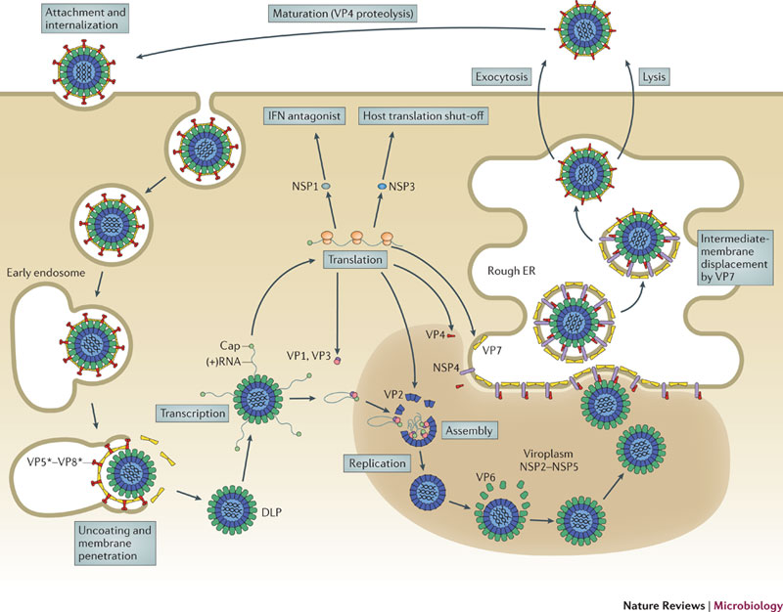

Slide 7
Mode of Transmission:
Ingestion of contaminated food and water
Directly from faeces contaminated fingers
Occasionally by droplet infection
Children below 5 years are mostly affected
Adults are infected by contact with pediatric cases
Incubation period: 2-3 days
Pathogenesis:
Rota virus replicates in enterocyte near the tip of villi destroying enterocytes
Viral encoded toxin: early profuse, secretory diarrhea is caused by enterotoxin, NSP4.
Disruption of intestinal epithelium due to virus replication
Histologic changes of enterocytes that triggers enteric nervous system, intestinal secretion and immune response
The acute infection and diarrhoea normally resolves within 7 days in immunocompetent hosts.

Slide 8
Clinical symptoms:
Local infection:
Acute Gastroenteritis, severe in case of infants aged 6-24 months.
Infected Infants are unable to digest milk due to lactase deficiency caused by destruction of enterocytes
Diarrhoea, nausea and vomiting
Malabsorption of Na+, water, and disaccharides
Symptoms of Dehydration: decrease in urination, dry mouth and throat and feeling dizzy when standing up.
2. Systemic infection:
High grade Fever
Lymphocytosis and transient neutropenia.
3. Complication:
Febrile Convulsion in small children
Severe dehydration, hypotonia and shock

Slide 9
Laboratory diagnosis:
Specimen: faeces in early infection,
Viral antigen detection: solid phase agglutination, ELISA
Electron microscopy
EIA (enzyme immune assay): it is sensitive to detect virus in stool
Dip stick/ rapid test
PCR: For genotyping of Rotavirus
Virus culture: No cell line culture

Slide 10
Treatment:
Oral rehydration
Other supportive rehydration therapy to control loss of water and electrolytes
Vaccine: Two Oral rotavirus vaccines are currently licensed for use in infants
  RotaTeq® (RV5) is given in 3 doses at ages 2 months, 4 months, and 6 months
  Rotarix® (RV1) is given in 2 doses at ages 2 months and 4 months
Prevention and control:
Sanitation
Waste water treatment
Health professional should wash their hands with soap and water before and after patient contact.

