Slide 1

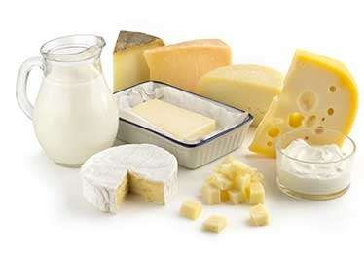
Class: II M.Sc MICROBIOLOGY
.
Dr . H. VAJIHA BANU
Assistant Professor
Department of Microbiology
Jamal Mohamed College (Autonomous)
Tiruchirappalli-620 020

Slide 2
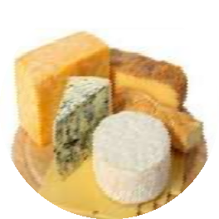
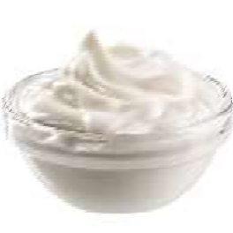

Cheese
FERMENTED FOOD PRODUCTS
Yoghurt
Kefir

Slide 3
FERMENTATION
Microorganisms are the key building blocks of fermented foods & beverages
The final product of fermentation is the result of chemical,physical & biological interactions between specific microbs & food
Bacteria ,Yeast & molds are involved in food fermentation
Sugar →Alchohol + Co2

Slide 4
Fermented milk products
Sour cream → Streptococcus sp.
Leuconostoc sp.
Butter milk → Streptococcus sp.
Leuconostoc sp.
Yoghurt → Streptococcus thermophilus,
Lactobacillus bulgaricus.
Cheese → Streptococcus sp.
Lactococcus lactis.
Kefir → Streptococcus lactis,
Lactobacillus bulgaricus, Yeast

Slide 5
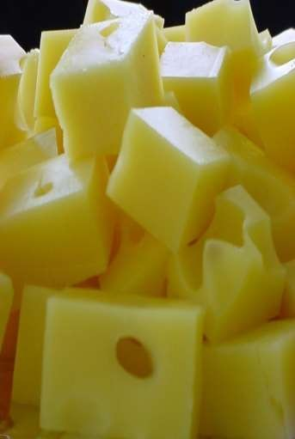
CHEESE
Cheese is a milk product
Method of preserving milk
Purely a product of microbial fermentation
Flavor & aroma changes depending upon the microbes being used
As a carrier for probiotics
Rich in nutrients : high content in protein,calcium,riboflavin, vitamin A&D

Slide 6
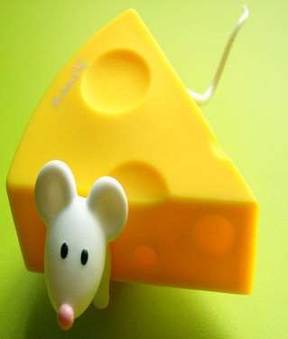
Production of cheese
A starter culture is added to pasteurized milk
Fermentation changes the sugar to acid cause curd
Rennet (enzyme) is added to speed up the process
Whey is drained off
Cut the curd & scalding stirring
And also cheddaring – squeezing & stretching the curd
After that milling & salting for prevent starter activity, flavour, release of whey
Moulding & pressing (further release of whey)
Ripening
Cheese produce

Slide 7
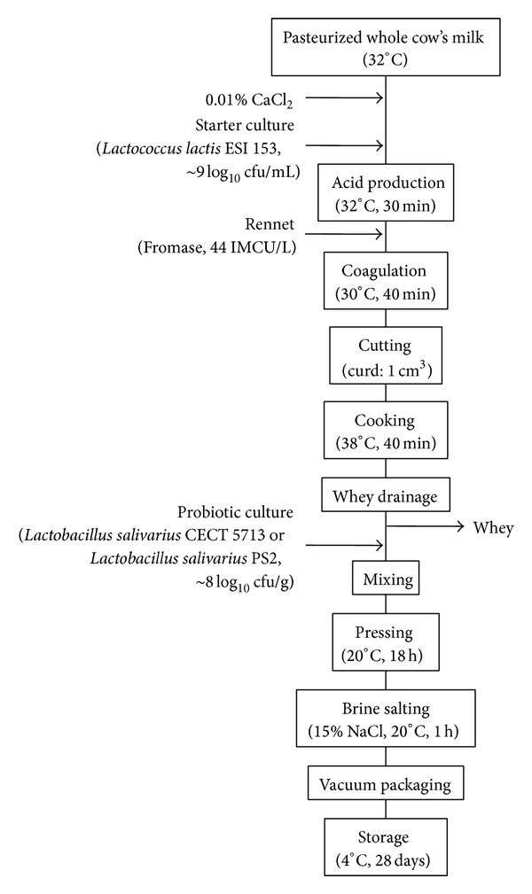
PRODUCTION OF CHEESE

Slide 8
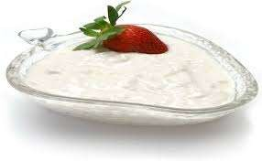
A fermented dairy product where by milk is inoculated with bacterial culture
Lactose →lactic acid →acid causes casein to denature & hold water into a semi-solid gel(yoghurt)
Lactococcus thermophilus & Streptococcus bulgaricus are involved in yoghurt production
S.thermophilus brings the pH of the milk down to 5.5
L.bulgaricus converts lactose to lactic acid
Taste depence on organoleptic aspects & no.of lactic enzymes contained.
yoghurt

Slide 9
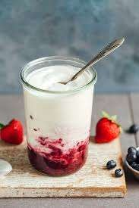
Production of yoghurt
Based on production & physical structure
Three methods:
Set yoghurt
Stirred yoghurt
Fluid yoghurt
Set yoghurt: fermentation of milk is carried out in a retail container
Stirred yoghurt: gel structure is broken before cooling & packaging
Fluid yoghurt: stirred yoghurt of low viscosity

Slide 10
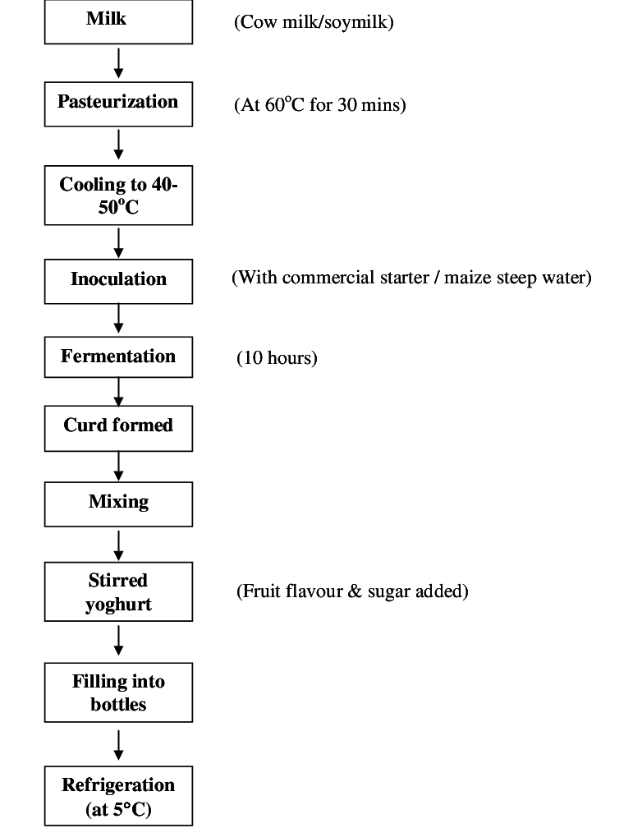
PRODUCTION OF YOGHURT

Slide 11
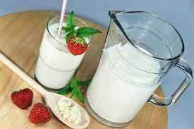
It is more powerful probiotic than yoghurt
Kefir is a fermented milk that contains a complex symbiotic mixture of lactic acid bacteria & mold
First produced in the caucasus
It is viscous, acidic & mildly alcoholic milk beverage
Kefir means “GOOD FEELINGS”.
KEFIR

Slide 12
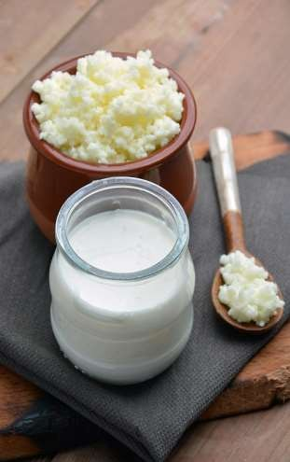
The main microorganisms are lactobacillus, torula, lactococcus, leuconostoc, streptococcus,saccharomyces, kluyveromyces.
Kefir is a fantastic source of many nutrients
It may protective against cancer
It has potent antibacterial property,anti-inflammatory,
Antioxidant properties, immune- stimulatory.
Improve bone health & lower the risk of osteoporosis.
KEFIR

Slide 13
Boiling of raw milk
Cooling 20-25⁰c
Incubation 20 25⁰c (kefir grains)
Production of kefir
Fermentation 20-25⁰c
(18-24 h)
Separation Kefir grains
Maturation & cooling 4⁰c
Stored 4⁰c

Slide 14
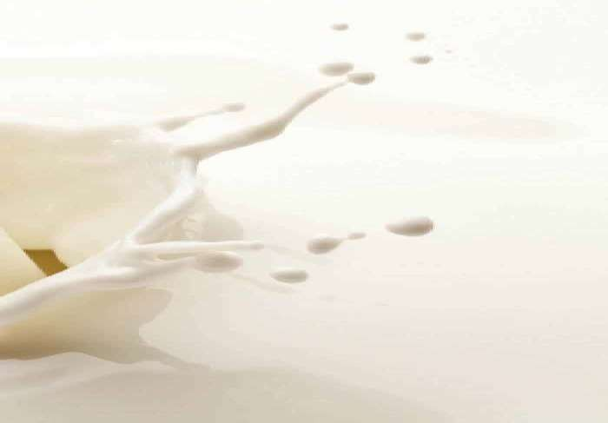
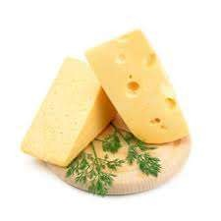
THANK YOU

