Slide 1
BIG DATA ANALYTICS (Hadoop) – In a Nutshell
Presented by
Dr.M.SABIBULLAH,
ASSOCIATE PROFESSOR,
PG & Research Dept. of Computer Science,
Jamal Mohamed College (Autonomous),
Trichy-620020.
Date: 18.11.2022

Slide 2
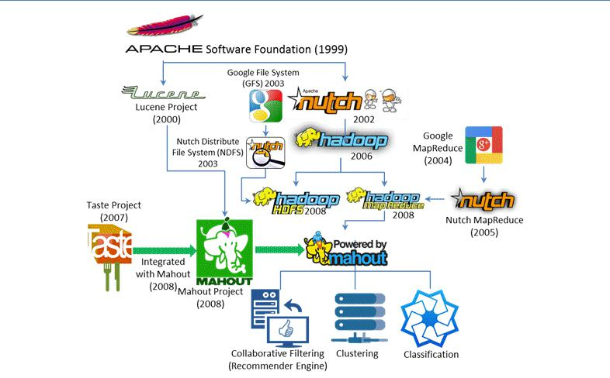
Evolution of GFS, HDFS, MapReduce and Hadoop

Slide 3
Apache Hadoop & Core Components
Apache Hadoop
    Developed by Apache Foundation
    Hadoop project adopted GFS architecture and developed HDFS
    Copies Data between Client (Local) & HDFS (Cluster)
    Heterogeneous Commodity Hardware
    Used for storing, processing, and analyzing the data
    It creates clusters of machines and coordinates work among them
  Hadoop Common
    Provides common utility and Java library functions.
Hadoop Core components
  Hadoop Distributed File System (HDFS)
    Self-healing Distributed and Shared Storage System for Hadoop.
    Rapidly distributes the data in a several nodes on a cluster.
    Provides fast performance and reliable replication of data.
  Hadoop YARN (Yet Another Resource Negotiator)
    Resource Management
  MapReduce 2.0 Architecture
    Used for parallel computations of massive datasets
Apache Mahout
    Library of Machine Learning - Supports different types of Algorithms

Slide 4

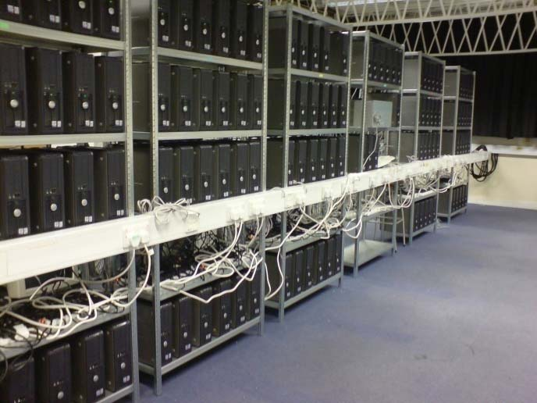
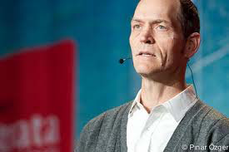
Hadoop is an open source implementation of MapReduce computational paradigm.
Apache Hadoop is an open-source software framework that supports data-intensive distributed applications, licensed under the Apache v2 license.
Created by Doug Cutting (chairman of board of directors of the Apache Software Foundation, 2010)

Slide 5
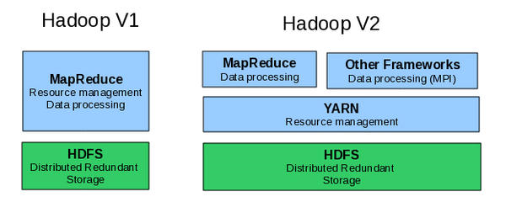
Hadoop Evolution
Map Reduce Limitations: Graph algorithms (Page Rank, Google), iterative algorithms.
Hadoop Core:

Slide 6
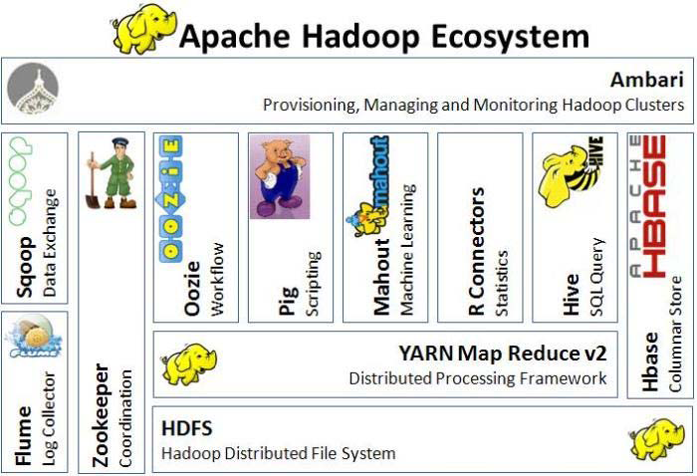
Apache Hadoop Ecosystem (Evolving) Components

Slide 7
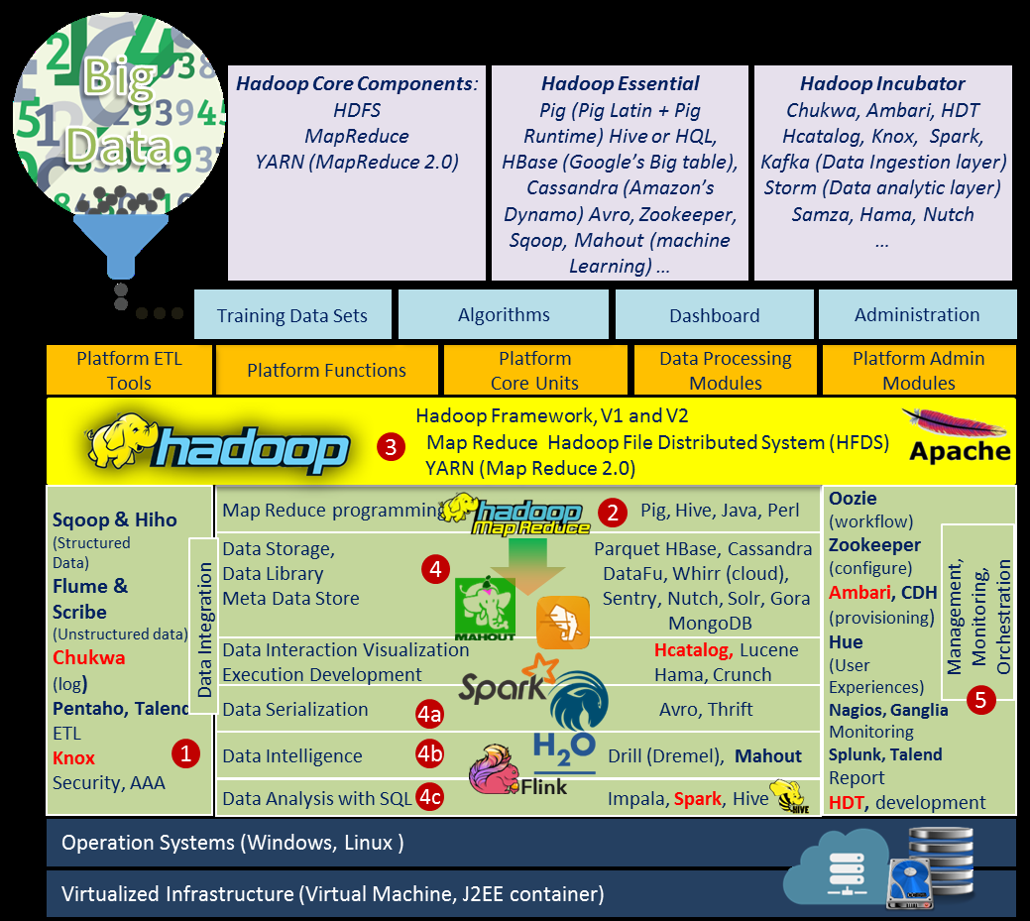
Hadoop Framework or Technology Stack & Ecosystem

Slide 8
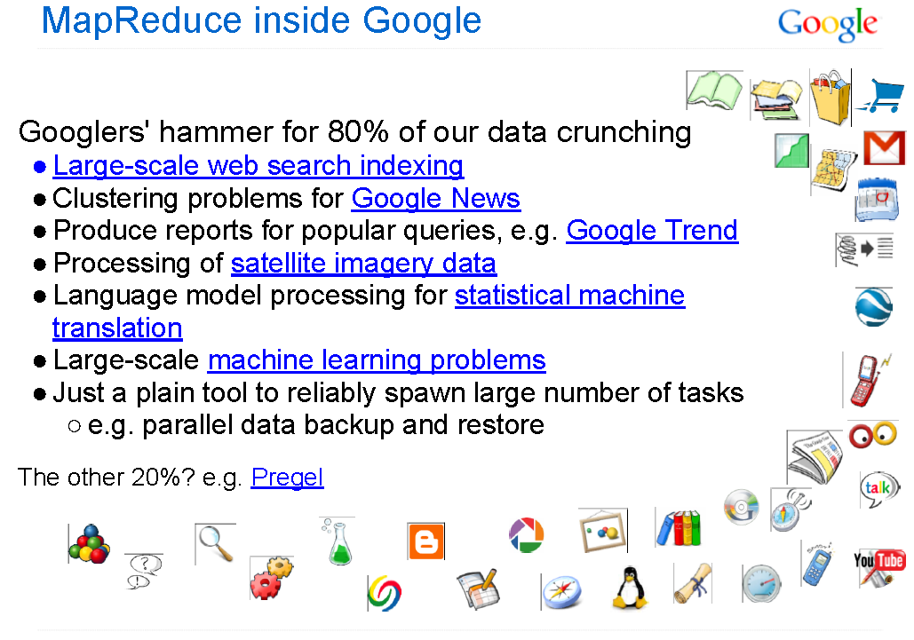
Map Reduce: More than 10000 applications in Google

Slide 9
Map Reduce
Advantage: MapReduce’s data-parallel programming model hides complexity of distribution and fault tolerance.
MapReduce (MR) = A Batch Query Processor
  Map = Distribute, Aggregate and Collaboration
  Reduce = Parallel Processing
Key philosophy:
  Make it scale, so you can throw hardware at problems.
  Make it cheap, saving hardware, programmer and administration costs (but requiring fault tolerance).
MapReduce is not suitable for all problems, but when it works, it may save you a lot of time.

Slide 10
MR Capability - Workloads
Google’s MapReduce is potentially capable to handle
FIVE types of workloads:
  Large-scale machine learning problems
  Clustering problems for the Google News and Google products
  Extraction of data used to produce reports of popular queries (e.g. Google Zeitgeist)
  Extraction of properties of web pages for new experiments and products (e.g. extraction of geographical locations from a large corpus of web pages for localized search), and
  Large-scale graph computations

Slide 11
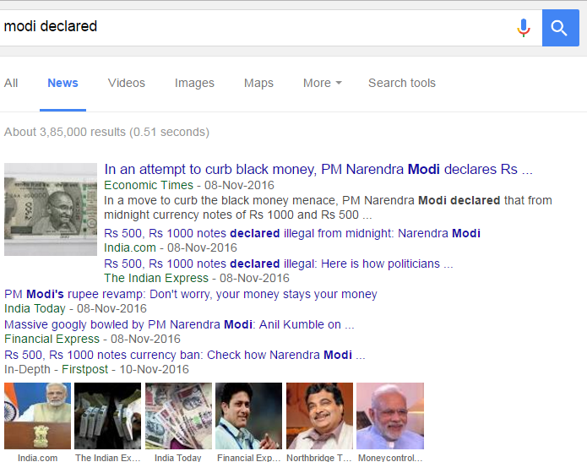
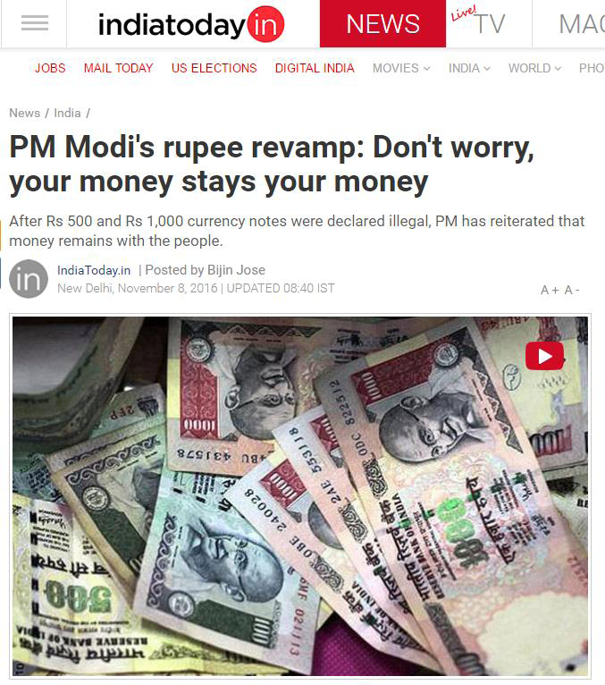
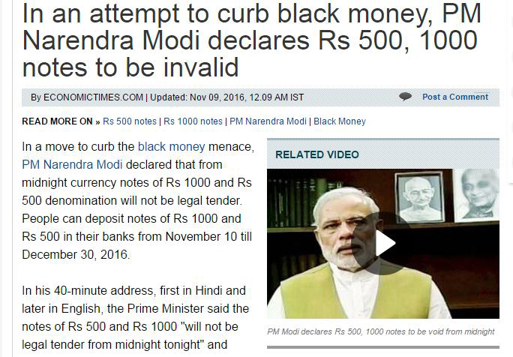
Clusters of News Articles (Grouping) from Google
[News from India Today & Economic Times]

Slide 12
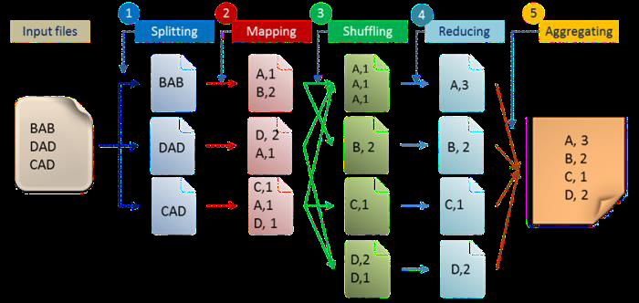
Five Steps MR – Programming Model
[1. Splitting, 2. Mapping (Distribution), 3. Shuffling and Storing, 4. Reducing (Parallelizing), 5. Aggregating]

Slide 13
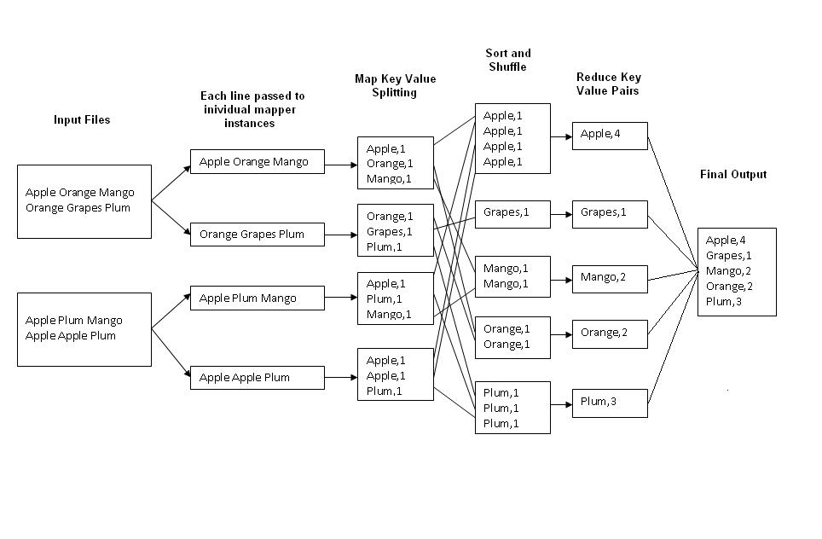
Map Reduce – Model

Slide 14
Architecture – BD on Analytics
MR Architecture
Fault Tolerance Graph Architecture
Streaming Graph Architecture

Slide 15
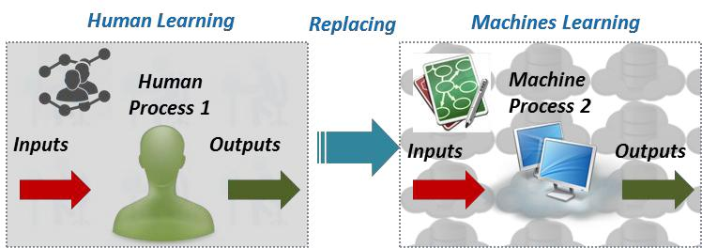
Replacing Human in Machine Learning Process

Slide 16
Major Techniques of ML - DM
Data Mining Process
Data Mining Techniques

Slide 17
Machine Learning
A core methodology in Data Analytics (DA) is Machine Learning (ML), is an area of computer science that aims to build a delivery systems and algorithms that learn from data.
The essence of ML is an automatic process of pattern recognition by a Learning Machine.
ML uses data to make any inferences or predictions to the specified tasks.
Historically, many terms to describe the equivalent meaning of ML, such as “Learning from data”, “Pattern Recognition”, “Data science”, “Data Mining”, “Text Mining” or even “Business Intelligence” and etc.
One of the Major techniques of ML is Data Mining
(DM –Looking for patterns of data), where
    Feature selection,
    Supervised learning (learning with labels),
    Unsupervised learning (without labels) and
    Deep learning (complex, mysterious and popular learning – able to identify features from raw data) / reinforcement learning or hybrid learning algorithms are utilized for the
    Purpose of ML tasks / methods like
      classification / clustering / association / regression / dimensionality reduction / batch-based collaborative filtering / decision-makings through decision trees.

Slide 18
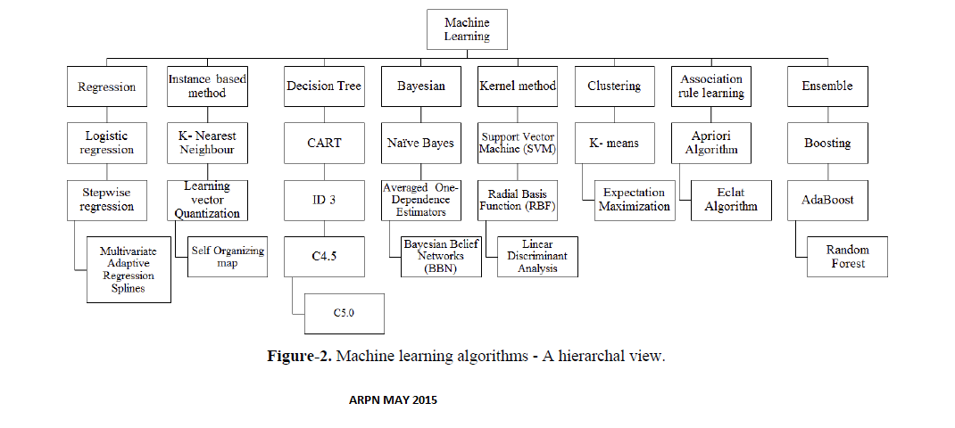
BD Supported -ML based Algorithms

Slide 19
BD Supported Languages
Python - Minimum codes
Scala
Java
R - For Statistical purpose - Visualization
Ruby and
Clojure
Note: Must thorough on Unix – shell commands
and SQL

Slide 20
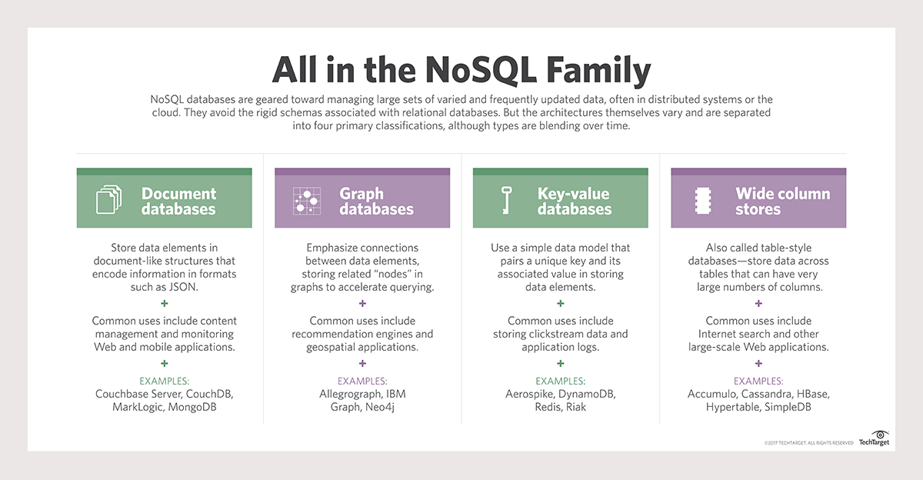
NOSQL (Not Only SQL) – Databases & its Examples
[Key-Value: Represent Data as a Collection of KV Pairs (known as Dictionary or Map)
Graph : Represent Data as a Network of nodes]

Slide 21
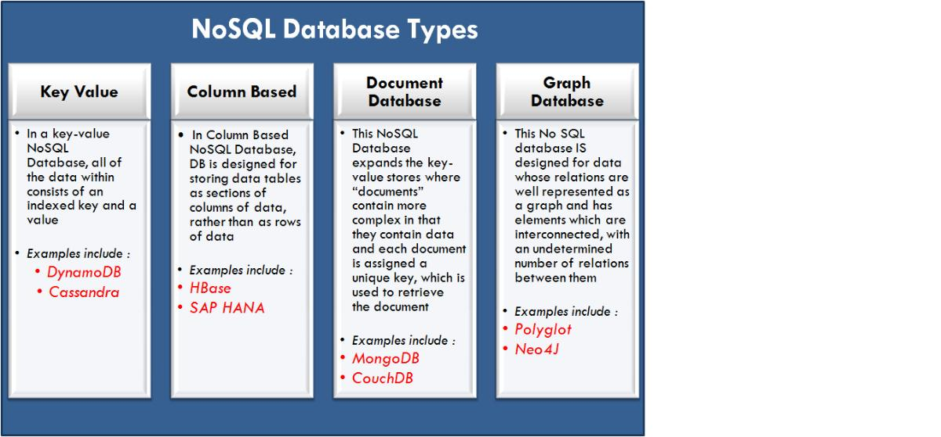
NOSQL - Types

Slide 22
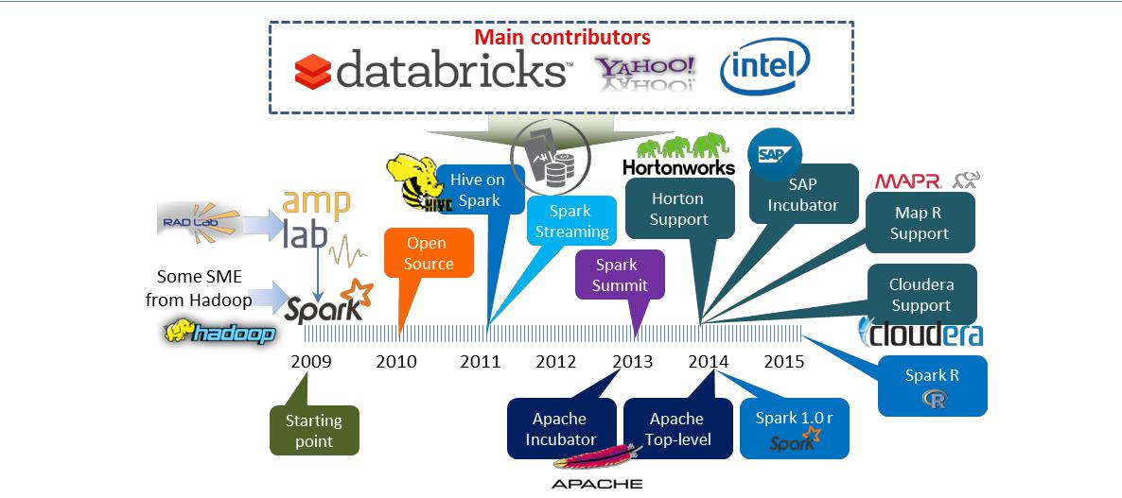
Spark – History

Slide 23
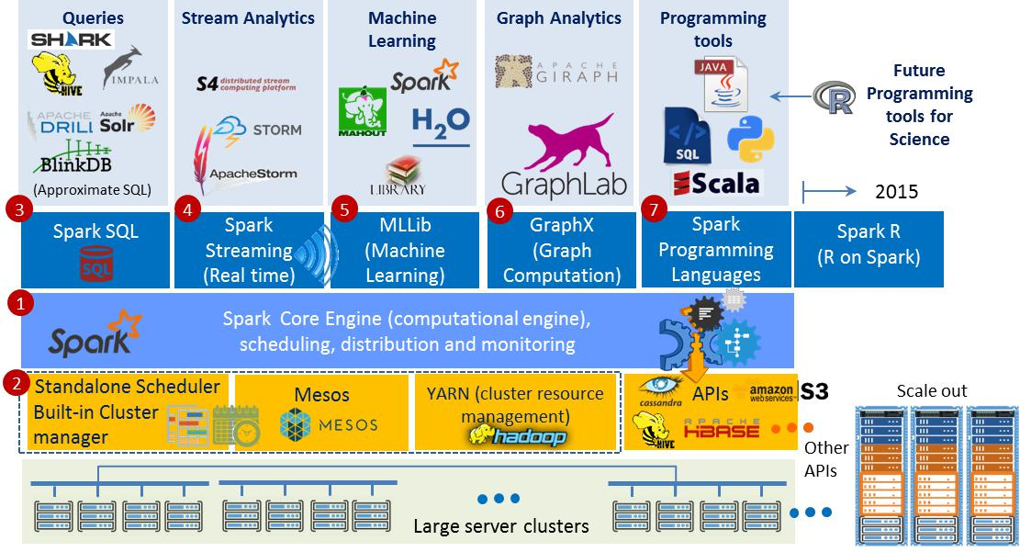
Spark Analytic - Stack

Slide 24
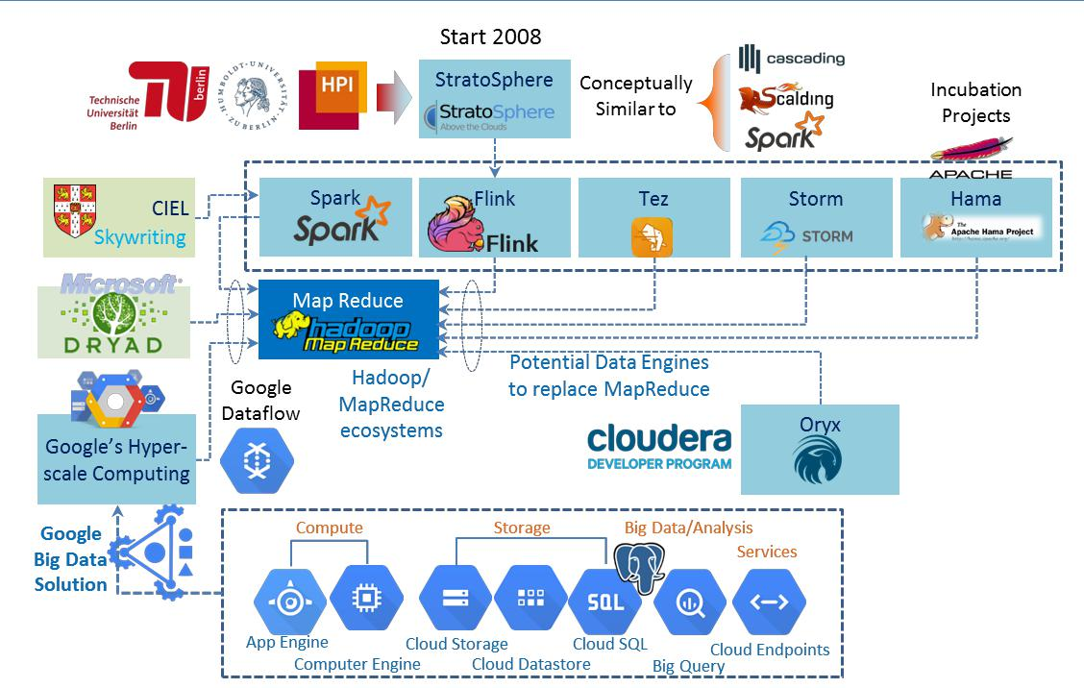
Potential data processing engines to replace MapReduce

Slide 25
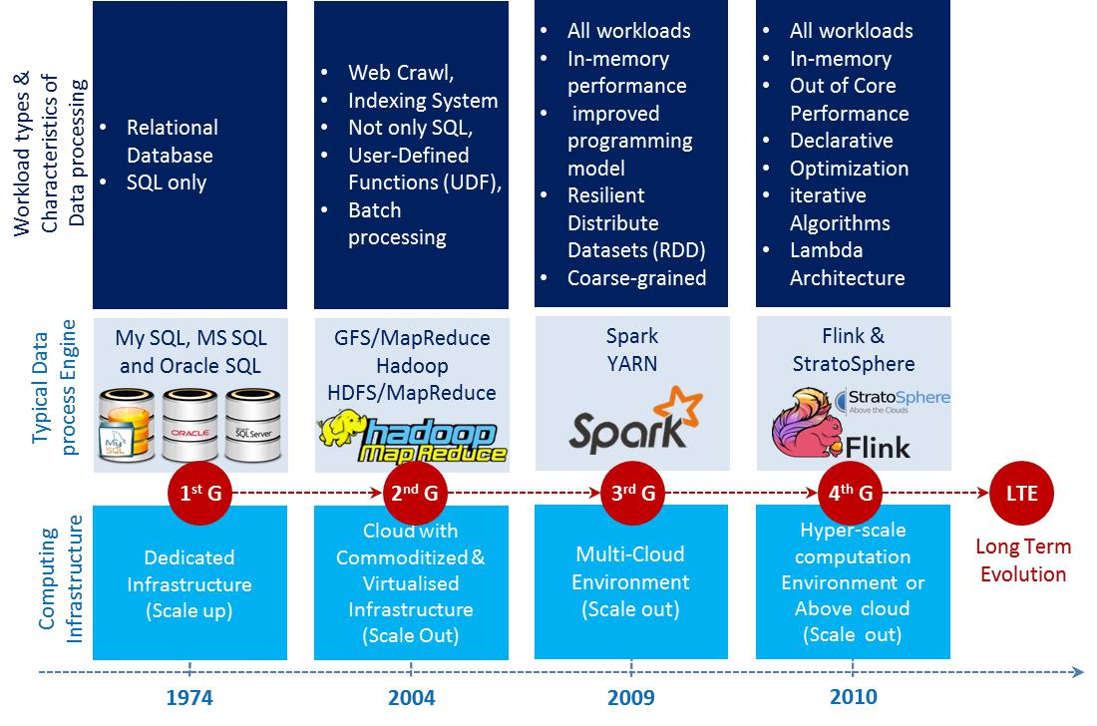
Evolution of Data and Big Data process engines

Slide 26
Computing Platforms
To analyze the massive data set in an effective manner, it is essential to have suitable hardware, software. i.e., we must have effective computing platforms, developing tools and algorithms.
Huge datasets are analyzed w.r.t data volume, band width of network used & different constraints of computations like End-User locations, algorithms / techniques used etc.,
Computational platforms for performing large data set analysis can be categorized into FOUR main models .
  Supercomputing
  Grid computing
  Cloud computing and
  Heterogeneous computing – Computer architecture that uses different types of computational processors such as GPP (General purpose processors) and GPU (Graphics Processing Unit)

Slide 27
Choosing a Platforms
Platforms based on Scaling:
  Horizontal Scaling (Scale-Out): Apache Hadoop, MR, Spark
  P to P Networks
  Vertical Scaling (Scale-Up): HPC clusters, Multi-core
  processors, GPU, FPGA, GPGPU
  Decision to be taken depends on
  Data Size
  Speed
  Throughput Optimization and
  Model Development

Slide 28
Typical Vendors in BD
MapR
Cloudera
Hortonworks
IBM
Teradata
Intel
AWS
Pivotal Software and
Microsoft

Slide 29
Major Industries Using BIG DATA
Healthcare
  Gene Sequencing, Bioinformatics, Pharmaceutical Research, Prediction of diseases
Banking
  Modeling true risks, Fraud Detection, Threat Analysis, Trade Surveillance, Credit Scoring and Analysis
Advertising
  Ad targeting, Recommendation Engine, Click Fraud Detection
Telecommunications
  Customer churn Prevention, Network Optimization, Calling data record analysis
Manufacturing
  Product Research, Engineering Analysis, Quality Analysis

Slide 30
Impact of BD Analytics in Health
Health BD Analytics can detect critical-clinical state-of-affairs to provide patients-wellness centric outcomes.
It will become a part of better solution-centric to predict epidemics, reduce preventable deaths by invoking proactive measures.
It explores the hidden behavioral patterns of people, controlling, escalating healthcare overheads and augment the QoL (Quality of Living) style to every patient.
According to a McKinsey report, big data analytics is the platform to deliver five values to healthcare: Right Living, Right Care, Right Provider, Right Value and Right Innovation.

Slide 31
Bio -Medical Big Data
It consists of molecule, cell structure and population data.
Bio medical data analytics is used to discover, development and delivery for personalized care.
Sharing in the bio-medical sciences can present sociological challenges.
Example:
    Data sharing in the neurosciences provides a valuable information

Slide 32
New Approach to Health BD Analytics
It can help in following areas:
  Clinical Treatments (Operations): Storage of healthcare data permits to perform analytics.
  Administration: Keeps track of all transactions records, EHRs data.
  Health Policy: Helps to governments to make decision on policy with respect to health, health budget.
  Clinical Research and Development: BDA will assist medical students to do research.
  Public health: To track infectious diseases outbreak, pattern analysis in improving public health.
  Patient Profile Analytics: To know about individuals health details.
  Device/Remote monitoring: Data from real time environment like CCTV footages.
  Outcome of clinical results/safety: During emergency & safety, access of patient’s record would assist.
  Fraud Detection: Fraudulent Insurance claim can be eliminated.

Slide 33
BD Technology Big Players in HC Applications
In Healthcare
    Diagnosis, Treatment and Re-admission are core applications areas in Health Care Analytics to probe the analysis
Technology Big Players
    Amazon
    Microsoft’s Health Vault
    Google, IBM’s Pure Data Solution-Diagnosis
    Watson Health-Super computer
    Watson Care Manager (WCM)-Treatment
    Piedmont Healthcare’s Patient First – CVD - Readmission

Slide 34
Examples of Big data analytics based applications
Text analytics
Web analytics
Multimedia analytics
Social analytics
Network analytics
Visual analytics
Genomic analytics and
Patient profile analytics

Slide 35
Identified Key issues in big data
Key issues identified in big data are
  Sufficient speed for large data size
  Familiarize the data
  Exploring data quality
  Displaying meaningful results

Slide 36
BD Applications – Promises of BD
Weather prediction
Medical diagnosis
Financial markets
Resource management
Computational social science
Smart buildings and cities

Slide 37
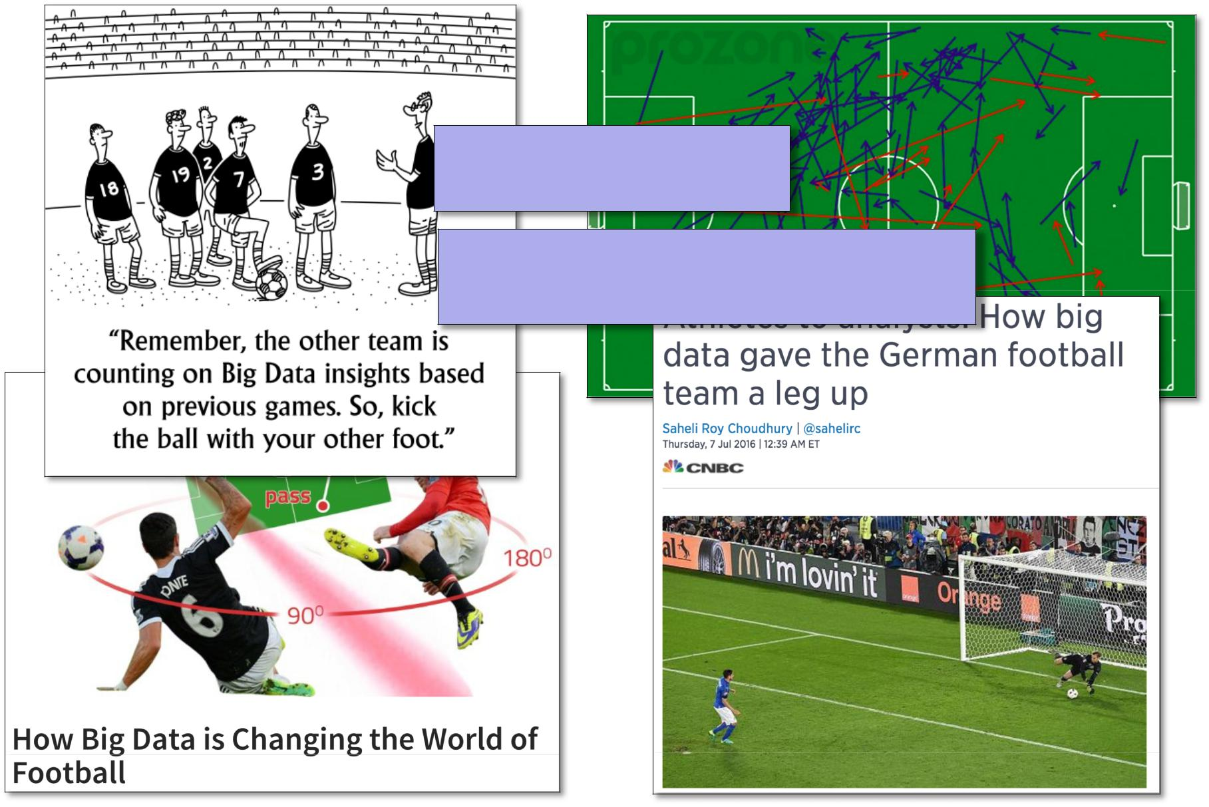
How BD has changed the world in Football
[Collect data, Do something with it]

Slide 38
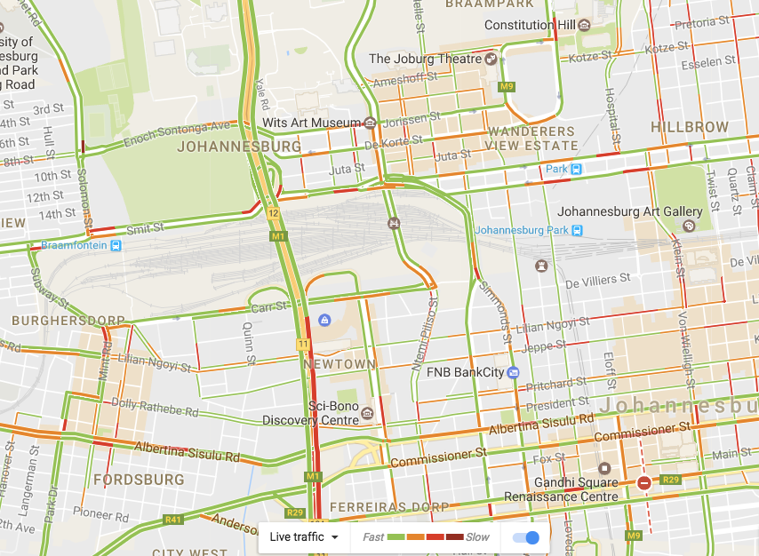
Eg., Promises of BD - Traffic Management
(1) Collect data
(2) Do something with it

Slide 39
Famous Sayings
Teachers are using their brain in 15%.
Students are using their brain in 40%.
Researchers are using their brain in 80%.
Best teacher teaches from heart and not from books.

Slide 40

Thank You

