Slide 1
VITAMIN C
Presented by
Dr.N.PACKIALAKSHMI
ASSISTANT PROFESSOR [DEPARTMENT OF MICROBIOLOGY]
JAMAL MOHAMED COLLEGE
TRICHY-620020

Slide 2
INTRODUCTION
Vitamin C -known as ascorbic acid - is a water-soluble vitamin.
Unlike most mammals, humans do not have the ability to make their own vitamin C. Therefore, we must obtain vitamin C through our diet.
Fun fact: "ascorbic acid" comes from the New Latin "scorbutus" meaning scurvy!

Slide 3
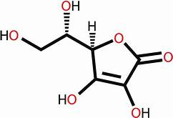
Structure and metabolism
Metabolism – oxidation/reduction – dehydroascorbic acid – dehydroascorbate reductase – glutathione (GSH)
Glutamate-cysteine glycine

Slide 4
RDA FOR VITAMIN C
10 mg/day prevents scurvy
Historic RDA’s 45-70 mg (60mg in 1989), 75mg in 2000

Slide 5
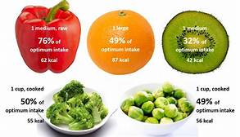
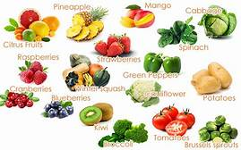
SOURCES OF VITAMIN C

Slide 6
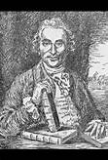
HISTORY OF VITAMIN C
17th century – sailors got scurvy on ships and ship surgeon, James Lind, prescribed lemon juice as preventative. Performed an experiment experiment that proved that lemon juice prevents scurvy.
We now know today that it is because of the Vitamin C in the lemon that prevents scurvy or a vitamin c deficiency.

Slide 7
FUNCTIONS OF VITAMIN C
Enhances absorption of iron.
Reduces iron to more absorbable ferrous form.
Chelates with ferrous ion to make it more soluble.
Antioxidant Activity:
Reacts and removes active oxygen species
Pro-oxidant Activity:
Reduces metals to their pro-oxidant formsn to make it more soluble

Slide 8
FUNCTIONS OF VITAMIN C
Hydroxylation of proline and lysine
post-translational reaction of procollagen
Hydroxylated collagen can be cross-linked to triple helix collagen
Scurvy - weak collagen Hydroxylation Reactions
Involves O 2 and metal coenzyme – (ferrous, cuprous)
Carnitine synthesis
Tyrosine synthesis & catabolism
Synthesis of Neurotransmitters – Dopamine – Norepinephrine – Serotonin
Bile acid synthesis

Slide 9
FUNCTIONS OF VITAMIN C
Synthesis of collagen, an important structural component of blood vessels, scar tissues, tendons, ligaments, and bone.
Synthesis of the neurotransmitters, norepinephrine critical to brain function and are known to affect mood.

Slide 10
FUNCTIONS OF VITAMIN C
Highly effective antioxidant protects proteins, lipids (fats), carbohydrates, and nucleic acid (DNA and RNA) from damage by free radicals.
Regenerates other antioxidants such as vitamin E.
Vitamin C is required for the synthesis of carnitine, a small molecule that is essential for the transport of fat to mitochondria, for conversion to energy.

Slide 11
DEFICIENCY OF VITAMIN C
Cardiovascular Disease
Stroke
Cataracts
Lead toxicity
Scurvy

Slide 12
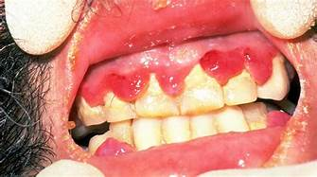
SCURVY
Bleeding gums
Petechiae
Easy bruising
Impaired wound healing and bone repair
Joint pain
Anemia

Slide 13
PEOPLE AT RISK FOR SCURY
People with chronic malnutrition or those that eat less than 2 servings of fruits/vegetables per day
Alcoholics
Elderly
Men who live alone (bachelor or widower scurvy)
Children
People on peculiar diets or food fads
People with other medical conditions that may prevent the intake and/or absorption of vitamin C
Dialysis patients
Malabsorption disorders
Severe dyspepsia

Slide 14
COMPLICATIONS
Skin problems: one of the first signs of scurvy is the development of perifollicular hyperkeratotic papules, These appear as reddish/bluish bruise-like spots surrounding hair follicles. The central hairs are twisted like corkscrews that may break easily. The papules may join together to form large areas of palpable purpura or ecchymoses (bruises).

Slide 15
COMPLICATIONS
Oral problems problems: gums may swell and become red, soft and spongy. Any slight friction may cause the gums to bleed. Often this results in poor oral hygiene and dental diseases.

Slide 16
COMPLICATIONS
Musculoskeletal problems: bleeding in the joints causes extreme discomfort and pain. Joints may be swollen and tender and the pain can be so severe that patients cannot walk.
Heart and lung problems: shortness of breath, low blood pressure, and chest pain leading to shock and death.

Slide 17
TREATMENT AND PREVENTION
Treatment is simply with vitamin C supplements taken orally.
The adult dose is 800-1000mg/day for at least 1 week, then 400mg/day until complete recovery.
In the U.S., the recommended dietary allowance (RDA) for vitamin vitamin C was recently recently revised revised upward from 60 mg daily for men and women. The RDA continues to be based primarily on the prevention of deficiency disease, rather than the prevention of chronic disease and the promotion of optimum health.
Infants who are being weaned from breast milk to cow's milk need a supplement containing vitamin C.

Slide 18
TOXICITY OF VITAMIN C
UL adults: 2000mg/d
Osmotic diarrhea
Oxalate kidney stones
Decreases uric acid reabsorption resulting in increased risk of gout
Affects diagnostic tests in feces and gout – fecal blood – urinary glucose

