Slide 1
Predicate Logic
By
Dr. G. Ravi
Head of the Department and Associate Professor
Department of Computer Science

Slide 2
Predicate Logic
Standard Logic Symbols
Representing simple facts in Logic
Representing Instance and Isa relationships
Computable functions and predicates
Resolution
Natural deduction

Slide 3
Standard Logic Symbols
v Or
→ Material Implication
∧ And
∃ There Exists
∀ For All
¬ Not

Slide 4
Representing Simple Facts in Logic
Using propositional logic
Represent real-world facts as logical propositions
written as well-formed formulas (wff’s)
Examples:
It is raining RAINING
It is sunny SUNNY
It is Windy WINDY
If it is raining, then it is not sunny RAINING → ¬SUNNY

Slide 5
Representing Simple Facts in Logic
……….
Examples
Socrates is a man SOCRATESMAN
Plato is a man PLATOMAN
All men are mortal MORTALMAN
Can’t draw any conclusion about similarities between Socrates and
Plato
Can’t capture the relationship between any individual being a man
and that individual being a mortal

Slide 6
Representing Simple Facts in Logic
……….
Using predicate logic
Example:
Socrates is a man man(socrates)
Plato is a man man(plato)
All men are mortal ∀X (man(X) → mortal(X))
=> mortal(socrates)

Slide 7
Representing Simple Facts in Logic
……….
Propositional logic vs. predicate logic
– Using propositional logic
• Theorem proving is decidable
• Cannot represent objects and quantification
– Using predicate logic
• Can represent objects and quantification
• Theorem proving is semi-decidable

Slide 8
Representing Simple Facts in Logic
1. Marcus was a man.
2. Marcus was a Pompeian.
3. All Pompeians were Romans.
4. Caesar was a ruler.
5. All Romans were either loyal to Caesar or
hated him.
6. Every one is loyal to someone.
7. People only try to assassinate rulers they
are not loyal to.
8. Marcus tried to assassinate Caesar

Slide 9
Representing Simple Facts in Logic
1. Marcus was a man.
man(Marcus)
2. Marcus was a Pompeian.
Pompeian(Marcus)
3. All Pompeians were Romans.
∀x: Pompeian(x) → Roman(x)
4. Caesar was a ruler.
ruler(Caesar)

Slide 10
Representing Simple Facts in Logic
5. All Romans were either loyal to Caesar or
hated him.
inclusive-or
∀x: Roman(x) → loyalto(x, Caesar) ∨ hate(x, Caesar)
exclusive-or (XOR)
∀x: Roman(x) →[(loyalto(x, Caesar) ∨
hate(x, Caesar)) ∧
¬ (loyalto(x, Caesar) ∧
hate(x, Caesar))]

Slide 11
Representing Simple Facts in Logic
6. Every one is loyal to someone.
∀x: ∃y: loyalto(x, y) ∃y: ∀x: loyalto(x, y)
∀x: ∃y: loyalto(y, x)
7. People only try to assassinate rulers they are
not loyal to.
∀x: ∀y: person(x) ∧ ruler(y) ∧ tryassassinate(x, y)
→ ¬ loyalto(x, y)
8. Marcus tried to assassinate Caesar.
tryassassinate(Marcus, Caesar)

Slide 12
Representing Simple Facts in Logic
Use these statements to answer the question.
Was Marcus loyal to Caesar?
To produce a formal proof, reasoning backward from the desired goal. ¬ (loyalto(Marcus,Caesar)
This attempts fails, however, since there is no way to satisfy the goal person(Marcus).

Slide 13
Representing Simple Facts in Logic
¬ (loyalto(Marcus,Caesar)
(7, substitution)
person(Marcus) ∧ ruler(Caesar) ∧
tryassassinate(Marcus, Caesar)
(4 ,Substituion)
person(Marcus) ∧ tryassassinate(Marcus, Caesar)
(8 ,substtution)
person(Marcus)
(9 substitution)
man(Marcus)
We can satify the goal and produce a proof that Marcus was not loyal to Caser.
9. All men are people ∀X : (man(X) → person(X))

Slide 14
Representing Simple Facts in Logic
Three important issues must be addressed in the process of converting English sentence into logical statements and using the those statements to deduce new ones.
Many English sentences are ambiguous. Chossing the correct interpretation may be difficult.
There is often a choice of how to represent knowledge.
Obvious information may be necessary for reasoning.
We may not know in advance which statements to
deduce (P or ←P).

Slide 15
Representing Instance & Isa Relationships
Pompeian(Marcus)
∀x: Pompeian(x) → Roman(x)
instance(Marcus, Pompeian)
∀x: instance(x, Pompeian) → instance(x,
Roman)
instance(Marcus, Pompeian)
isa(Pompeian, Roman)
∀x: ∀y: ∀z: instance(x, y) ∧ isa(y, z) →
instance(x, z)

Slide 16
Make an Exception
Example
Paulus was a Pompeian. Paulus neither
hate Caesar nor are loyal to him”
Pompeian(Paulus) ∧ ¬[loyalto(Paulus,
Caesar) v hate(Pualus, Caesar)]
=> make the knowledge base inconsistent

Slide 17
Make an Exception
Solution:
– Modify the original assertion to which an
exception is being made.
∀X: Roman(X) ∧ ¬eq(X, Paulus) →
loyalto(X, Caesar) v hate(X, Caesar)
– Problem arises when information is
incomplete and it not possible that no
exceptions apply in a particular instance.

Slide 18
Computable Functions and Predicates
Computable predicates
greater-than(1, 0) less-than(0, 1)
greater-than(2, 1) less-than(1, 2)
greater-than(3, 2) less-than(2, 3)
…. ….
Computable functions
greater-than(2 + 3, 1)

Slide 19
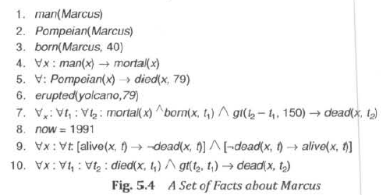
Computable Functions and predicates
Question: Is Marcus alive now?
Example

Slide 20
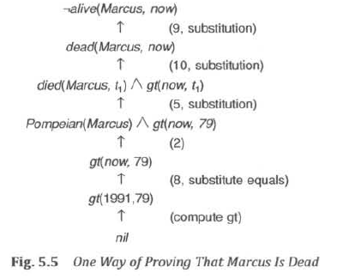
Computable Functions and predicates

Slide 21
Resolution
Refutation proof procedure.
Reduces some of the complexity because it operates on statements that have been converted to a single canonical form.
To prove a statement , resolution attempts to show that the negation of statement produces a contradiction with the known statements.

Slide 22
Resolution in Propositional Logic
Suppose a set of axioms(propositions) is given. Convert all propositions of this set to clause form. The resolution algorithm is given as follows.
Algorithm for propositional resolution
1.Convert all propositions to clause form.
2.Negate P and convert the result to clause form. Add it to the set of
clauses.
3.Repeat until either a contradiction is found or no progress is possible.
(a) Take any two clauses as parent clauses.
(b) Resolve these two clauses. The resulting clause is called resolvent.
(c ) if the resolvent is empty clause then a contradiction is found. If not,
then add resolvent to the set of clauses.
Suppose following propositions are given and we have to prove R.

Slide 23
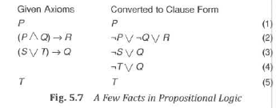
Resolution in Propositional Logic
Example

Slide 24
Resolution in Predicate Logic
Unification Algorithm
To determine contradictions, a matching procedure that compares
two literals and discovers there a set of substitutions that makes
them identical.
Covert to clause Form -Algorithm
To use formula in a proof requires a complex matching process.
The formula would be easier to work with if
1. It were flatter i.e., there was less embedding of components.
2. Quantifiers were separated from the rest of the so they did not
need to be considered.
Conjunctive normal form has both of these properties.

Slide 25
UNIFICATION
Example
The literals
hate(x, y)
hate(Marcus, z)
could be unified with any of the following substitutions:
(Marcus/x, z/y)
(Marcus/x, y/z)
(Marcus/x, Caesar/y, Caesar/z)
(Marcus/x, Polonius/y, Polonius/z)

Slide 26
UNIFICATION
The empty list, NIL, indicates that a match was found without any substitutions. The list consisting of the single value FAIL indicates that the unification procedure failed.
Algorithm: Unify(L1, L2)
I. If L1 or L2 are both variables or constants, then:
(a) If L1 and L2 are identical, then return NIL.
(b) Else if L1 is a variable, then if L1 occurs in L2 then return {FAIL}, else return (L2/L1).
(c) Else if L2 is a variable, then if L2 occurs in L1 then return {FAIL} , else return (L1/L2).
(d) Else return {FAIL}.
2. If the initial predicate symbols in L1 and L2 are not identical, then return {FAIL}.
3. If LI and L2 have a different number of arguments, then return {FAIL}.
4. Set SUBST to NIL. (At the end of this procedure, SUBST will contain all the substitutions used to unify L1 and L2.)
5. For i ← 1 to number of arguments in L1 :
(a) Call Unify with the ith argument of L1 and the ith argument of L2, putting result in S.
(b) If S contains FAIL then return {FAIL}.
(c) If S is not equal to NIL then:
(i) Apply S to the remainder of both L1 and L2.
(ii) SUBST: = APPEND(S, SUBST).
6. Return SUBST.

Slide 27

Conversion to clause form

Slide 28
Example
All Romans who know Marcus either hate Caesar or think that anyone who hates anyone is crazy
∀x, [ Roman(x) ∧ know(x, Marcus) ] ⇒
[ hate(x, Caesar) ∨
(∀y, ∃z, hate(y, z) ⇒ thinkCrazy(x, y))]

Slide 29
Step 1: Eliminate implications
Use the fact that x ⇒ y is equivalent to ¬x ∨ y
∀x, [ Roman(x) ∧ know(x, Marcus) ] ⇒
[ hate(x, Caesar) ∨
(∀y, ∃z, hate(y, z) ⇒ thinkCrazy(x, y))]
∀x, ¬[ Roman(x) ∧ know(x, Marcus) ] ∨
[hate(x, Caesar) ∨
(∀y, ¬(∃z, hate(y, z) ∨ thinkCrazy(x, y))]

Slide 30
Step 2: Reduce the scope of ¬
Reduce the scope of negation to a single term, using:
  ¬(¬p) ≡ p
  ¬(a ∧ b) ≡ (¬a ∨ ¬b)
  ¬(a ∨ b) ≡ (¬a ∧ ¬b)
  ¬∀x, p(x) ≡ ∃x, ¬p(x)
  ¬∃x, p(x) ≡ ∀x, ¬p(x)
∀x, ¬[ Roman(x) ∧ know(x, Marcus) ] ∨
[hate(x, Caesar) ∨
(∀y, ¬(∃z, hate(y, z) ∨ thinkCrazy(x, y))]
∀x, [ ¬Roman(x) ∨ ¬know(x, Marcus) ] ∨
[hate(x, Caesar) ∨
(∀y, ∀z, ¬hate(y, z) ∨ thinkCrazy(x, y))]

Slide 31
Step 3: Standardize variables apart
∀x, P(x) ∨ ∀x, Q(x)
becomes
∀x, P(x) ∨ ∀y, Q(y)
This is just to keep the scopes of variables from getting confused
Not necessary in our running example

Slide 32
Step 4: Move quantifiers
Move all quantifiers to the left, without changing their relative positions
∀x, [ ¬Roman(x) ∨ ¬know(x, Marcus) ] ∨
[hate(x, Caesar) ∨
(∀y, ∀z, ¬hate(y, z) ∨ thinkCrazy(x, y)]
∀x, ∀y, ∀z,[ ¬Roman(x) ∨ ¬know(x, Marcus) ] ∨
[hate(x, Caesar) ∨
(¬hate(y, z) ∨ thinkCrazy(x, y))]

Slide 33
Step 4: Move quantifiers
Move all quantifiers to the left, without changing their relative positions
∀x, [ ¬Roman(x) ∨ ¬know(x, Marcus) ] ∨
[hate(x, Caesar) ∨
(∀y, ∀z, ¬hate(y, z) ∨ thinkCrazy(x, y)]
∀x, ∀y, ∀z,[ ¬Roman(x) ∨ ¬know(x, Marcus) ] ∨
[hate(x, Caesar) ∨
(¬hate(y, z) ∨ thinkCrazy(x, y))]

Slide 34
Step 5: Eliminate existential quantifiers
We do this by introducing Skolem functions:
  If ∃x, p(x) then just pick one; call it x’
  If the existential quantifier is under control of a universal quantifier, then the picked value has to be a function of the universally quantified variable:
    If ∀x, ∃y, p(x, y) then ∀x, p(x, y(x))
Not necessary in our running example

Slide 35
Step 6: Drop the prefix (quantifiers)
∀x, ∀y, ∀z,[ ¬Roman(x) ∨ ¬know(x, Marcus) ] ∨
[hate(x, Caesar) ∨ (¬hate(y, z) ∨ thinkCrazy(x, y))]
At this point, all the quantifiers are universal quantifiers
We can just take it for granted that all variables are universally quantified
[ ¬Roman(x) ∨ ¬know(x, Marcus) ] ∨
[hate(x, Caesar) ∨ (¬hate(y, z) ∨ thinkCrazy(x, y))]

Slide 36
Step 7: Create a conjunction of disjuncts
[ ¬Roman(x) ∨ ¬know(x, Marcus) ] ∨
[hate(x, Caesar) ∨ (¬hate(y, z) ∨ thinkCrazy(x, y))]
becomes
¬Roman(x) ∨ ¬know(x, Marcus) ∨
hate(x, Caesar) ∨ ¬hate(y, z) ∨ thinkCrazy(x, y)

Slide 37
Step 8: Create separate clauses
Every place we have an ∧, we break our expression up into separate pieces
Not necessary in our running example

Slide 38
Step 9: Standardize apart
Rename variables so that no two clauses have the same variable
Not necessary in our running example
Final result:
¬Roman(x) ∨ ¬know(x, Marcus) ∨
hate(x, Caesar) ∨ ¬hate(y, z) ∨ thinkCrazy(x, y)
That’s it! It’s a long process, but easy enough to do mechanically

Slide 39
Resolution in Predicate Logic
1. Marcus was a man.
2. Marcus was a Pompeian.
3. All Pompeians were Romans.
4. Caesar was a ruler.
5. All Romans were either loyal to Caesar or hated him.
6. Every one is loyal to someone.
7. People only try to assassinate rulers they are not loyal to.
8. Marcus tried to assassinate Caesar.
Prove: Marcus hated Caesar.

Slide 40
Resolution in Predicate Logic
man(Marcus).
2. Pompeian(Marcus).
3. ∀x: Pompeian(x) → Roman(x).
4. ruler(Caesar).
5. ∀x: Roman(x) → loyalto(x, Caesar) ∨ hate(x, Caesar).
6. ∀x: ∃y: loyalto(x, y).
7. ∀x: ∀y: person(x)∧ruler(y)∧tryassassinate(x, y) → ←loyalto(x, y).
8. tryassassinate(Marcus, Caesar).
Prove: hate(Marcus, Caesar).

Slide 41
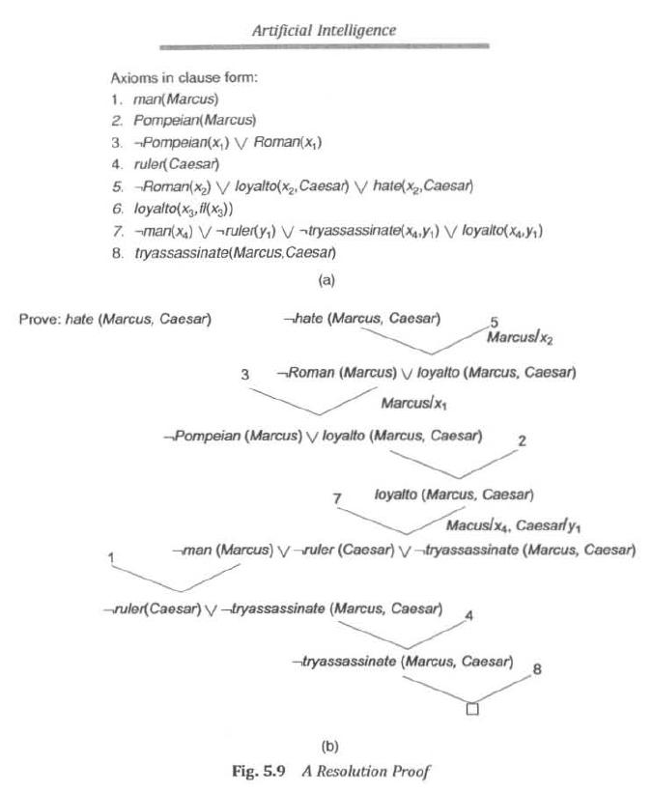

Slide 42
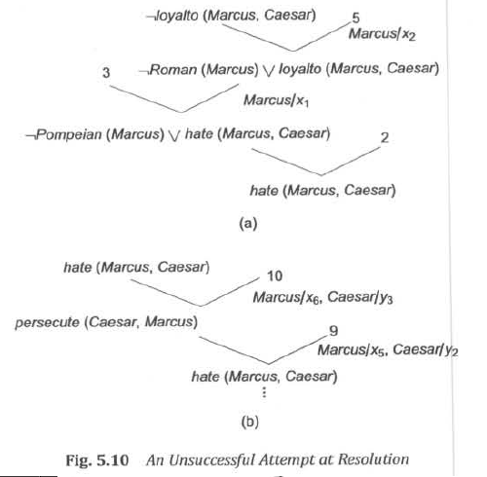
UNSUCCESSFUL ATTEMPT AT RESOLUTION - EXAMPLE

Slide 43
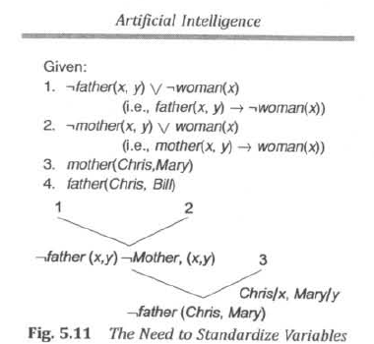
Need To Standardize Variables

Slide 44
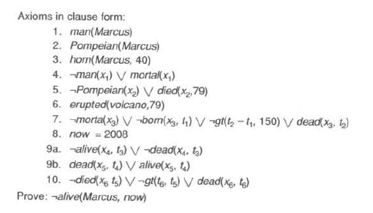
Using Resolution with Equality and Reduce - Example

Slide 45
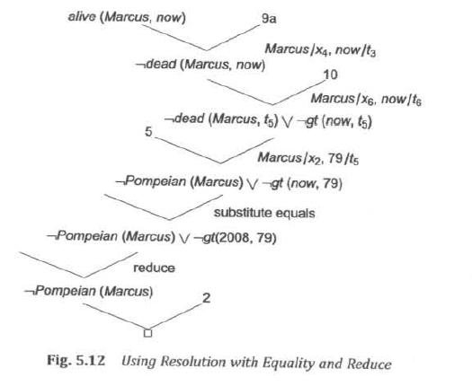
Using Resolution with Equality and Reduce - Example

Slide 46
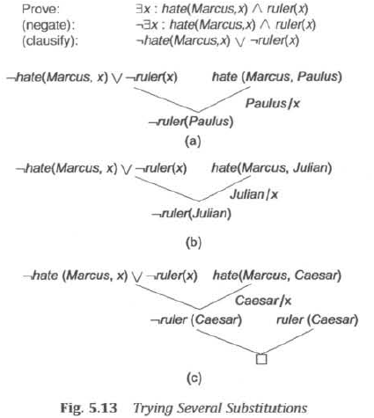
Need to Try Several Substitutions - Example

Slide 47
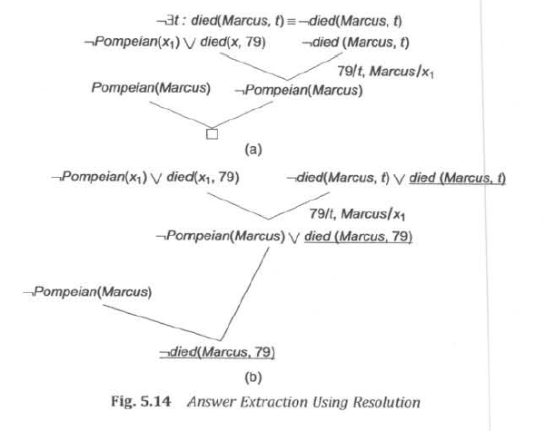
Answer Extraction Using Resolution -- Example

Slide 48
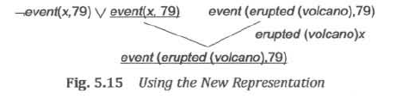
Proof Using New Representation
What happened in 79 AD?
To prove that something happened in 79 AD ∃x :event(x,79)
do not have any statements of the for event(x,y)
Change our representation from erupted(volcano, 79) to
Event(erupted (volcano),79)

Slide 49
Natural Deduction
Problems with resolution
The heuristic information contained in the original statements can be lost in the
transformation.
Example : All judges who are not crooked are educated.
∀x: judge(x) ∧ ¬ crooked(x) → educated(x) : This form suggests that some one
is educated.
¬ judge(x) v crooked(x) v educated(x) : This form deduces that someone is
not judge by showing that he is not
cooked and not educated.
It not best way to show that some
is not a judge.
People do not think in resolution.
Natural deduction: A way of doing machine theorem proving that corresponds
more closely to processes used in human theorem proving.

