Slide 1
RPR Test
Ms. A. Fasila Begum
Assistant Professor
Dept. of Microbiology
Jamal Mohamed College

Slide 2
Introduction
Serologic screening test for syphilis.
Rapid Plasma Reagin test (RPR).
It is a macroscopic, non treponemal, flocculation card test.
Rapid – Rapid test that can be done within few minutes.
Plasma – The sample is plasma or serum.
Reagin – Detects antibodies against substances released by the cells when they are damaged by Treponema pallidum.

Slide 3
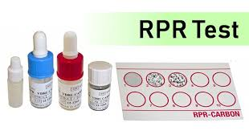
It detects the Ig M and Ig G antibodies to lipoidal material released from the damaged host cell
The lipoprotein like material and possibly caridiolipin released from the treponemes.

Slide 4
Principle
The antigen used in RPR is a modified VDRL (caridiolipin) antigen where the particles are coated with carbon or dye.
It is a non treponemal slide agglutination test for the qualitative and semi-quantitative detection of plasma reagin in human serum.
Carbon particles coated with a lipid complex are agglutinated when mixed with sample containing reagins.

Slide 5
The known RPR antigen consists of cardiolipin, lecithin and cholesterol bound to charcoal particles.
Charcoal makes the reaction visible.
If the patient has syphilis, the antilipid antibodies (reagin) in patient’s serum will cross react with the known RPR lipid antigens giving a visible clumping of the charcoal particles.

Slide 6
Reagents
1. Antigen used in RPR test
RPR antigen suspension is a stabilized combination of 0.03% cardiolipin, 0.20-0.22% lecithin, 0.9% cholesterol, 10% choline chloride, 0.0125M EDTA, 0.01875% charcoal, 0.01M Na2HP04, 0.01M KH2P04, 0.1% thimerosal in distilled water.
The antigen suspension is packaged in ampules. Store unopened ampules at 2° to 8°C; do not store the antigen in bright sunlight or in temperatures above 29°C; do not freeze. An unopened ampule of antigen is stable up to the expiration date.

Slide 7
2. Control serum samples:
Control serum samples are lyophilized reactive (R), minimally reactive (Rm), and nonreactive (N) control serum specimens on a card, or liquid or lyophilized serum samples of graded reactivity.
If quantitative tests are to be performed, a control serum that can be tittered to at least a 1:4 dilution should be used.
Store control cards or serum samples according to the manufacturer’s direction

Slide 8
3. 0.9% Saline.
4. Diluent (control):
Prepare a 2% solution of human serum in 0.9% saline, by diluting a human serum nonreactive for syphilis 1:50 in 0.9% saline

Slide 9
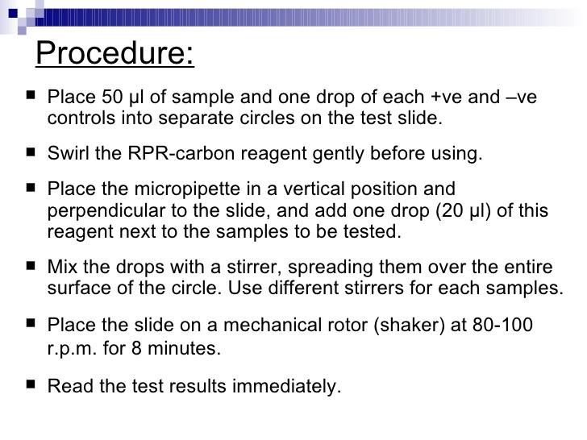
Procedure
Qualitative method

Slide 10
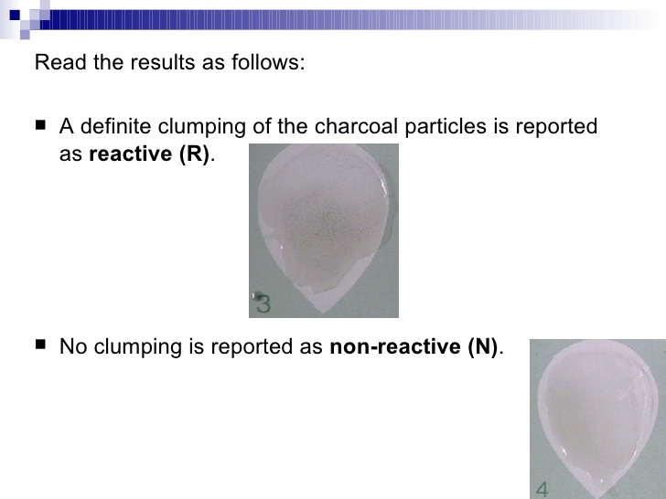

Slide 11
Semi Quantitative method
Using isotonic saline prepare serial dilutions of the test sample positive in the qualitative method 1:2, 1:4, 1:8, 1:16,1:32, 1:64, 1:128 and so on as follows:
For each specimen to be tested, add 100 µL of 0.9% saline into test tubes numbered 1 to 5.
Add 100 µL of specimen onto test tube 1. Mix the mixture. Avoid formation of bubbles. Transfer 100 µL of mixed sample from tube 1 to 2.
Repeat this serial dilution procedure in tube 3 to 4, and then 5.
Dispose 100 µL from test tube 5 after mixing.
Perform the qualitative test procedure using each dilution as test specimen.

Slide 12
RPR test positive (reactive) for
    Person infected with T. pallidum without symptoms.
    Other treponemal infection
    occasionally during pregnancy
    In acute malaria
    Leprosy
    Tuberculosis
    Viral pneumonia
    Leptospirosis
    Cancer
    Infectious mononucleosis
    Sometimes after certain vaccination.

Slide 13
Applications
It is card test because it is performed in commercially available card.
Rapid and cost effective test
Result can be visualized macroscopically
More sensitive than VDRL
Non treponemal test
Screening test for syphilis

Slide 14
Limitations
False positive reactions occur occasionally with the RPR Carbon Antigen test. Such reactions sometimes occur in drug abuse and in such diseases as lupus erythematous, mononucleosis, leprosy, viral pneumonia and after smallpox vaccinations.
Reactive specimens should be subjected to further serologic study, including quantitation, whenever feasible.
The RPR card test cannot be used to test spinal fluids.
There will not be a detectable immune response for 14-21 days after exposure.
This test is most useful during the secondary stage of syphilis when the presence of reagin peaks, with typical results >1:32. It is less sensitive to primary syphilis, although there is a low level of <1:16 in about 80% of those who come for medical intervention in the primary stage.

