Slide 1
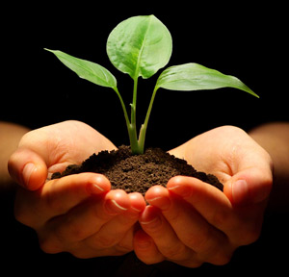
INTRODUCTION TO SOIL MICROBIOLOGY
Mrs.K.VIJAYALAKSHMI,
ASSISTANT PROFESSOR,
DEPT.OF MICROBIOLOGY,
JMC,TRICHY

Slide 8
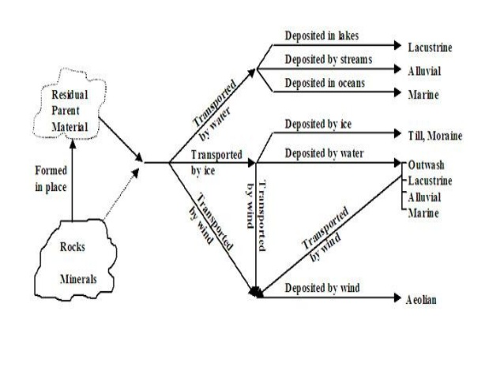

Slide 16
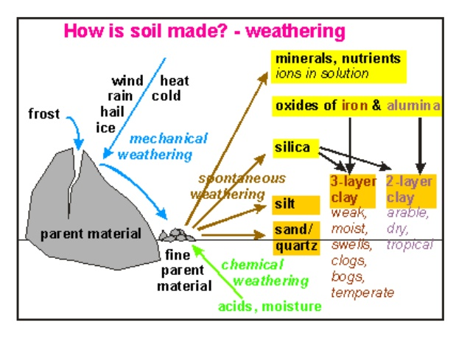

Slide 17
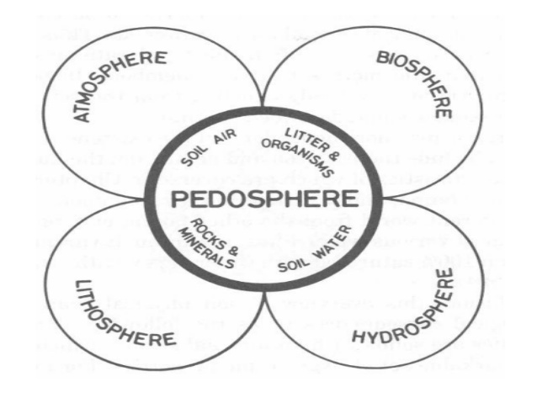

Slide 19
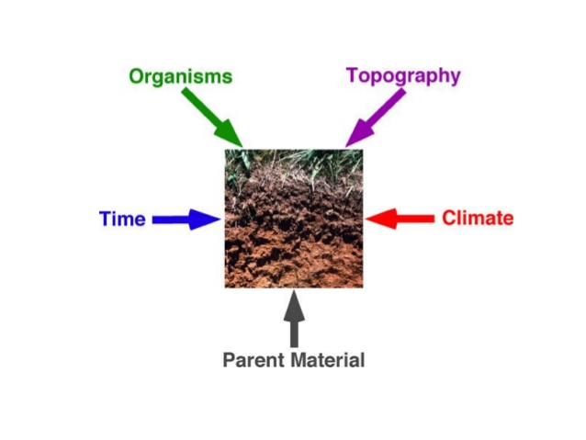

Slide 21
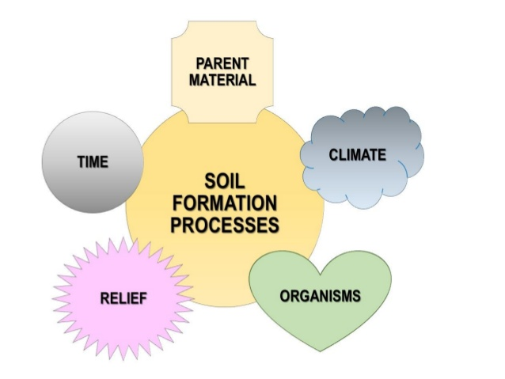

Slide 24
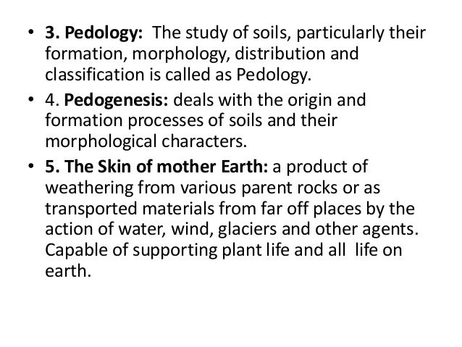

Slide 27
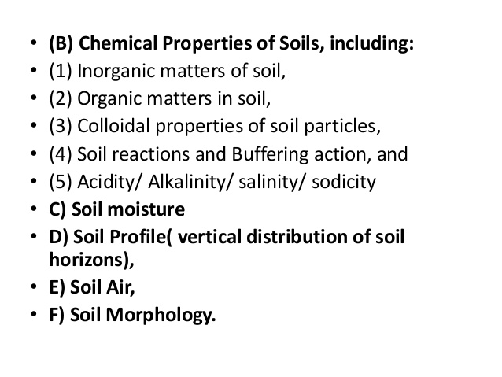

Slide 30
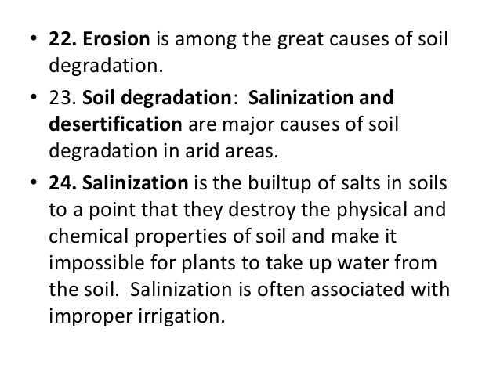

Slide 32
