Slide 1
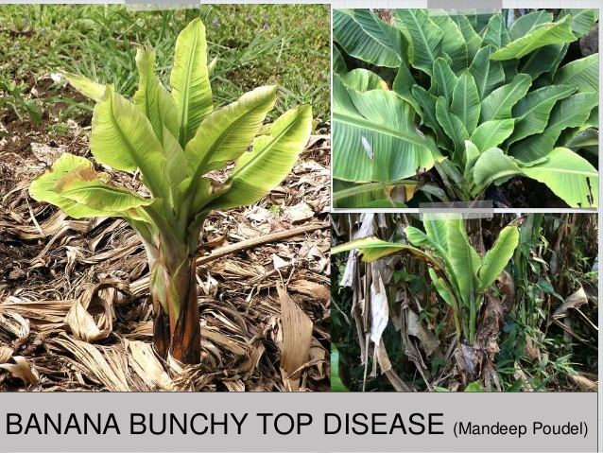
PRESENTED BY,
K.VIJAYALAKSHMI,
ASSISTANT PROFESSOR OF MICROBIOLOGY,
JMC,TRICHY-20

Slide 9
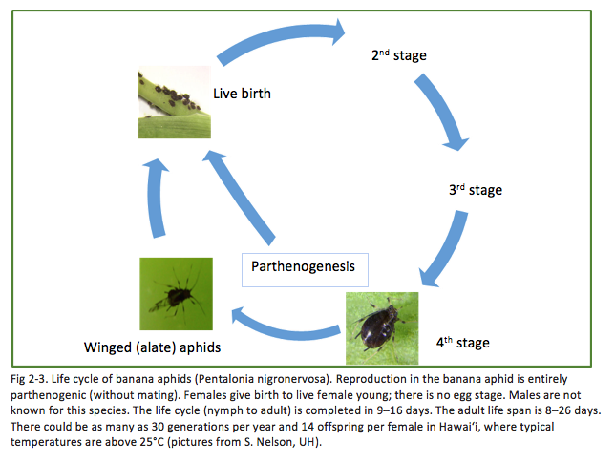

Slide 10
Banana bunchy top virus is transmitted by the banana aphid, Pentalonia nigronervosa (Fig 2-3).
Banana aphid management is a key factor in BBTV control.
When a banana aphid feeds on a BBTV-infected plant and moves to a healthy banana plant, it can transmit the virus through its piercing and sucking mouthparts.
Banana aphid colonies are often found under leaf petioles or in other hidden, tender areas of the banana plant (Fig. 2-4).
It is accepted by growers and Extension personnel that inspecting the most recently unfurled leaf (i.e., cigar leaf) of a banana plant is a good way to check for the presence of banana aphids.

Slide 11
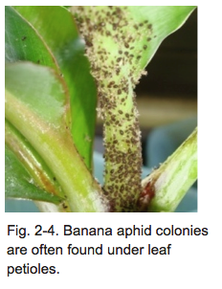

Slide 16
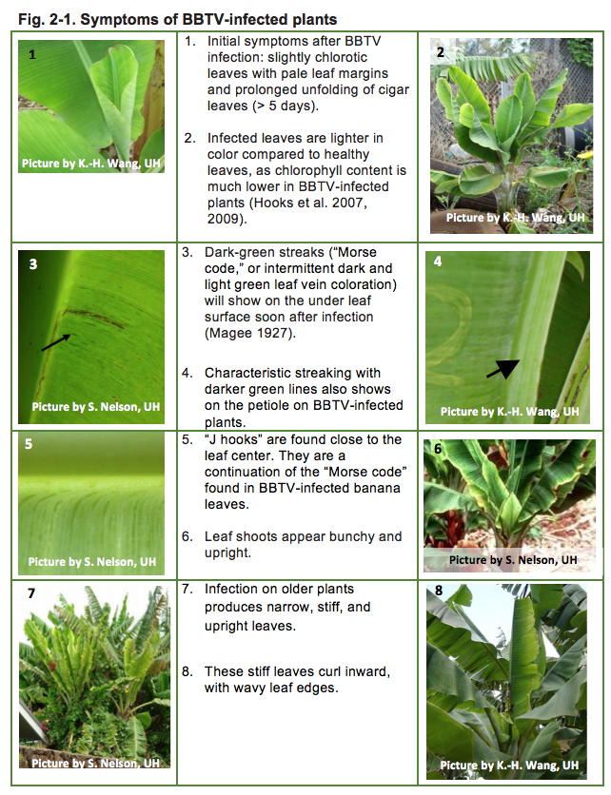

Slide 18
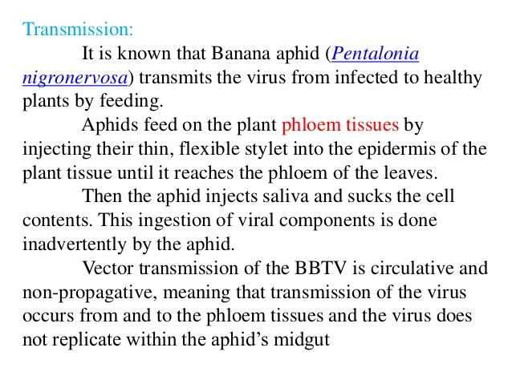

Slide 29
Disease Diagnosis
BBTD is identified based on the disease symptoms and use of diagnostic tools.
A range of diagnostic methods based on the Enzyme-linked Immunosorbent Assay (ELISA), Polymerase Chain reaction (PCR), Loop-mediated Isothermal Amplification) and RPA (recombinase polymerase amplification) have been established for the detection of BBTV in plants and aphid vectors.

