Slide 1
WHITE BLOOD CELLS
Class : II B.Sc Microbiology
Dr. H. VAJIHA BANU
Assistant Professor
Department of Microbiology
Jamal Mohamed College (Autonomous)
Tiruchirappalli-620 020

Slide 3
LEUCOCYTES
White blood cells or leucocytes are defined as a
white or colorless blood cells (corpuscle).
They are capable of amoeboid movement
Its chief functions is to protect the body against micro organisms causing disease.

Slide 4
LEUCOCYTES
Leucocytes are formed in the bone marrow from
myeloid stem cells and some being formed in the lymph nodes from lymphoid stem cells.
Leucocytes are the units of the body’s resistance to
infection, disease

Slide 5
CLASSIFCATION
They are classified in two main groups which are
granular or agranular.
This is dependent on whether they contain conspicuous ( visible) chemical filled cytoplasmic granules ( vesicles), that are made visible by staining.

Slide 6
DIFFERENCES BETWEEN A AND GRANULAR

Slide 7
CLASSIFICATION
Granular
Basophils
Neutrophils
Eosinophils
Agranular
Lymphocytes
Monocytes

Slide 8
GRANULAR LEUCOCYTES

Slide 9
BASOPHILS
Make up 0.5-1% of all white blood cells.
They are 8-10 micrometer in diameter
The nucleus contains 2 lobes
When stained, large cytoplasmic granules appear deep blue-purple.

Slide 10
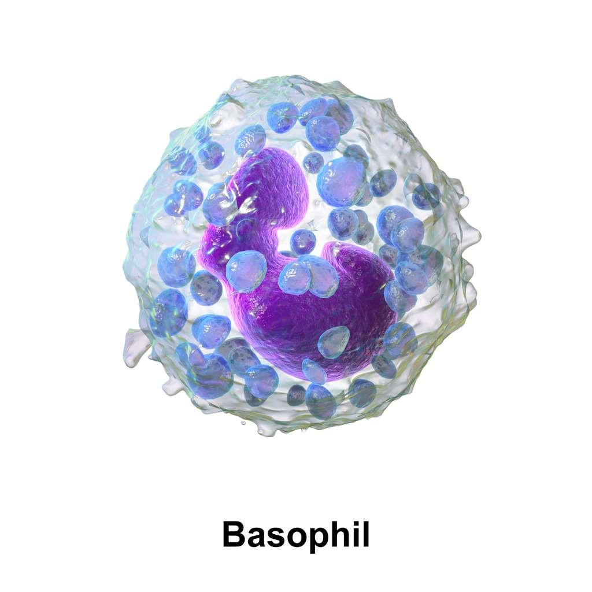

Slide 11
Liberate heparin, histamine, and
BASOPHILS FUNCTION
serotonin in allergic reactions that
intensify the overall inflammatory response.

Slide 12
NEUTROPHILS
Make up 60%-70% of all white blood cells.
They are normally 10-12 micro meters in diameter
The nucleus contains 2-5 lobes connected by thin
strand of chromatin
The cytoplasm has very fine, pale lilac granules

Slide 14
NEUTROPHILS FUNCTION
Its functions as a phagocyte
Destroy bacteria with lysozyme, defensins and
strong oxidocents such as superoxide anions, hydrogen peroxide and hydrochlorite anion.

Slide 15
EOSINOPHILS
Makes up 2-4% of all white blood cells.
They are 10-12 micrometer in diameter
Its nucleus has 2 or 3 lobes: large, red-orange granules fill the cytoplasm.

Slide 16
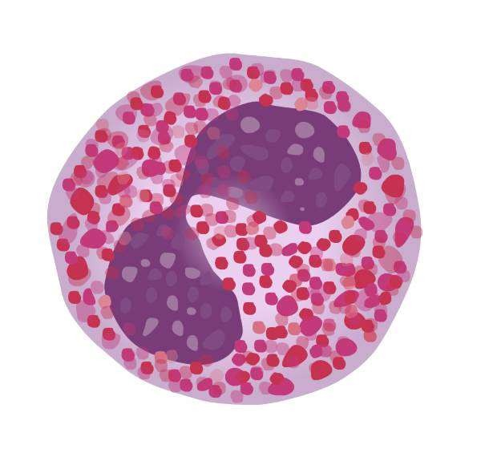

Slide 17
EOSINOPHILS FUNCTION
Combat the effects of histamine in allergic
reactions,
Phagocytize antigen-antibody complexes
Destroy certain parasitic worms.

Slide 18
AGRANULAR LEUCOCYTES

Slide 19
MONOCYTES
They are 12-20 micrometer in diameter
The nucleus is kidney shaped or horseshoe shaped
Cytoplasm is blue-gray and has foamy appearance.
Make up 3-8% of all white blood cells.

Slide 20
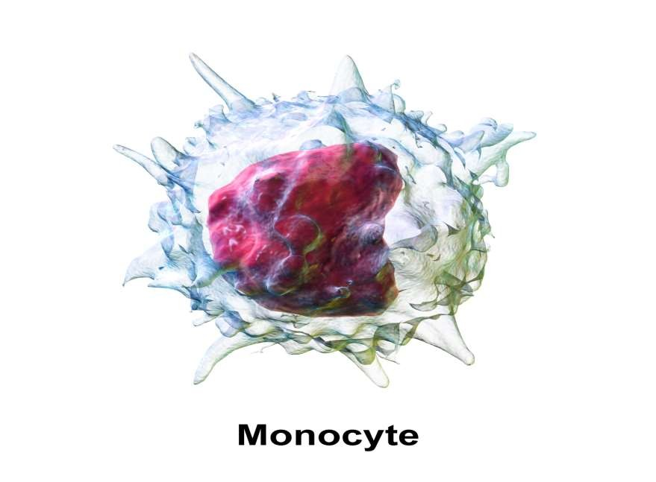

Slide 21
MONOCYTES FUNCTION
Phagocytosis this occurs after they transform into
fixed or wandering macrophages.

Slide 22
LYMPHOCYTES
Lymphocytes are divided in to three subtypes
T Cells
B cells
Natural killer cells

Slide 23
LEUCOCYTES
Make up 20-25% of all white blood cells.
Small lymphocytes are 6-9 micrometer in diameter
large lymphocytes are 10-14 micrometer in diameter

Slide 24
LYMPHOCYTES
nucleus is round or slightly indented
cytoplasm forms a rim around the nucleus that looks sky blue
the larger the cell, the more cytoplasm is visible.

Slide 26
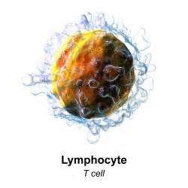

Slide 27
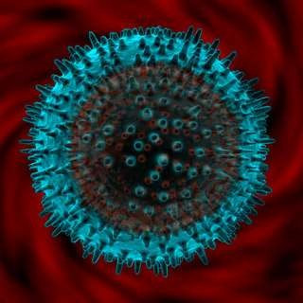

Slide 28
LEUCOCYTES FUNCTION
Mediate immune responses, including antigen- antibody reactions.
B cells develop into plasma cell, which secrete antibodies.
T cells attack invading viruses, cancer cells and transplanted tissue cells.
Natural killer cells attack a wide variety of infectious microbes and certain spontaneously arising tumor cells.

Slide 29
THANK YOU

