Slide 2
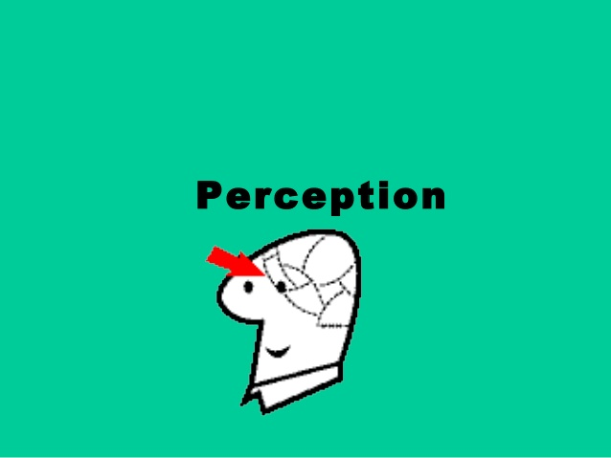

Slide 3
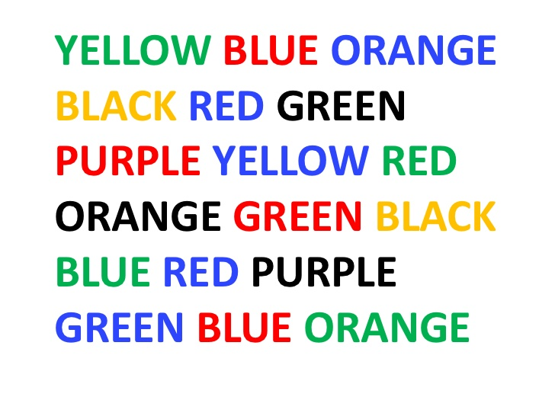

Slide 4
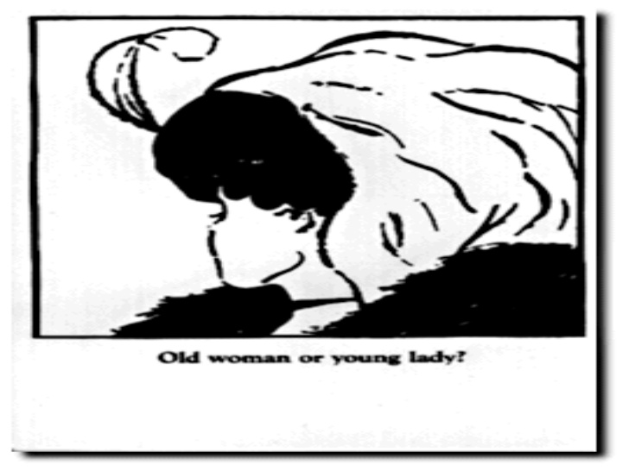

Slide 7
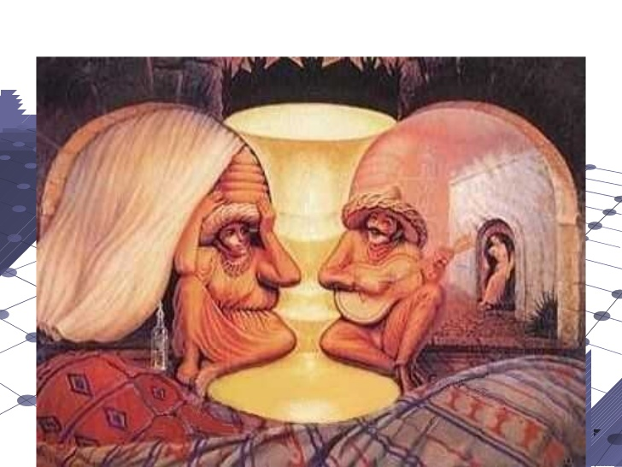

Slide 8
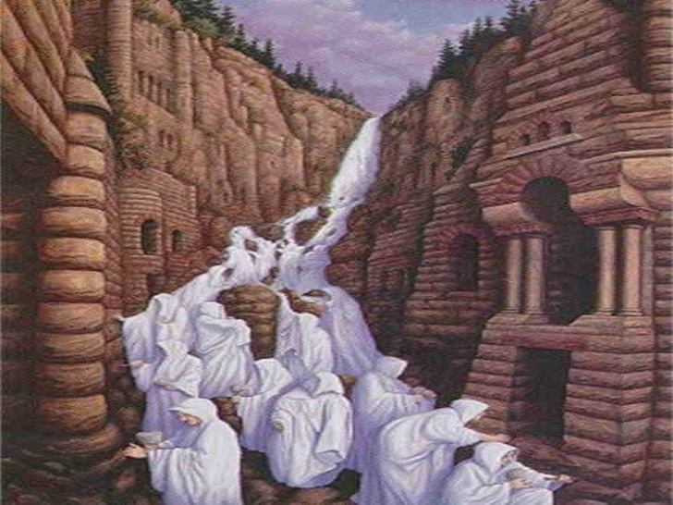

Slide 9
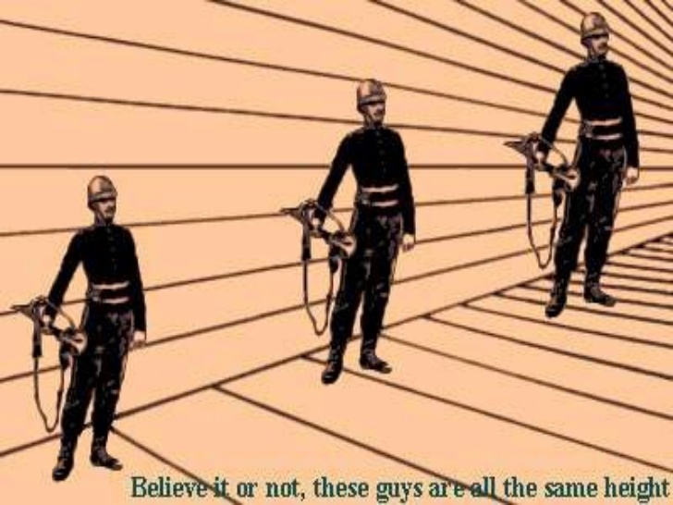

Slide 10
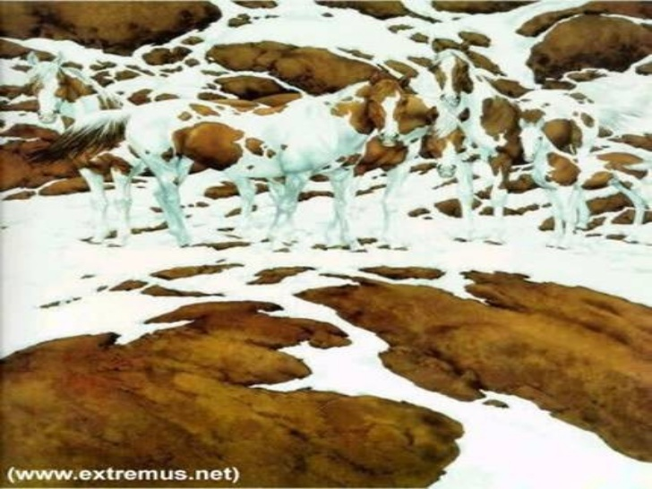

Slide 19
Factors influencing Perception
Factors in the perceiver
Attitudes
Motives
Interests
Experience
Expectations
Factors in the situation
Time
Work Setting
Social Setting
Perception
Factors in the Target
Novelty
Motion
Sounds
Size
Background
Proximity
Similarity

