Slide 1
Self-Learning Machines / Artificial Neural Networks
– An overview By
Prof. Dr.M.SABIBULLAH,
Associate Professor,
Department of CS & IT,
Jamal Mohamed College (Autonomous),
Trichirappalli- 620020.

Slide 2
Inspired Slogan
“Man should think and
Machine should work “ - IBM
Present scenario is……….
“Man should work and
Machine should think” - SAFI

Slide 3
What is BIT?
Bio - Technology
+
Information Technology = BIT
IT = Computer + Communication + Contents

Slide 4
Classification of some Computings
Nano-Computing
Parallel Computing
Distributed Computing
Quantum Computing
Grid Computing
Mobile Computing
Bio-Computing / Chemical Computing
Neuro Computing (Neural Networks)

Slide 5
TERMINOLOGY
Neural Information Processing (Neuro-Computing)
Computational Intelligence
Pattern Recognition Machine
Artificial Neural Systems
Adaptive Networks
Soft Computing Tool
Connectionism
Loosely Coupled Model
Self-Learning Machines
Massively Parallel Distributed Processor

Slide 6
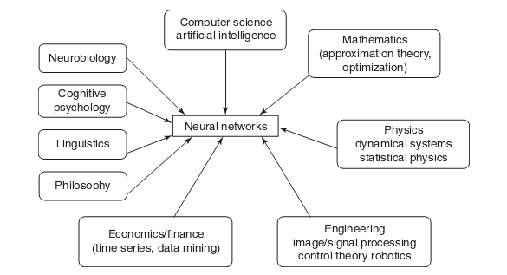
MULTI-DISCIPLINARY VIEW OF NEURAL NETWORKS
April 2007

Slide 7
BNN to ANN
Mimic the Brain Neuron to Artificial Neuron

Slide 8
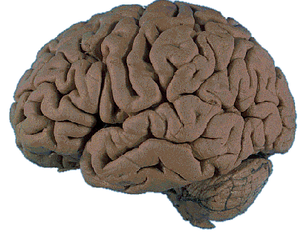
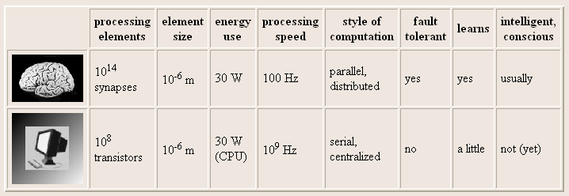
BRAIN COMPUTATION
The human brain contains about 10 billion nerve cells, or neurons. On average, each neuron is connected to other neurons through approximately 10,000 synapses.

Slide 9
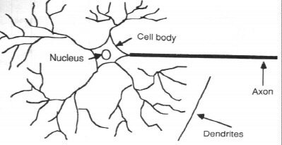
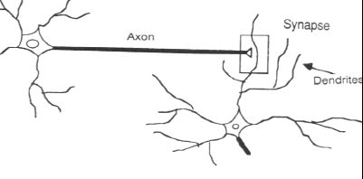
Biological Neural Network
Biological Neural Network Structure
“Neuron” consists “Cell Body” or Soma, containing “Cell Nucleus”. It process the Input and Outputs.
Cell Body having no. of “Dendrites”, single one is called “ AXON”.
Connection Junction is called “Synapse”.
* (Electro-Chemical contact between Neurons ).

Slide 10
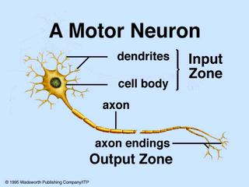
BIOLOGICAL (MOTOR) NEURON

Slide 11
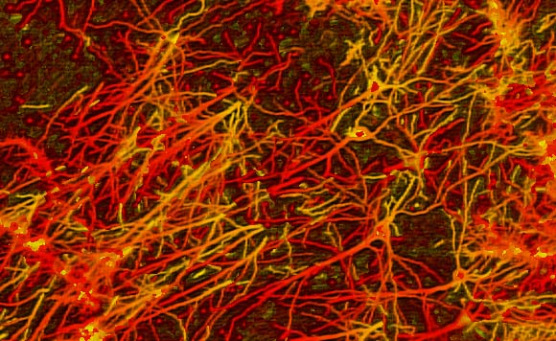
INTERCONNECTIONS IN BRAIN

Slide 12
Human Brain
Human brain has 5 Portals [ Sound, Visual Stimuli, Pain (Touch), Smell and Taste of entries for its inputs.
It has 100 billion neurons with 1015 interconnections.
Parallel connections exists between primary areas of the brain.
It adds enormous computational task
(ie., “Parallel Processing”).
“Neurotransmission” occurs by marvelous
“Bio-chemical factory”.
20% of neurons only used by Human brain, rest are idle.
If 1.1 litre blood per minute is not supplied to the human Brain, the patient will suffer from Cognitive problems. (Recent study in Hypertension-2009).

Slide 13
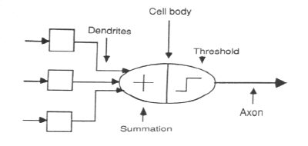
ANN Structure
Artificial Neural Network Structure

Slide 14
ANN Diagram
Neural Network Diagram
Target
Input
Neural Network including connections (Called Weights) between Neurons
Output
Compare
Adjust Weights

Slide 15
ANN-Development
AI : [ Conditions & Actions] - It is not structurally similar, as the intelligence is “Pre-programmed”.
Biological Neural Networks (Brain) – Learned organ
Artificial Neural Networks (ANN) - Training
ANN :(Self-Modifying Machines) Developed in 1960’s based on Human brain neurons.
It duplicates the brain function / Mimic brain structure.
It was inspired by biological neuron.
“Neuron”: Decision Maker /Intelligent Actor

Slide 16
Development
In 1943, Warren McCulloch (Neurophysiologist) and Walter Pitts
(18 year old Mathematician ) designed a simple NN using electrical circuits.
In late 1980’s, this field literally exploded and many researchers demonstrated the capabilities & possibilities of NN.

Slide 17
ANN
It is a field of Science that tricks to replicate brain like “Computings”.
It is a system loosely modeled on the human brain.
It is an attempt to stimulate within “specialized hardware” or “sophisticated software”.
ANNs are good alternatives to conventional statistical methods for prediction.
It has broad applicability to real world applications.

Slide 18
Why ANN?
It is an information processing paradigm that is inspired by the way – biological nervous systems.
In the present era, brain computations (speed & functions) are to be converted. Since world activities are converted into automation.
Complex things are now transformed into systems (may be an Intelligent Systems) in order to derive meaning from complicated or imprecise data.
A trained NN can be thought of as an “Expert”.
To create “Knowledge Engineers”.

Slide 19
MOTIVATION FOR NEURAL NET
Scientists are challenged to use machines more effectively for tasks currently solved by humans.
Symbolic rules don't reflect processes actually
used by humans.
Traditional computing excels in many areas, but not in others.

Slide 20
ANN Methodology
Training Set : To fit the parameters-weights
Validation Set: To tune the parameters-
Architecture
Ie., to choose the Hidden Units
Test Set : To assess the performance
[Generalization]

Slide 21
LAYERS
INPUT LAYER – receives input from outside
HIDDEN LAYER – resides between I/O Layers
OUTPUT LAYER – communicate the output of the system to the user.

Slide 22
COMMUNICATION & TYPE OF LAYER CONNECTIONS
Inter-Layer Connections
Intra-Layer Connections
Inter-Later :
1. Fully connected
2. Partially connected
3. Feed Forward
4. Bi-directional
5. Hierarchical
6. Resonance

Slide 23
LAYER CONNECTIONS
Intra-Layer:
In more complex structures the neurons communicate among themselves within a layer.
1. Recurrent
2. On-center / Off surround

Slide 24
TYPES & TOPOLOGY of ANN
Feed Forward ( Associative Network)
Feedback (Auto-Associative Network)
Both (FF & FB)
TOPOLOGY :
1. Processing Units (neurons)
2. Connections (FF / FB)
3. Patterns (Input / Output)

Slide 25
TAXONOMY of ANN MODELS
Learning Paradigms (ANN)
Network Architecture (Supervised /Unsupervised / Hybrid)
Network Connectivity (FF /FB / Recurrent)
Learning Algorithms (BP / ART / RBF / SOM / SL / ML / PNN / Hopfield /Boltzman)

Slide 26
ANN DESIGN
It is an alternative process & issues are complex.
“Trial and error”, - By Developers.
Design Steps :
1. Arranging Neurons in various Layers.
2. Deciding the type of Connections.
3. Deciding the way of I/O by the neurons.
4. Determining the strength of Connection
(Training Data set).

Slide 27
BUILDING BLOCKS OF ARTIFICIAL
NEURAL NET
Network Architecture (connection
between Neurons)
Setting the Weights (Training)
Activation Function

Slide 28
Characteristics of ANN
ROBUSTNESS
FLEXIBILITY
GENERALIZATION
LEARNING
MASSIVE POTENTIAL PARALLELISM
PARTIAL MATCH

Slide 29
Characteristics
Robustness :If some neurons go wrong, the whole system may still perform well.
Flexibility : Ability to put to a large number of uses.
Generalization : It adopts with new data.
- To provide correct answers that correspond to input data, it has never seen before.

Slide 30
Characteristics
Learning : A network can start with “no knowledge” and can be trained using a given set of data examples.
Massive Parallelism : During processing the data, many neurons fire simultaneously.

Slide 31
LEARNING
It is not an individual ability of a single neuron.
It is a method of determining the weights on the connections.
It is a collective process of the whole NN and a result of a “Training procedure”.
We do not know exactly how learning is achieved in the human brain.
There are some “Genetic laws” of learning which have been discovered & implemented.

Slide 32
LEARNING
Brain basically learns from experience.
Weights (Learning equations) of a network in an incremental manner.
Implementation : “Learning Laws” are models of synaptic dynamics

Slide 33
Samples /Examples
The “Quantity” of examples is not as important as the “Quality”.
The Samples need to be selected very carefully if the system is to perform reliably and efficiently.
Samples are often subdivided into;
Training Set (Used for learning – fit the parameters)
Validation Set ( used to tune the parameters)
Testing Set ( Used only to assess the performance [ Generalization ])

Slide 34
Learning Algorithms
Each task requires a different kind of network and “Learning algorithm” [ which stores the knowledge specific to a problem in the weights of connections between neurons].
eg. 1. Back Propagation Training Algorithm
2. MLP Algorithm
3. SOM
4. Hopfield etc.,

Slide 35
GENERAL APPLICATIONS
Different kinds of tasks:
1. Pattern Classification (Diagnosis)
2. Clustering (Class Separation)
3. Pattern Association (Image Completion)
4. Forecasting /Prediction (Prognosis)
5. Functional Approximation (Modeling)
6. Optimization
7. Bio-chemistry (Protein & DNA Sequence,
Structure)
8. Clinical Chemistry (Signal Processing, Diagnosis)
9. Pathology (Diagnosis & Prognosis)
10. Genetics (Diagnosis)

Slide 36
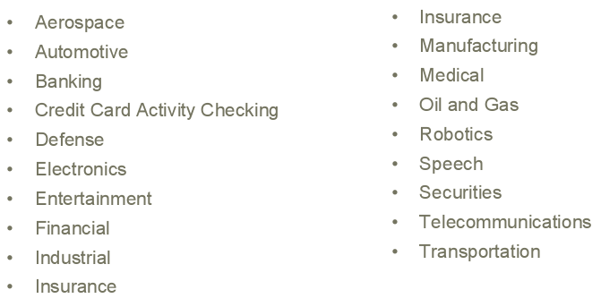
APPLICATIONS OF NEURAL
NETWORKS

Slide 37
Soft Computing Tools
Artificial Neural Networks
Fuzzy Logic
Genetic Algorithms
Graphic Set Theory
Neuro-Fuzzy

Slide 38
Basic Nomenclatures of NN & Statistics
NN → Model
Input → Independent Variable (s)
Output → Dependent Variable (s)
Learning → Estimation
Supervised → Regression
Generalization → Interpolation
Training Set → Observations
Weight Decay → Ridge Regression

Slide 39
Neural Network Forums
International Neural Network Societies:
1. IEEE Neural Network Society
2. INNS
3. ENNS
4. JNNS

Slide 40
Research Areas
Neuroscience, Hardware Implementation of NN (Neural-chip)
Modeling with NN (In EEE, ECE, and Control)
Statistical NN Models, Image Processing
Data (Web, Text, Video, Audio, ...) Mining
Pattern Recognition, Signal Processing, Time series Prediction
Handwriting and Finger Print Recognition
Neural Networks Architectures
Learning and Theory, Face Recognition
Perception, Emotion and Cognition
Computer Vision and Auditory Models
Learning Algorithms & Memory, Cognitive Science
Brain Imaging, Vision & Robotics
Biomedical Applications & Bioinformatics
Fuzzy Neural Systems, Intelligent Control etc.,

Slide 41
Sayings
Teachers are using their brain in 15%.
Students are using their brain in 40%.
Researchers are using their brain in 80%.
Best teacher teaches from heart and not from books.

Slide 42
Discussions if any ?
I am ready ………
Are You ready ?...........

Slide 43
Multi layer feed-forward NN (FFNN)
FFNN is a more general network architecture, where there are hidden layers between input and output layers.
Hidden nodes do not directly receive inputs nor send outputs to the external environment.
FFNNs overcome the limitation of single-layer NN.
They can handle non-linearly separable learning tasks.
Input
layer
Output
layer
Hidden Layer
3-4-2 Network

Slide 44
Arteries

Slide 45
Motor & Sensory Function

Slide 46
Hemispheres

