Slide 1
Microbiology of Air
Class: II M.Sc MICROBIOLOGY
Dr. H. VAJIHA BANU
Assistant Professor
Department of Microbiology
Jamal Mohamed College (Autonomous)
Tiruchirappalli-620 020

Slide 2
CONTENTS:
Aero-microbiology
Airborne diseases.
Sources of microorganisms in Air
Microbes in atmosphere
Bioaerosol

Slide 3
Aero-microbiology:
Definition:
“Study of living microbes suspended in air”
Various layers present in the atmosphere at height of 1000km
Nearest to earth is troposphere
troposphere contains heavy load of microorganisms

Slide 4
Sources of microorganisms in air:
Number of microorganisms in atmosphere but air is not a natural environment for microorganisms because it does not contain enough moisture and nutrient
Soil sources of microorganisms:
Digging and ploughing the soil
Wind blow
Water sources of microorganisms:
Splashing of water by wind action
Microorganisms are discharged out in three different forms
Basis on their relative size
Moisture content

Slide 5
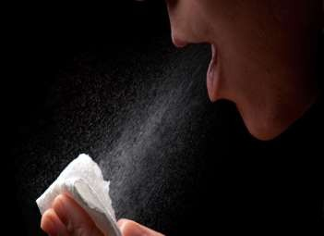
Air born transmission:
Droplet:
Droplets formed by sneezing, coughing and talking
It consists of saliva and mucous
It contains hundred of micro organisms which may be pathogenic mostly respiratory track origins
Size depend of duration of time
Pathogenic microorganisms may be a source of infectious disease
Droplet of nuclei:
small droplets in warm and dry atmosphere evaporate rapidly and become droplet nuclei
Size 1-4μm
Factors atmospheric conditions like humidity, sunlight and temperature
No of bacteria in a single sneeze between 10000-100000

Slide 6
Air born transmission:
Infectious dust:
Large aerosol droplets settle out rapidly from air
Nasal and throat discharge from a patient
Air born diseases transmitted by two droplets, depending upon their size
Droplets larger than 100um in diameter
Dried residues of droplets

Slide 7
Air borne microbial diseases:
Bacterial diseases:
Brucellosis: occupational disease among slaughter house workers
Pulmonary Anthrax: transmission by contaminated animal products
Streptococcus pyogenes: throat and skin disease
Rheumatic fever: inflammation and degeneration of heart valves
Streptococcal pneumonia:
Meningitis: common in children
Diphtheria: infection of tonsils, throat and nose
Tuberculosis: respiratory disease
Legionellosis: cause by natural water contamination

Slide 8
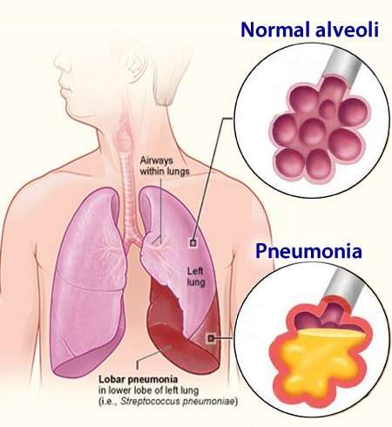
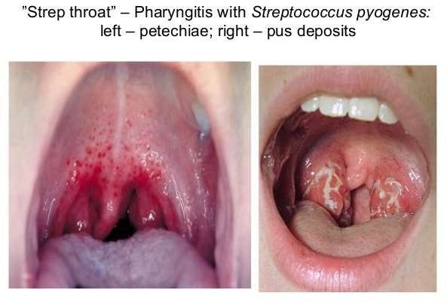

Slide 9
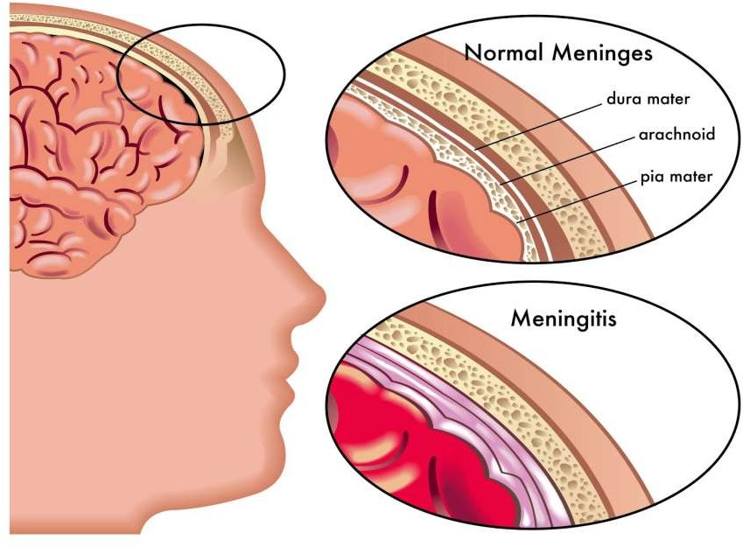

Slide 10
Air borne microbial diseases:
Fungal diseases:
Cryptococcosis: caused by inhalation of soil particles
Blastomycosis: lesion formation
Coccidioidomycosis: influenza fever
Aspergillosis: disease of human
Viral diseases:
Common cold: droplets from nose
Influenza: nasal discharge, headache, muscle pains, sore throat
Measles: red blotchy skin rash
Mumps: swelling of parotid gland and salivary glands
Adeno viral diseases: acute respiratory disease and eye infection

Slide 11
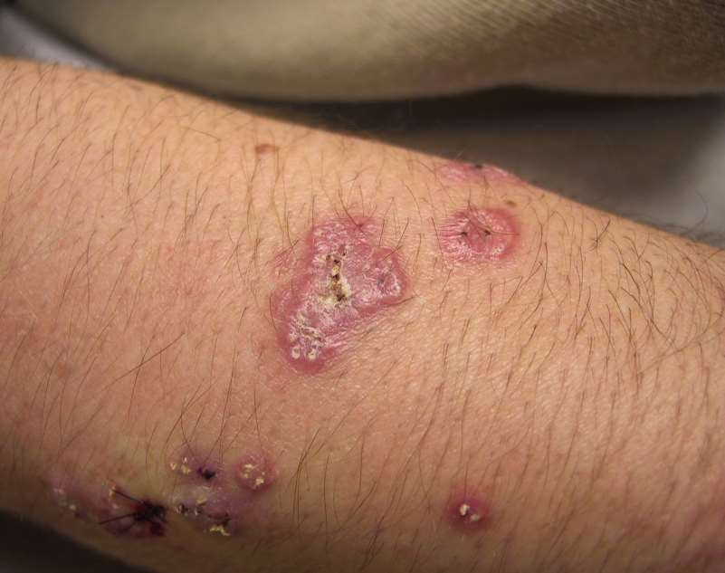

Slide 12
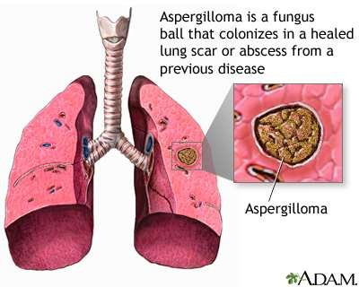

Slide 13
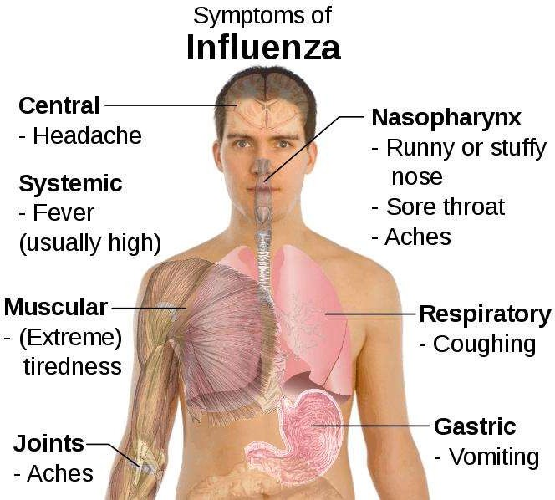

Slide 14
Microbes in atmosphere:
The atmospheric layer are important forces in determining viable particles in air
Aero microbiological pathways AMP
The layer of most interest and significance is the boundary layer that is 0.1km from earth surface
Boundary layer responsible for transport of particles both short and long
distances
Boundary layer consist of three parts
First layer: laminar boundary layer
Second layer: turbulent boundary layer
Third layer: local eddy layer

Slide 15
Dispersal of microbes in atmosphere:
Dispersal begins with discharge of microbial cell, spores to the atmosphere
Particles transport via diffusion, dispersion and deposition
Example: liquid aerosol containing influenza virus
Deposition of microorganisms occurs through three processes
launching
transport
and deposition

Slide 16
Bioaerosol:
Definition:
“particles release from terrestrial and marine ecosystem into the atmosphere they consist of both living and non living components including organisms, dispersal method of organisms and excretion”
Mist of dust micrometer in range
General range from 0.02-100 um in diameter
Classification on basis of size:
Smaller particle <0.1um in diameter are in nuclei mode
Particle 0.1-2um are in accumulation mode
Larger particles are coarse mode

Slide 17
Launching:
Definition:
“The process whereby microbes loaded particles become suspended within the earth’s atmosphere is termed launching”
factors:
Air turbulence
Waste materials
Natural mechanical process
Release of fungal spores
Sources: terrestrial and aquatic
Instantaneous point sources
Continuous point sources

Slide 18
Bioaerosol transport:
Transport is the process by which a viable particles move from one point to another
Sub microscale transport involves short period of time 10mints under 100m
Micro transport ranges 10mints to 1 hour and 100m to 1km
Estimation by using Osbert Reynolds method
Re = velocity x dimension viscosity

Slide 20
Bioaerosol deposition:
Regarded as the Last step in AMB pathway
Rate of deposition of a particle is directly proportional to its mass, volume and mass/volume ratio
1 Gravitational sittings:
Microbial particles that are exposed to wind above 8 x 103 m/hrs then gravitational deposition may be negligible
2 Downward molecular diffusion:
Natural air currents
Force of winds
Deposition rate
3 Surface impaction:
Particles make contact with surfaces such as leaves, tree, wall and furniture
Causes:
Allow downward molecular diffusion and gravitational setting
Allow particles to escape the surface

Slide 21
Bioaerosol deposition:
4. Rain and electrostatic deposition:
Rainfall occurs as a condensation reaction b/w two particles which combine and create bioaerosol with a greater mass making it to settle faster
Microorganism have negative charge due to which they associates with positive
charged air borne particles resulting in electrostatic condensation

Slide 22
THANK YOU
THANK YOU

